Slide 1

~WELCOME~
Colorado Wine Country:
Back to the Future
Barb Bowman, Division Director
Grand Junction Visitor & Convention Bureau

Slide 2
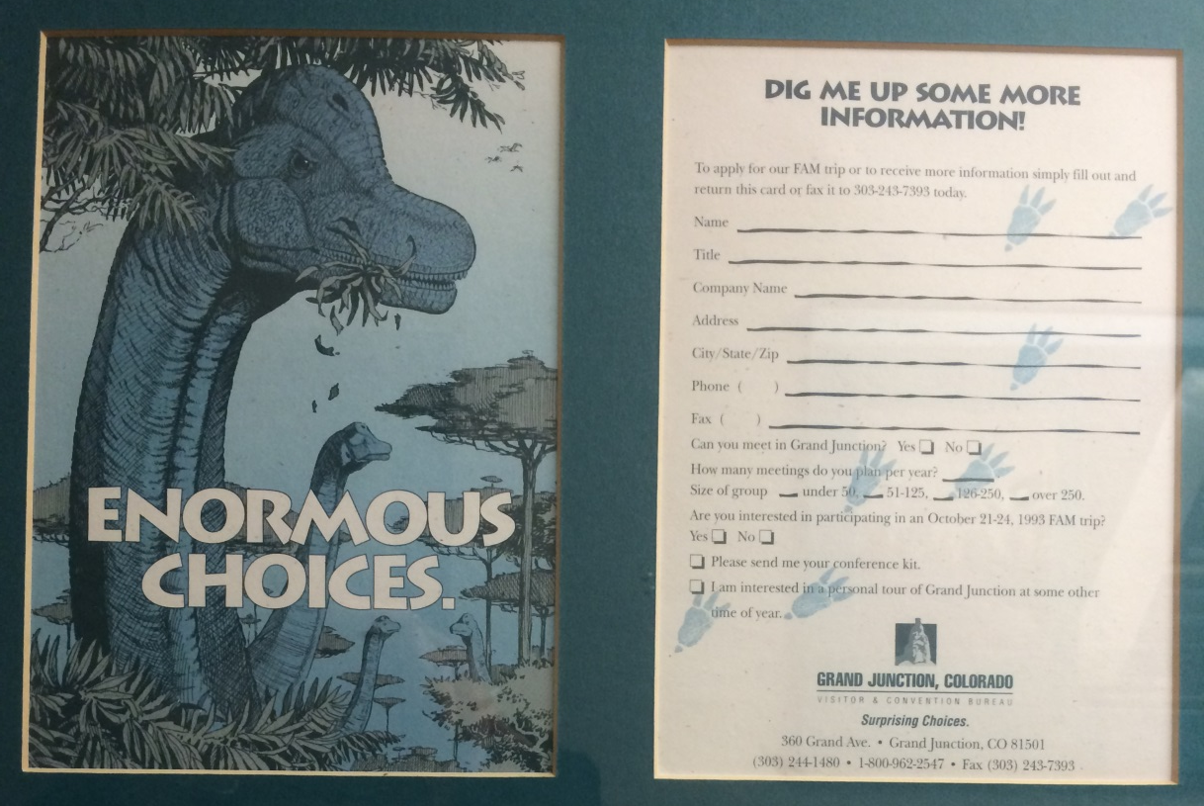

1993 – Enormous Choices

Slide 3
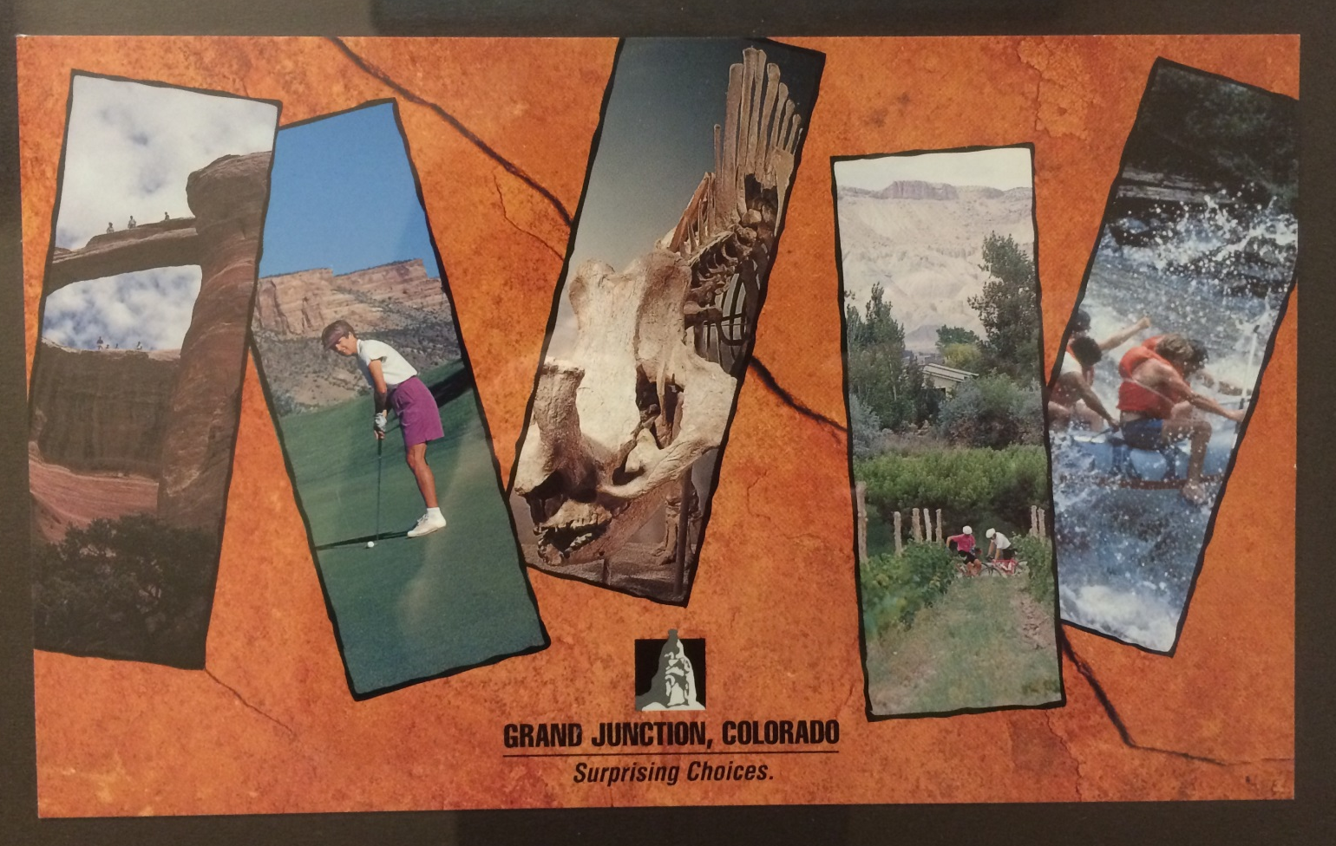
1994 – 1997
Surprising Choices

Slide 4
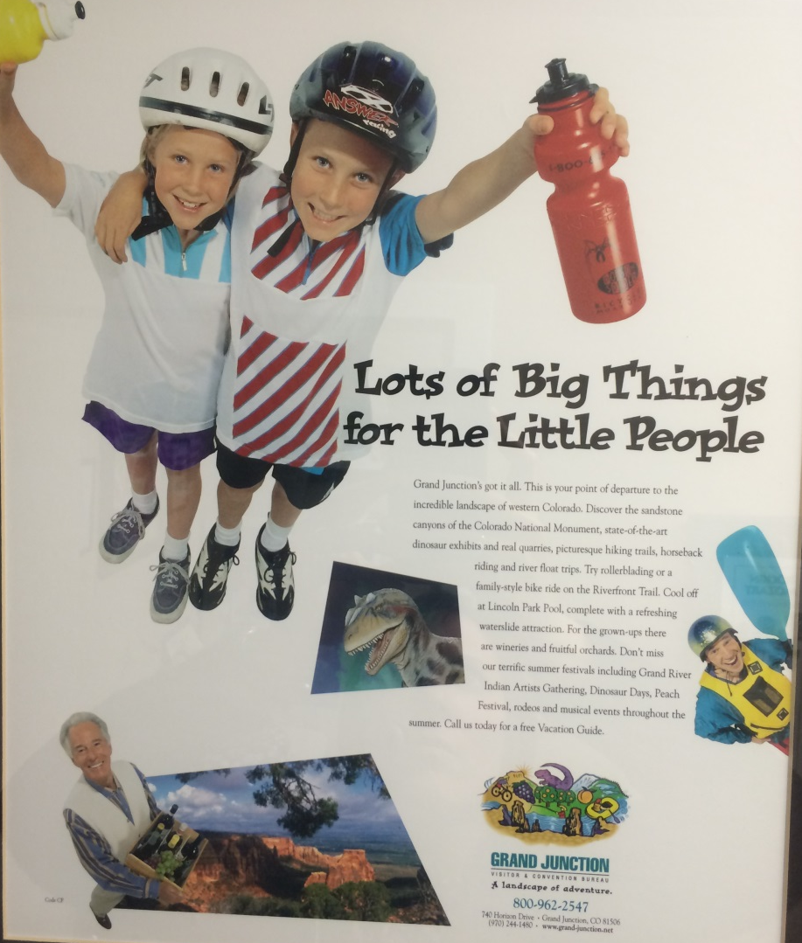
1998 – 1999
Landscape of Adventure

Slide 5
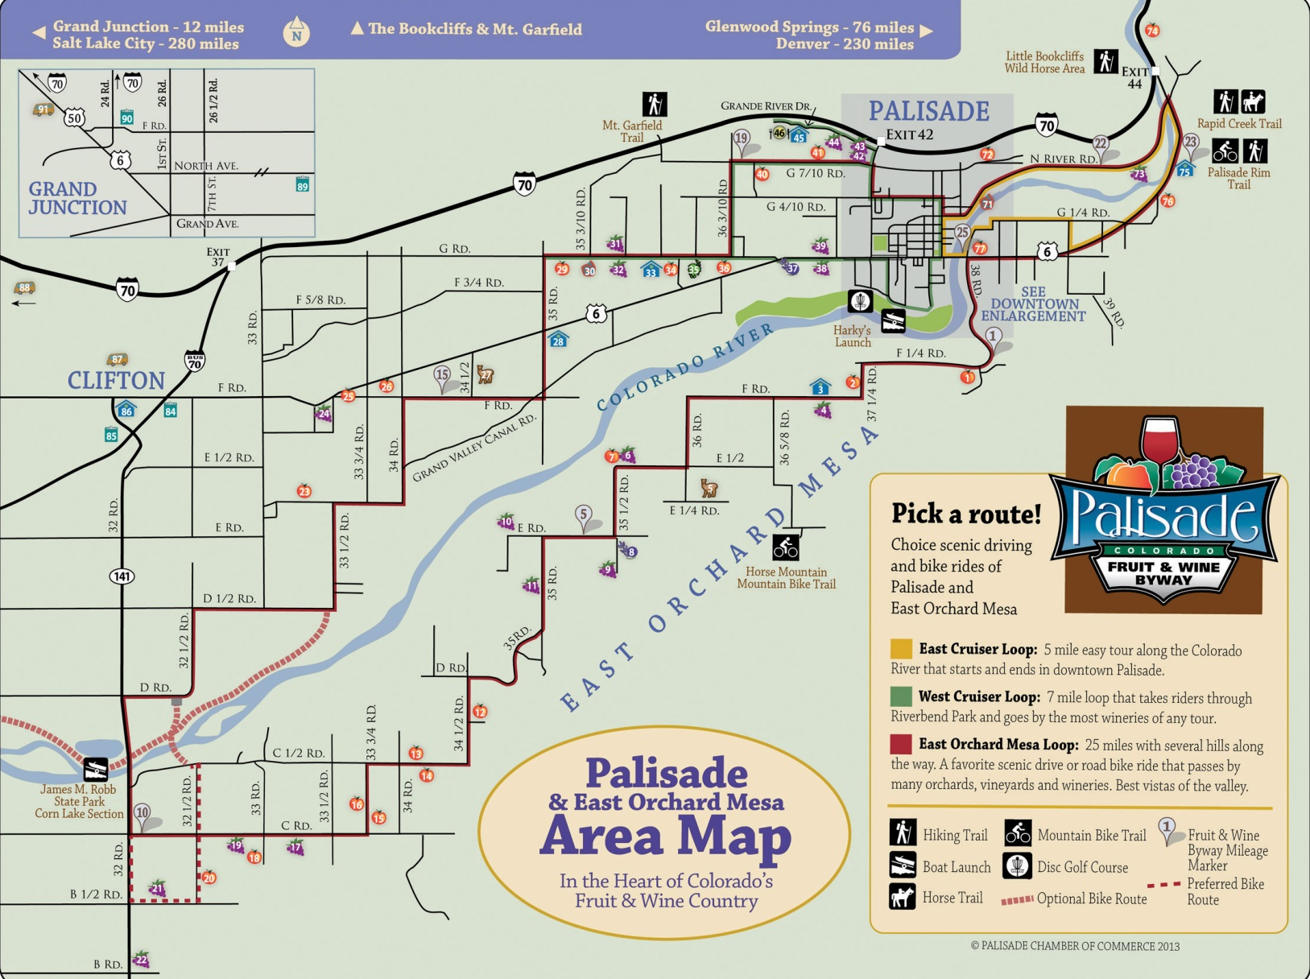
Palisade Fruit & Wine Byway

Slide 6
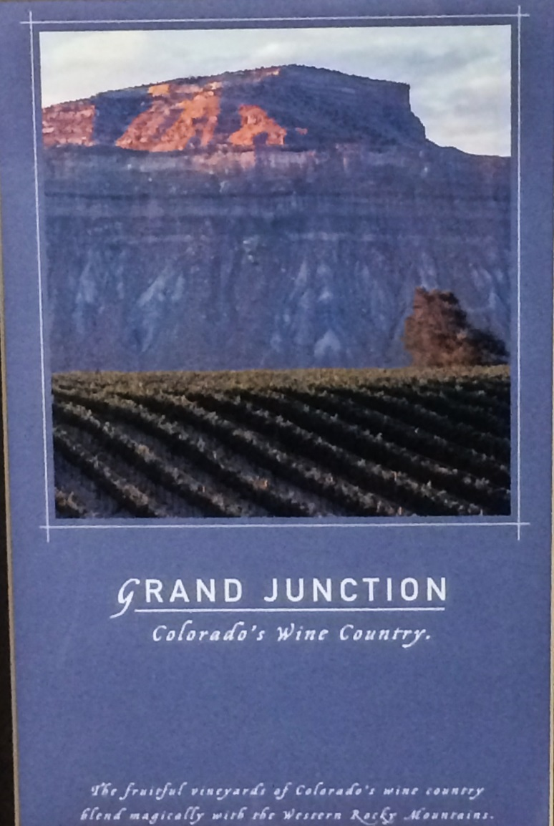
2000 - Branded as
“Colorado’s Wine Country”

Slide 7
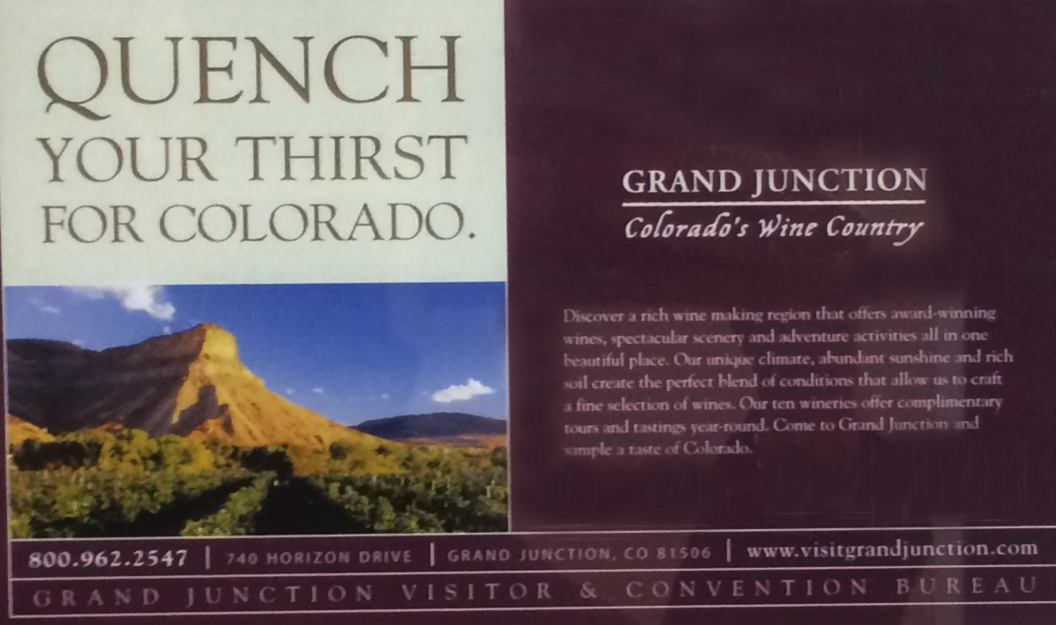
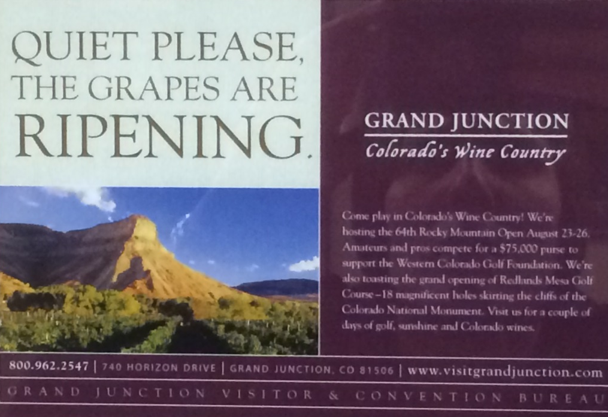
2001

Slide 8
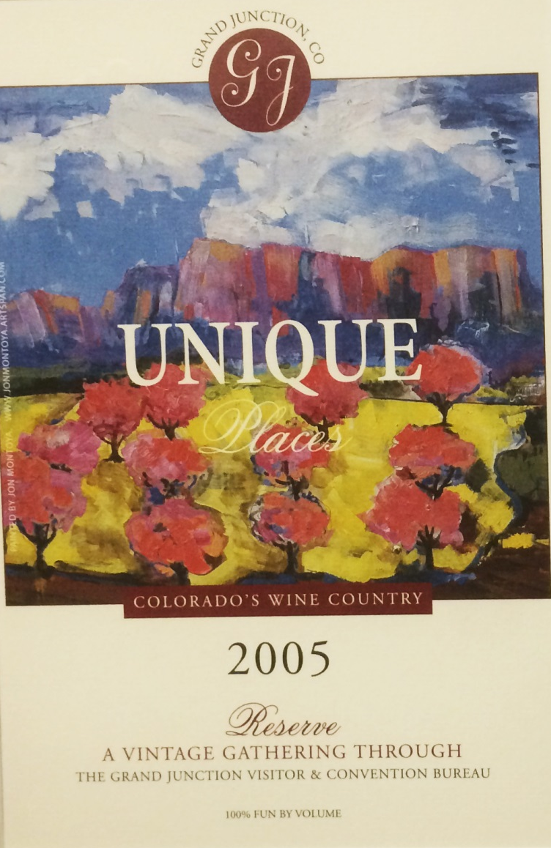

2005

Slide 9


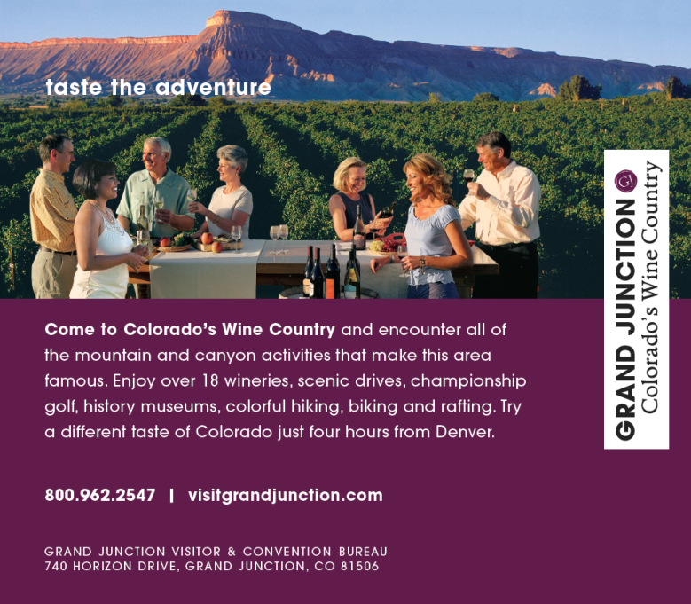
2006 – 2008

Slide 10




2009 - 2010

Slide 11
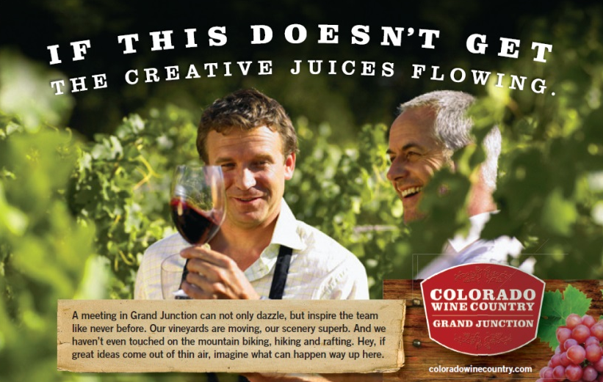



2011 - 2012

Slide 12


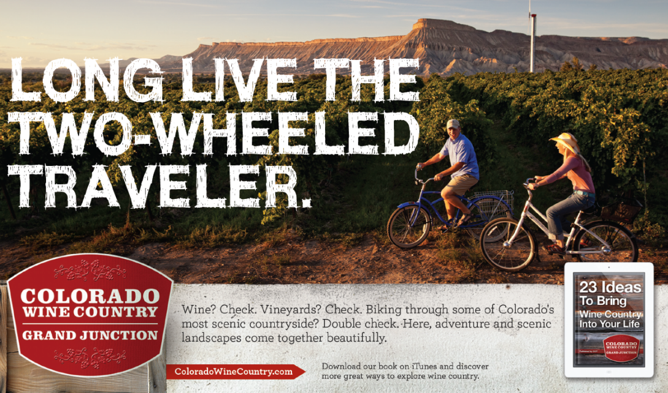
2013

Slide 13

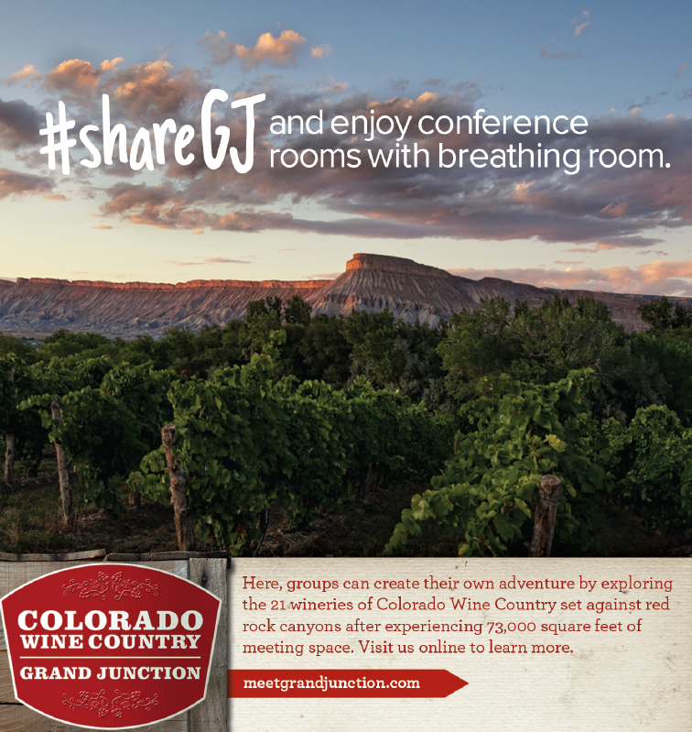
2014

Slide 14

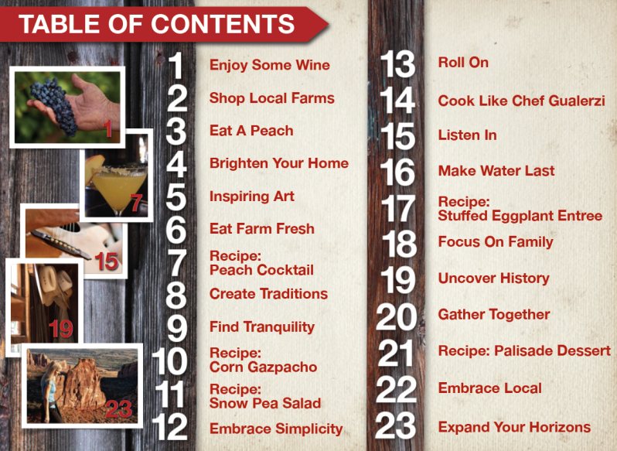
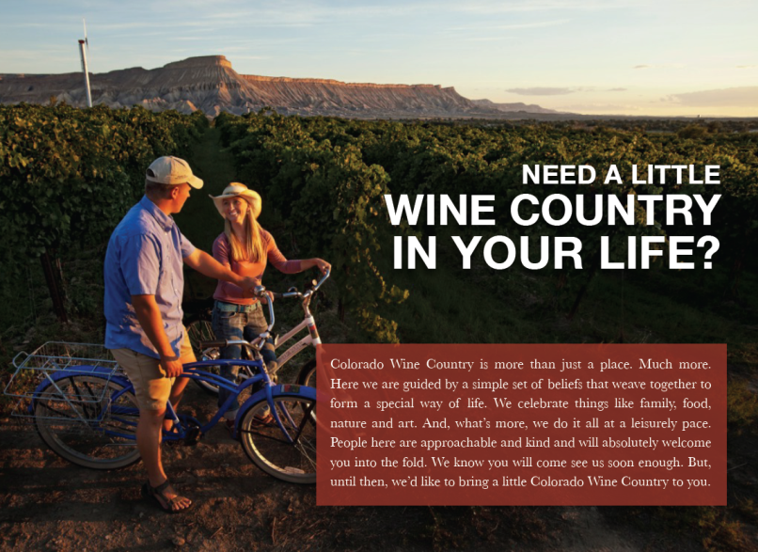
E-Book – 23 Ideas to Bring Wine Country Into Your Life

