Slide 1
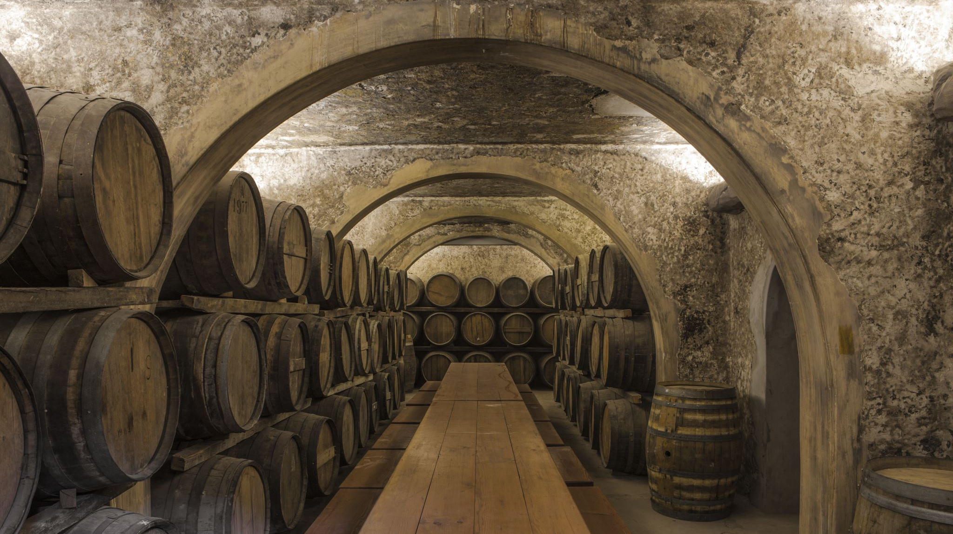
Small Winery Start-up VinCo 2023
Jenne Baldwin-Eaton​

Slide 2
Introduction
Commercial winemaker for Plum Creek Cellars 22 years
Started the first Associates of Applied Science in Viticulture and Enology in Colorado at WCCC/CMU
Founding Chair for the WWGIIVE
Wine consultant
Co-founded the western slope chapter of AWS
Wine judge

Slide 3
Dream
1992 Colorado Cabernet Franc
Wine is ART and SCIENCE
Passion!

Slide 4
Today’s goal
Information!
Information!
Information!

Slide 5
# 1 -Time
Wine time vs. your time
Very time-consuming venture overall
Physically challenging

Slide 6
# 2 - Science Orientated

Slide 7
# 3 - Cleaning

Slide 8
Vines & Vineyards
Dr. Horst Caspari ~ State Viticulturist
Dr. Charlotte Oliver ~ Viticulture Extension Specialist for Colorado
Growers

Slide 9
Cost of venture

Slide 10
Cash Flow – going out
Purchase of grapes
Vineyard expenses start in spring and continue through fall
Fermentation supplies
Lab analysis
Packaging
Labor
Taxes

Slide 11
Cash Flow – sales
Tasting room traffic
01
January – April
May – September
October
November – December
Wine Club
02
Wine Festivals
03
Farmers Markets
04

Slide 12
Important Aspects:
Sales
Education/research
Planning
Licenses/Regulatory
Record Keeping
Jack of all trades
Brand

Slide 13
Sales

Slide 14
Education / Experience / Research
Join an association ,tasting group, volunteer for events, get involved in the industry
Take educational courses/workshops
Read books
Make home wine & enter competitions
Harvest intern
Taste wines from all over
Do your research and go talk to folks in the industry
Tour winery designs/set-ups

Slide 15
Planning
What are your goals?
The size of winery for the next 5 years
Business plan
Numbers on paper, use calculator
This stage of proper planning can make a difference
Harvest can be like playing chess
Size/goals will determine equipment
Many ways to set up a winery, based on size, space, goals and style of wines

Slide 16
Licenses
Limited winery license
Sales room license
Sales tax license
Shipping permit
License fee to play music
Special event license
Manufacturer’s license

Slide 17
Regulatory
TTB
State
Health Department
FSMA
EPA

Slide 18
Record Keeping
Increase quality and SOP’s
Regulatory purposes/ 702 report
Sales records

Slide 19
Jack of all Trades
Winemaker/Scientist/Creative
Plumber
Electrician
Refrigeration
Mechanic/Engineer
Taster/food & wine pairing
Public speaking
Ambassador/Marketer/social media

Slide 20
Pick your brand & stick with it!

Slide 21
Amateur vs. Commercial Winemaker
Stresses increase
Stabilities
Fault-free
Sterile filtration

Slide 22
Winery Design
Flow from grapes arriving to bottling:
Crush pad
Fermentation tanks
Bottling line
Lab
Bottled wine storage
Equipment space
Miscellaneous storage
Tools
Storage tanks
Barrel aging

Slide 23
Winery Specifics
Electrical – 3 phase/air compressor
Drains
Water source/filtration/heater
Septic/sewer
Building temperature/humidity
Carbon dioxide venting
Refrigeration/temperature control
Nitrogen/carbon dioxide cylinders secured
Forklift/pallet Jack

Slide 24
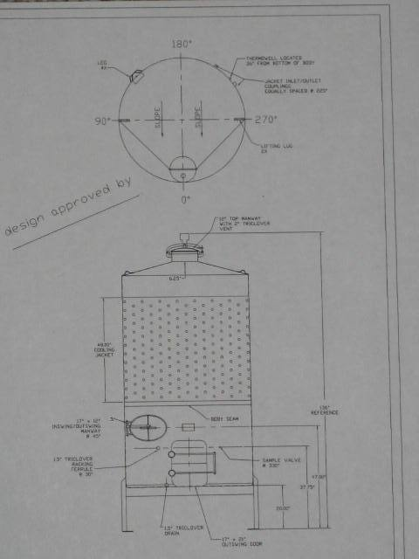
Tank Design:
Fixed vs. variable lid
Top manway- Front/back
Chiller jacket/column
One vs. two manways
Racking valve
Bottom valve
Sample valve
Height of legs
Diameter

Slide 25
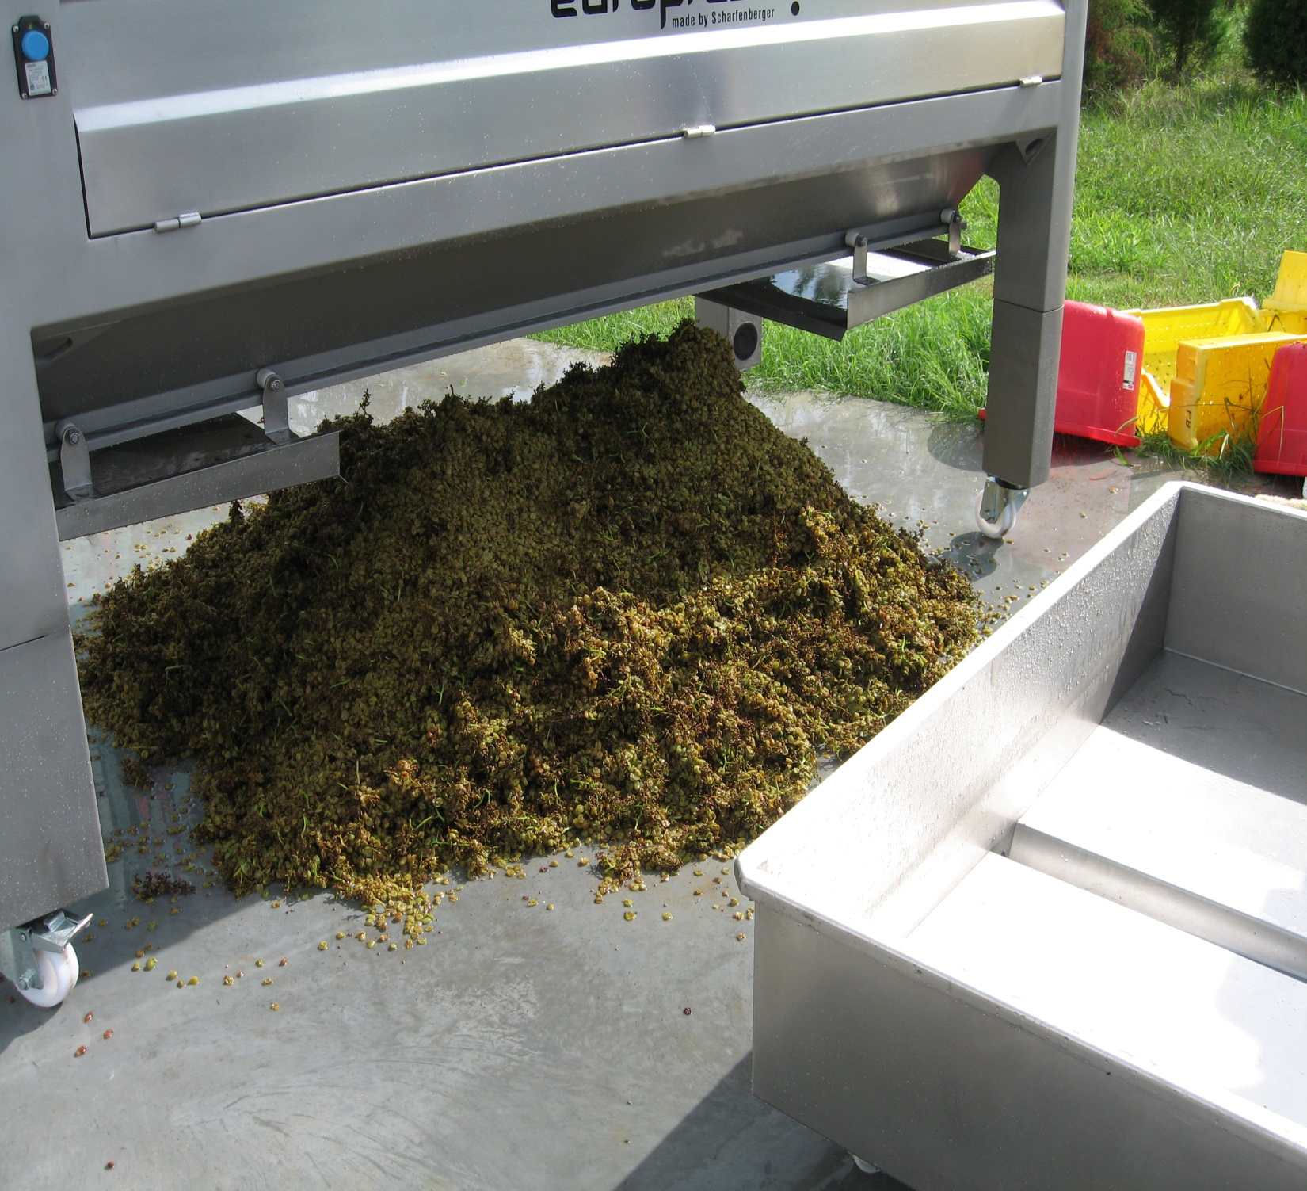
SOP’s

Slide 26
Tasting Room
Based on your brand, what is your vision?
Parking
Well marked signage
Inviting
Flow of customers, increase purchases
Restrooms
VIP or special event space
Impeccable customer service
Current material
LED

Slide 27
Labels
Tells your story
For DTC or wholesale
COLA’s

Slide 28
Advice
Design you space for it’s use. Plan out tank space, make sure you have ample drains.
Rely on a TEAM, you can’t know how to do everything.
The importance of planning out 2-3 years, harvest/fermentation/aging/bottling.
Wine business is a wonderful hard working and very gratifying lifestyle/business!
Start small & build over time. Best to keep overhead down when you start out.

Slide 29
Advice cont’d
Are you positive you want to do this, plan on working long days, 7 days a week for at least 5 years.
Think about bringing on investors or looking into the many different types of loans or grants that are out there.
Tell your story and build the brand identity. Show the journey, share behind-the-scenes, build momentum. A solid fanbase equals a solid sales base.
At any stage of the business, be kind and professional, it goes a long way.
Find ways to intern or volunteer with a winery with which you resonate, ask questions and work as hard as you would if working for yourself.
Be cautious mixing family and friends within your business plan. If you do, make sure the roles are very clearly defined and written out.

Slide 30
Thank you
Jenne Baldwin-Eaton
coloradowinemaker@me.com
A BIG thank you to all the wineries and folks that answered questions to make this possible

