Slide 1
Tidbits – from an adult with undiagnosed ADHD
[Sort of like drinking out of a firehose.
Please ask questions as we go along]
Donniella Winchell
dwinchell@OhioWines.org

Slide 2
What are the two most important words to any business owner?

Slide 3
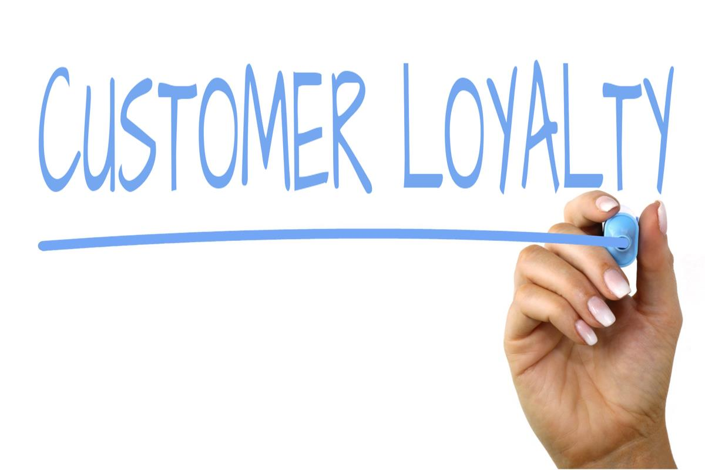
The key to everything below
ANSWER: Your customer’s first and last name ….
Remember it is not about you, you wine or your bottom line.
Everything you do and offer needs to be customer centric [and that will allow your business to benefit and grow well beyond your expectations]

Slide 4
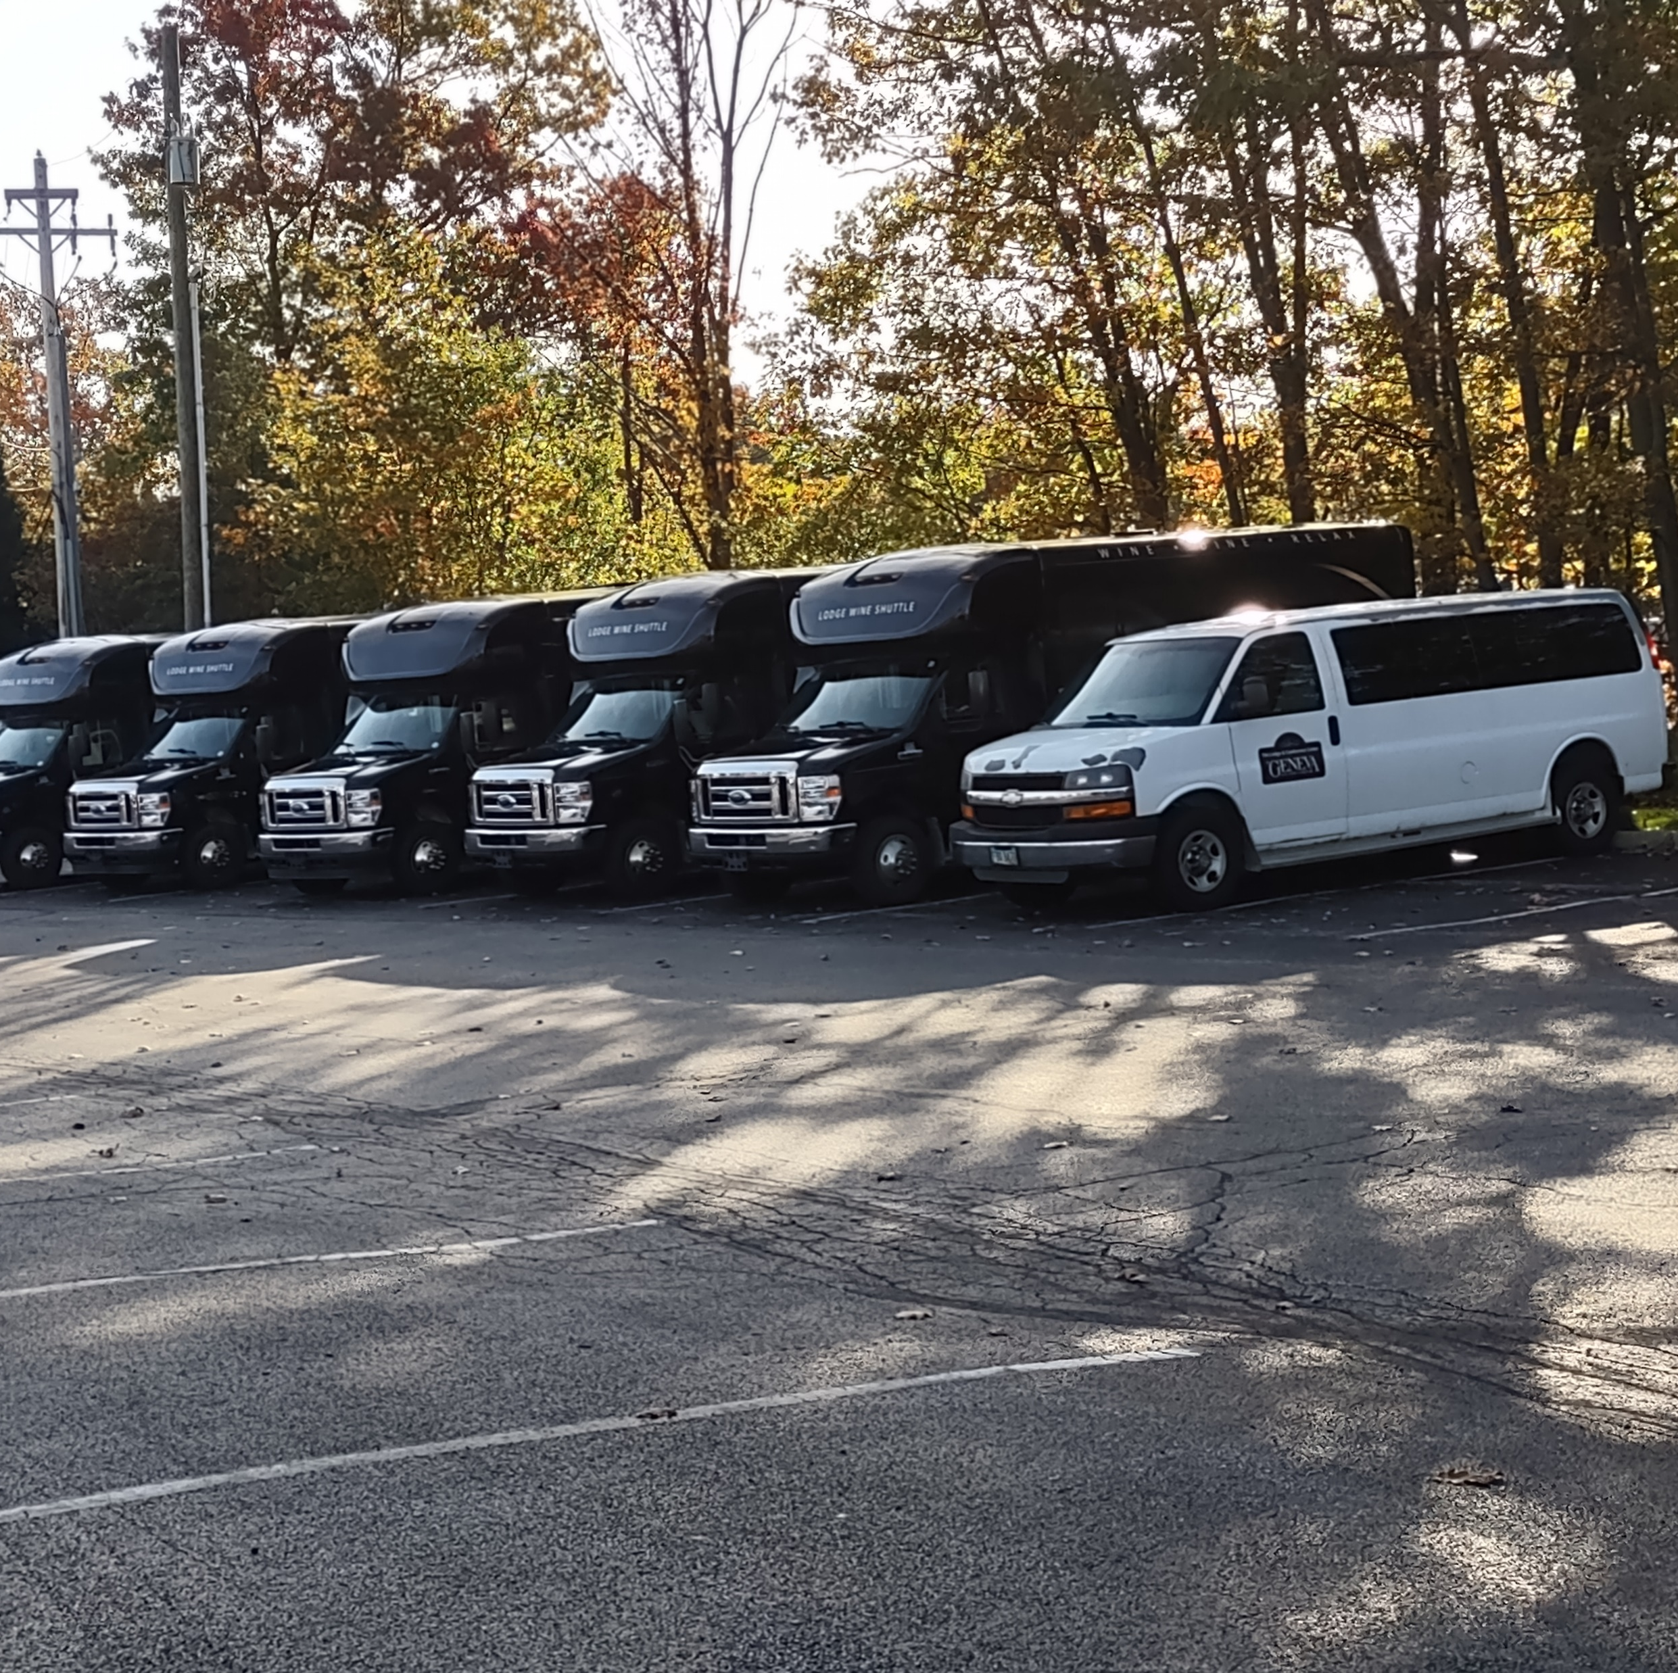
Wine livery business
18-20 passenger vans
Entrepreneurs?
Hotels with airport shuttles
Provide in room gifts as a part of a package
Set standards
Driver training
Management ‘rules’
Transportation only vs. inclusive tastings?
DO NOT end in a parking lot
No more than 3 alcohol stops
Bus greeters
Gifts? Left over labels, used corks, key chain, pens
Do not shuttle them off in a corner except maybe the ‘Woo-Woo Girls’????

Slide 5
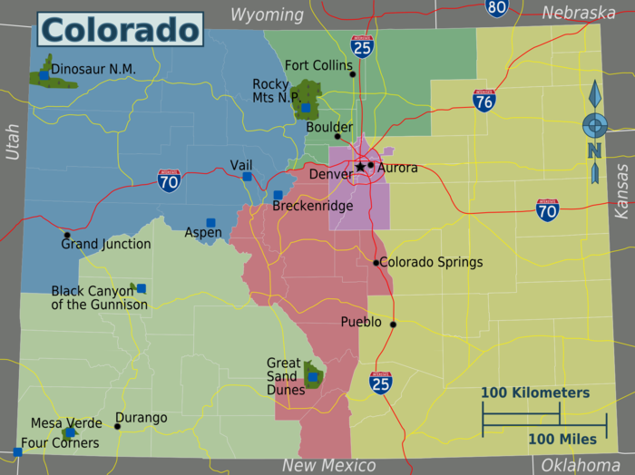
Map with pins
Use quilting straight pins
People like to comment that there are folks from their hometown
It tells you where to spend your ad dollars
This Photo by Unknown Author is licensed under CC BY-SA

Slide 6
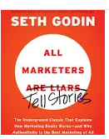
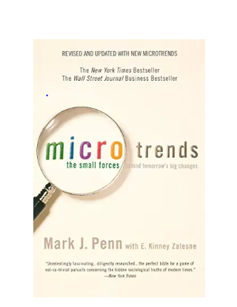
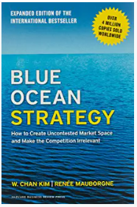
Books to read – beyond the ones mentioned
Mark Penn – Micro trends --affinity groups – superimpose your passion
Blue Ocean Strategy – finding new blue water when competition turns the sea bloody red
Malcomb Gladwell – Blink – first impressions for hiring for you and engaging your customers as they walk into your tasting room
Seth Godin: All Marketers are Liars/Tell Stories

Slide 7
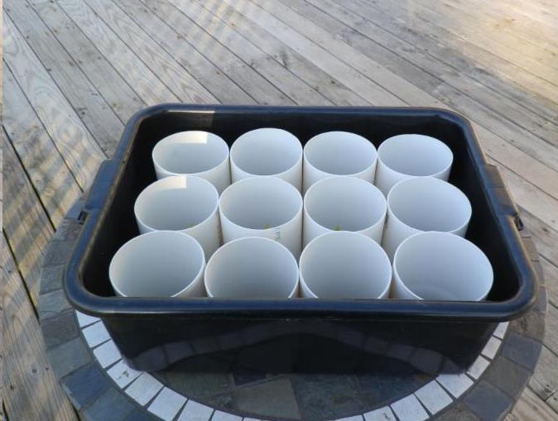
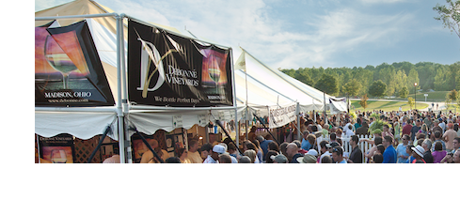
For wine festivals
Bus pan and pvc pipe
Signage via pvc pipe
Table height via pvc pipe
Engaging the neighbors
Sports teams for charity and labor
Sign-up-genius for volunteers

Slide 8
In the tasting room
2 questions for general public
Coloring books and table for kids
Baskets for carry out
Dual pricing
Standard wine – premium wine
In house – to go
Consistent hours
Open area to the right of the door
Movable tables and chairs
Interruption table for specials
Reading materials
VIP seated tastings – by appointment only -- extra charge – quality stemware - sells lots more – well versed staff -- pays for itself
Secret Shopper assessments

Slide 9
Reaching out to the general public [beyond ‘paint and sip’!!]
Service club talks
Newspaper columns – especially for weeklies
Church bulletins
Teacher Fridays
Work at home Mom’s Mondays
‘Weekends” for service and safety workers
“Medical Friends of Wine”
Discounts or happy hours for military and safety forces
Charity fund raisers for local groups [band, sports, academic] on off nights

Slide 10
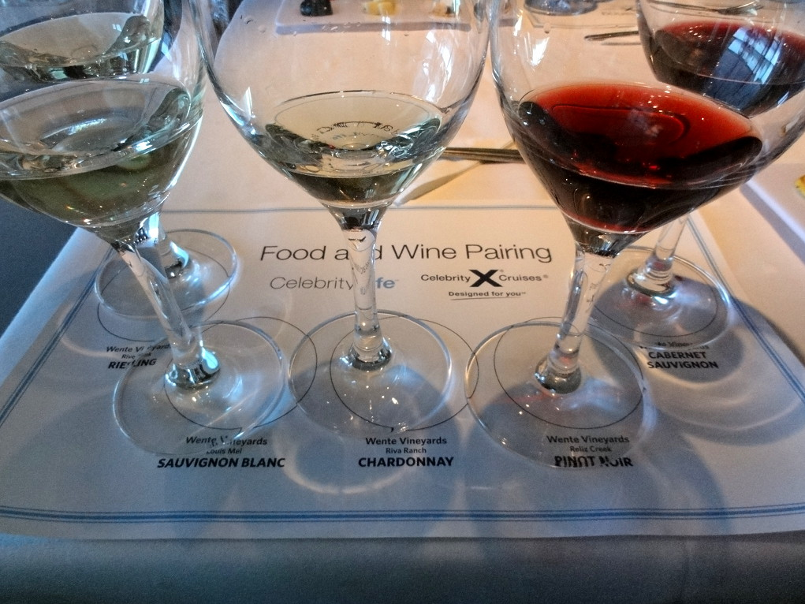
Experiential programs
Walk through the vineyards
Harvest ‘experiences’
Winemaker for a day
Vertical tastings
Library tastings
Riedel events [we are doing Schott Zwiesel ones too]
Movie nights: Sideways, Bottle Shock
Pairings:
Chocolate
Spicy foods
Desserts
Fish and red wine
Coffee
Take your wines to a local cooking school

Slide 11
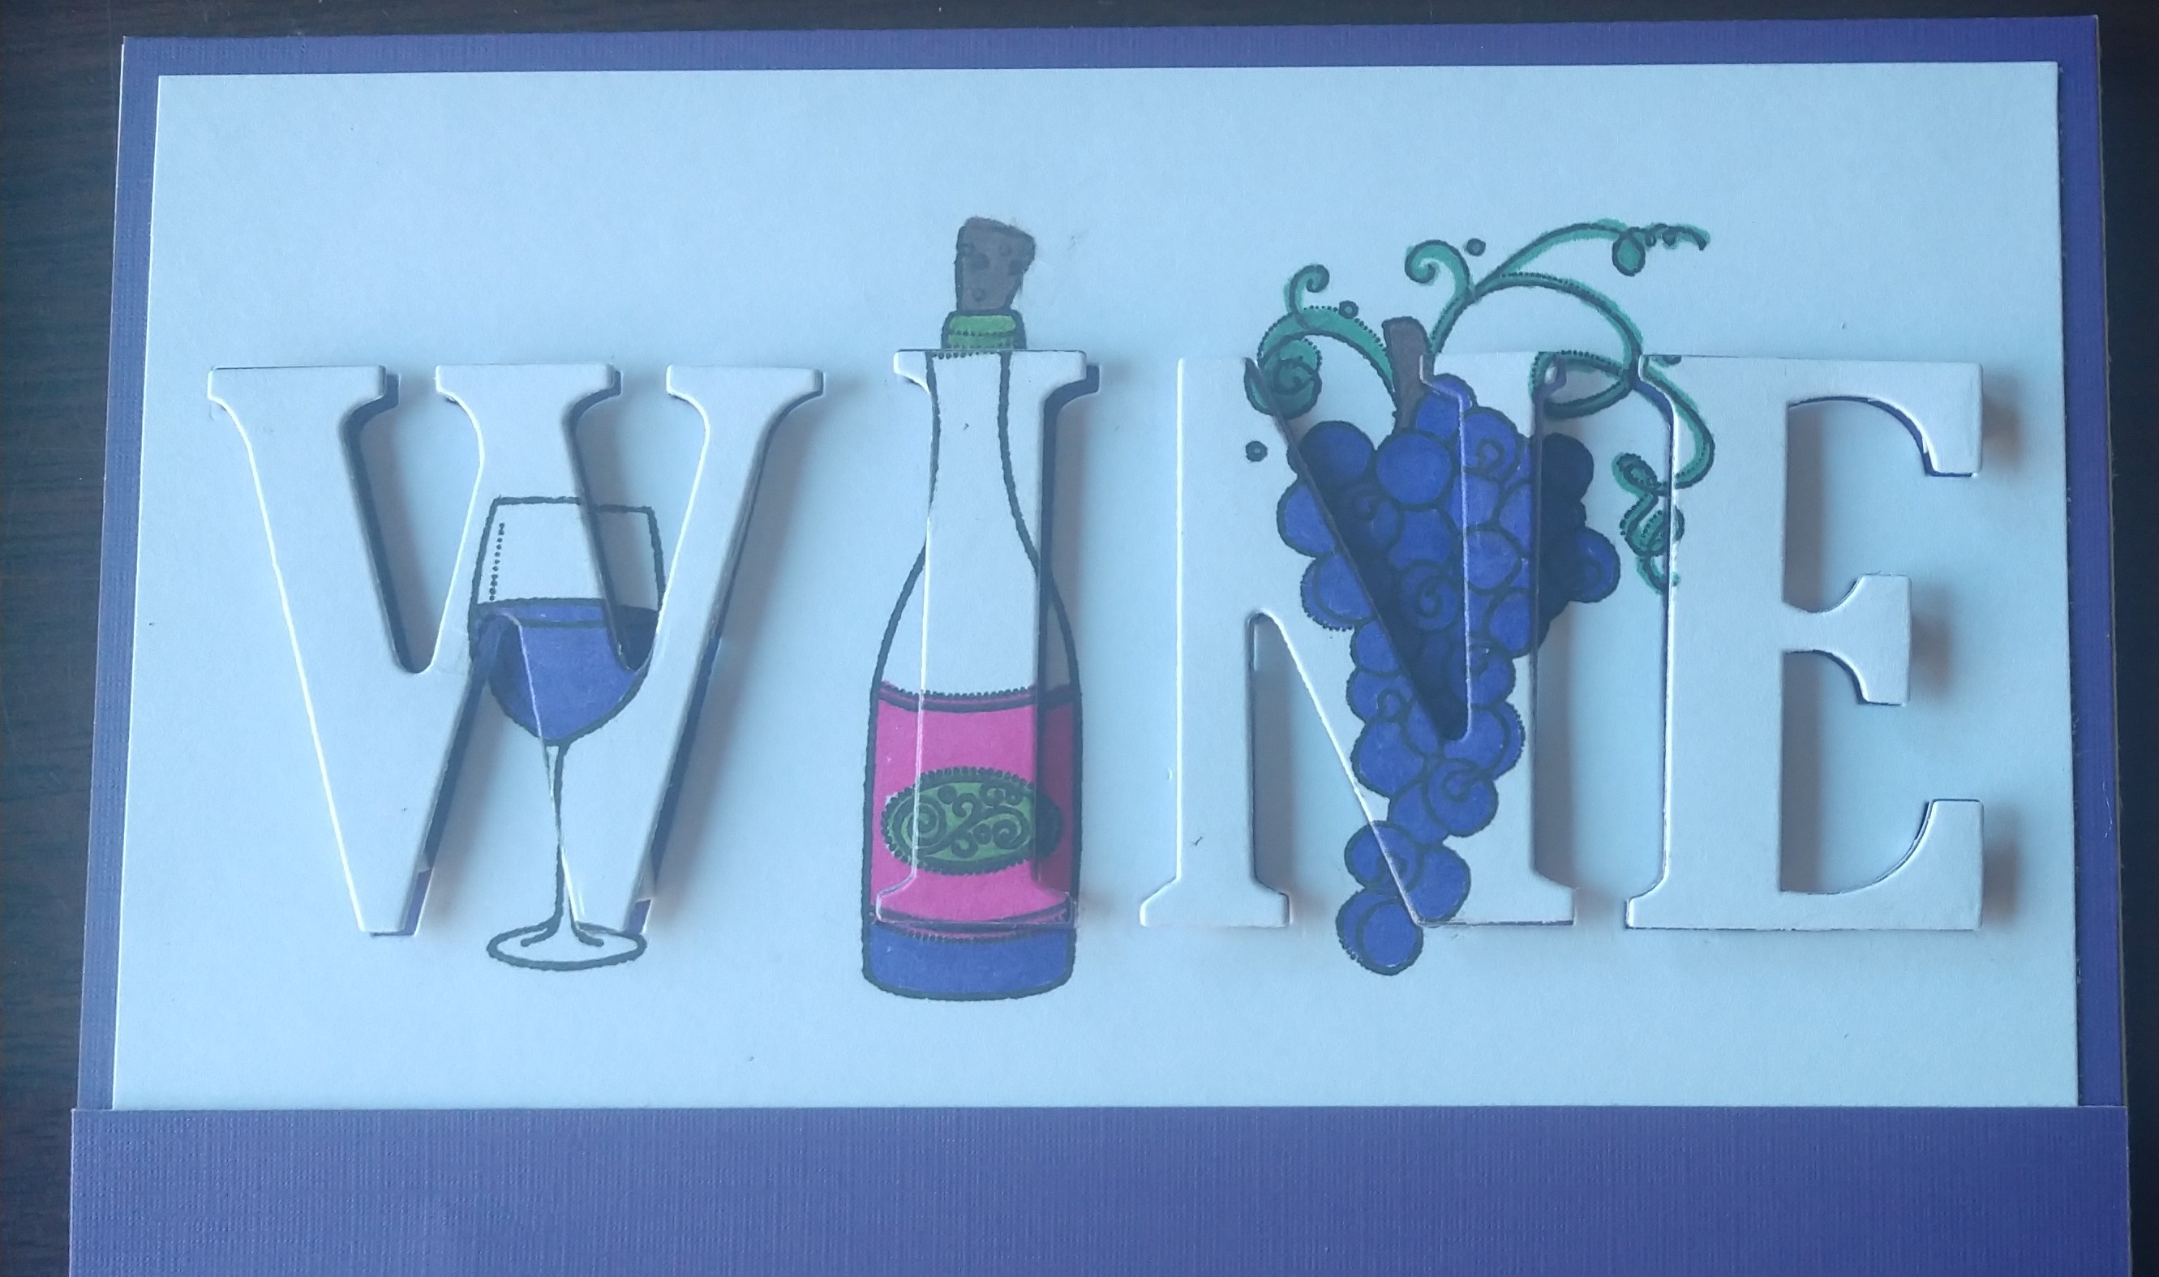
Reaching out to the media
THE 25
VIP tours
Thank you cards
Beat-specific releases
Be wary of deadlines
Know the publications’ special columns and opportunities for you
Wine minutes [sponsors]
Gift baskets as gifts or for trade
Be THE SOURCE for every subject
Don’t waste your first launch
Spend your money with those that give you freebees

Slide 12
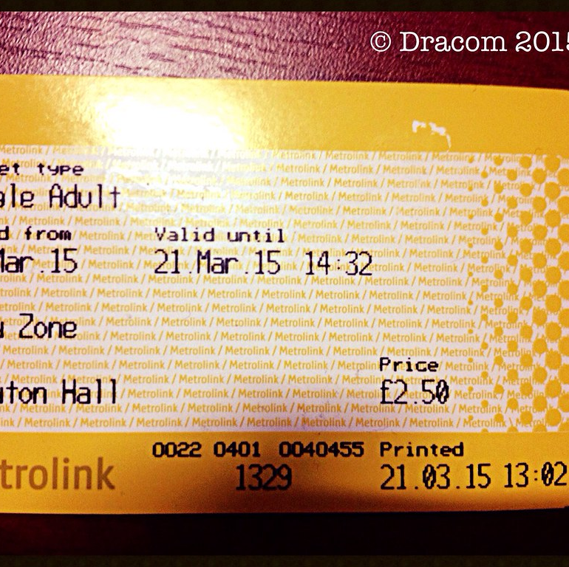
Selling tickets
Eventbrite and others
Fareharbor and others
Groupon – maybe not, but if so, VERY carefully
Coding for discounts and tracking for future ads
Make your advance purchases worthwhile
Sell 50% advance or more vs. rain insurance
Consignment at Lodging and livery supporters? Other outlets?
This Photo by Unknown Author is licensed under CC BY-SA

Slide 13
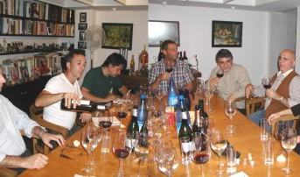
Virtual tastings
Live and virtual
For the ex-pats
Shipping issues
Holiday gatherings
Regional identity – Finger Lakes
Docs, Lawyers, Accountants
Use winemakers and chefs
Be authentic – practice – make them fun and informational
Scott Harvey video
Offer discounts and sell to go where allowed

Slide 14
Newsletter hints
Work on great subject line
Small images on the top
San serf or Tahoma fonts
EDUCATE FIRST – build trust
25% information, 25% your stories, 25% evergreen, 25% sales – make it valuable to THEM
Limit the numbers of things to sell per issue
Multiple contact lists by interests
Frequency monthly or bi- monthly -- Consistent day and time
Tuesday and Wednesday mid afternoon: for information and education
Thursday mid day – for weekend events
Saturday mid morning for upcoming week events
Monday early morning for B to B
Check open rates and test
Use only authorized names
Edit content for social media posts

Slide 15
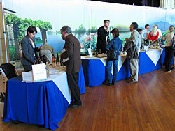
Staffing
5%-90%-5% hiring formula
Hire nice, teach wine
10 second greeting rule
2 questions to create customer comfort and assess wine knowledge
Various ages
Recognition: parking slot?
School teachers, students [juniors in college?]
Reading library in lunchroom
Name tags and ‘uniforms’
Incentive programs by shifts
Send them to other wineries and events on your tab

Slide 16
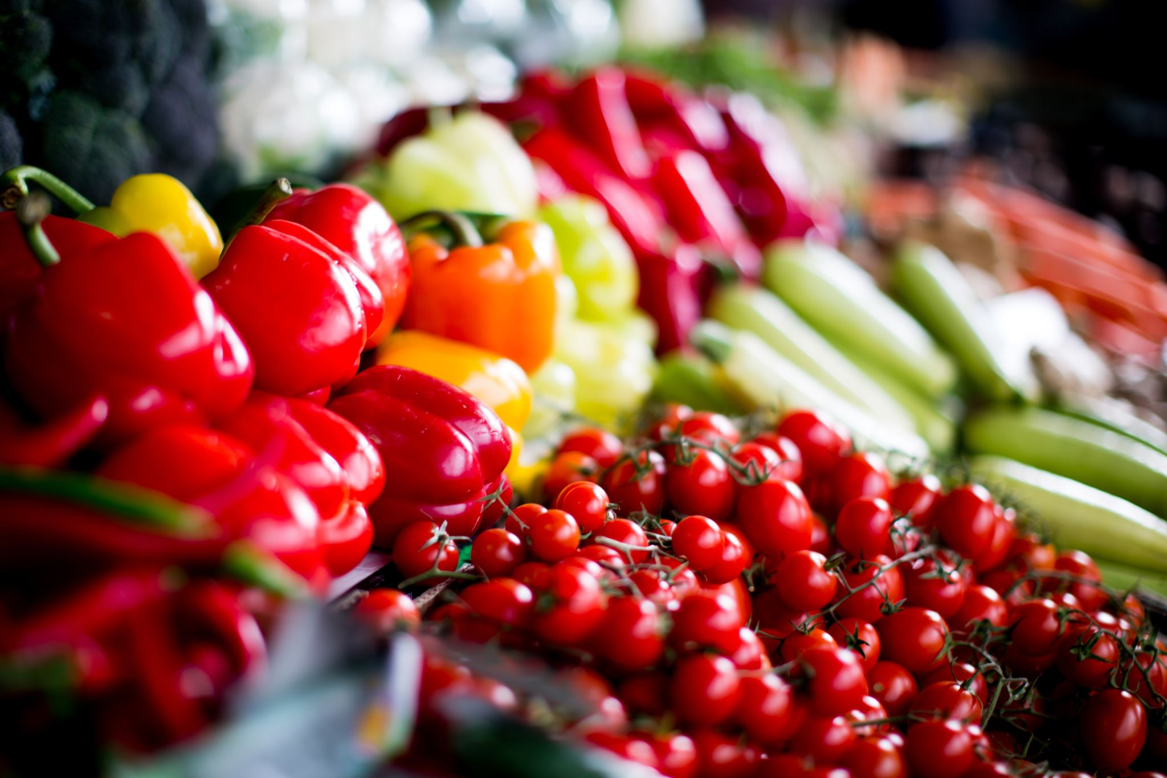
Farmers Markets
Target audiences: Z’s, Milennials, Birkenstock crowd
Create recipes with vendors
Host them
Be a pickup location for weekly food services [CSA – community sourced agriculture]
College students [future employees?]
Distribute ‘educational’ materials
Motorcycle van
Wine in first
Tent/decorations in last
Then …..
tent decorations in first
wine in last

Slide 17
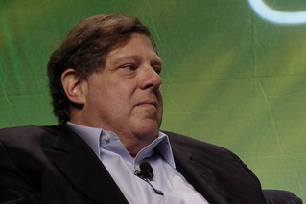
Non-traditional partnerships – affinity groups
Mark Penn’s books: Micro trends
Dog and cat lovers
Boaters
Aspiring authors and artists
Garden clubs
Parent-teacher groups
Birders/ Natural history museums
Crafters, scrapbookers, knitters, quilters, flower arrangers, card clubs, board gamers, cake decorating, candle making
Football widows
Small second weddings
Ethnic chefs
Adult ed: Computer classes, interior design, travel planning, fly-fishing tying, wedding planners
This Photo by Unknown Author is licensed under CC BY

Slide 18
Do good to do good
Be authentic and fulfill your promises
Pick charities that have a personal or local connection
Upcharge a bottle of wine for Breast Cancer month or MoVember
Pay the charity by the number of volunteers who help out
Host youth athletic teams for pasta dinners
Publicize your efforts
Donate ‘experiences’ for 6-8 people vs a couple or instead of wine

Slide 19
Events beyond the ordinary– building special loyalties [be sure to comply with licensing restrictions]
After hours events at museums’ tastings and for fund raisers
Invitation only events for VIP’s and favorite fund raisers
Wine club receptions
Wedding, anniversary and special closed events
Private labels
Pictures on the wall and TV scrolls [get releases]
Tasting panels to release new wines
Reserved seating areas
Social media recognition [get releases]
Picture ‘spots’
Spread sheet of personal stories of best customers for staff

Slide 20
Questions? Sign up for Tuesday Tidbits? And Thank you …

