Slide 1
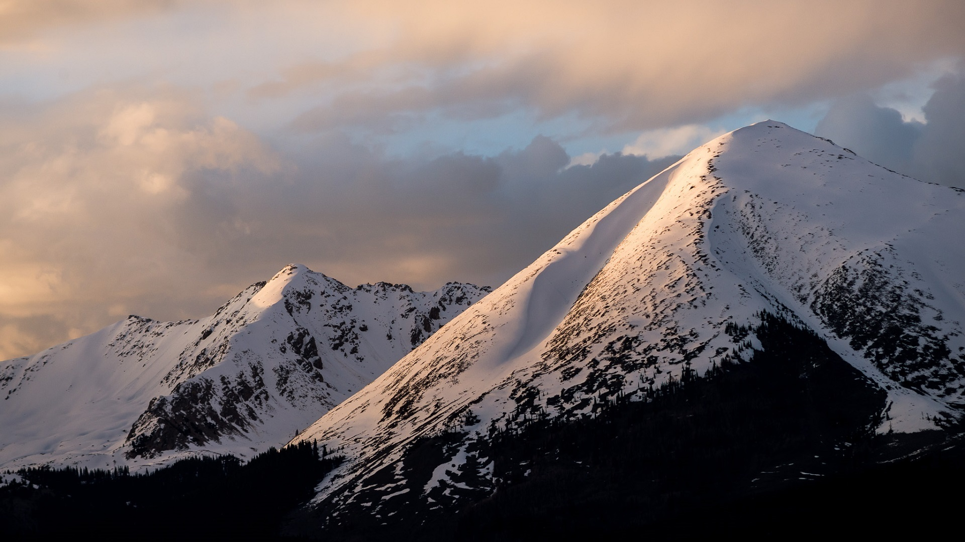
Staff training: Danny meyer: Enlightened hospitality
The key to your success
Enlightened Hospitality definition
Consider the various roles:
Wine education
Wine selling
Customer service
Colorado LTS WORKSHOP 2023
dwinchell@ohiowines.org

Slide 2
Enlightened hospitality
Even in the finest restaurants, food is secondary WINE TOO?
For the owners
For the employees
For the customers
Some keys
Eye contact
Smile
Greeting
Perhaps even an occasional hug where appropriate
Even the ‘Dollar’ store
Thus to win….. Wine is a given, hospitality is the differentiating component

Slide 3
There are lots of wines AND WINERIES – OUR EXPERIENCE IN WOODINVILLE --- EYE OPENING EVEN FOR US – Tannenbaum example at ohio wineries
Local is critical [written in 2006 well before the locavore movements took hold]
Food: to be enjoyed with your eyes, nose and stomach [wine? palate?]
He observed everything, collected those things that matched what MIGHT be needed in the future
For you ….. Use the secret shopper project toward that end
“Hospitality is the foundation of my business philosophy. Virtually nothing else is as important as how one is made to feel in any business transaction. Hospitality exists when you believe the other person is on your side. The converse is just as true. Hospitality is present when something happens FOR you. It is absent when something happens TO you.”

Slide 4
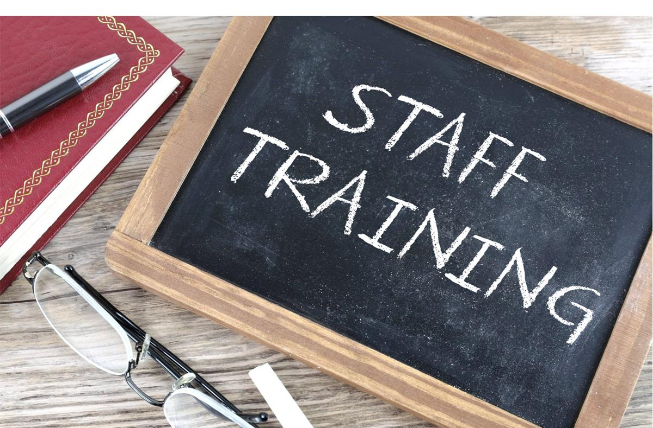
Defining sales/hiring for sales
Sales: its NOT ‘marketing’
Need to understand 2 steps
Closing the deal
Expanding the ‘take’
Hiring
Hire ‘nice’ teach sales techniques
Hire ‘talkers’ and ‘educators’
Hire ‘passion’ where possible
Remember 5-90-5 ratio
Matching personalities to the customer

Slide 5
Some general hiring and retention ideas, especially in A TIGHT MARKET
We ARE ‘cool’ so it can be easier than some other businesses
Understand the generational differences when comes to working at a job
Boomer question? What do you do? I work for the wine industry
Gen X question? What do you do? I run the kids around
Millennial-Z question? What do you do? I mountain bike
Work-life balance is increasingly important: You have an ’owner’ mindset, most employees have a different one
Flexible schedules: around school hours, college classes, spouse travel responsibilities, work at home sometimes?
Develop general job descriptions, then tweak them to accommodate the employees’ needs as best you can: WRITE THEM DOWN, SHARE THEM AND MAKE SURE THERE ARE NO MISUNDERSTANDINGS
Finding them: Social media, ask around [be careful with relationships that are too close]

Slide 6
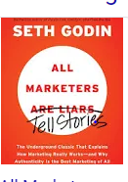
Hiring for wine education
Hire smart, pleasant, teach wine
5-90-5 rule on selecting staff
Hire story tellers
Name tags
Uniforms
Offer perks where legal
Variety of ages
Sources: teachers [retired and otherwise], college students, young parents, mix of part timers
NO VOLUNTEERS – federal law – Ohio created ‘Wine Team’ – as needed volunteers – c. 100 around the state – ‘gig’ workers – we use for our events and then offer them to wineries for a price – 1099 on us

Slide 7
STAFF TRAINING – Educating about wine
They need to know wine generally and you specifically
Tastings, stipend to visit other areas, WSET level 1 is a great investment
Non intimidation environment is critical but ALSO
Non- judgmental attitude is more important
Gauge customers – 2 questions
Red or white – dry or sweet
‘Connoisseur’ or not – take it from there
Staff variety: match skills when you can [see Sterling ideas from the ‘selling’ segment]

Slide 8
Provide your team with tools
Notebooks – backroom computers – identify the 50 best and cater to them: potentially 80% of existing sales come from 20% of your customers – what are the 2 most important words in a marketer’s lexicon?
Weekly meetings for wine education of staff
Specific goal for each new hire and each meeting: www.Ohiowines.org: Wine 201 simple one pagers to ‘steal’
Tips or TAMS certification – Sometimes Public Safety has a free program
WSET
Library – suggestions
Old Wine Business Mags, Wine Enthusiast, Spectator, Wine and Food….multiple issues
Zraly: Windows on the World Wine Course
Wine Folly – also Marnie Old’s books
Law: Backyard Vintner

Slide 9
Once you have a loyal customer base and a trained, competent staff
Maintain your core customers --- Grow your sales in 2 ways
Building and expanding your casual customers
Up-selling – thoughtfully and gently – understanding they are doing this FOR the customer, not TO the customer

Slide 10
But the largest potential growth comes from casual buyers: Larry Lockshin, University of South Australia, Ehrened-Bass institute research
So, you need to seek out and treat those casuals as though they are potential ‘heavy buyers’ – and all the materials you share with them will be seen by your regulars in any case

Slide 11
Building those casual customers
First and foremost – engagement to make them feel comfortable – and knowledgeable, without ‘educating’ them
Totally open, absolutely NO judgment
The best wine is the wine you like the most
Tim Hanni: Why you like the wines you like – the taste bud and skin sensitivity story
Maps of where grapes are grown
Table toppers with wine descriptions and food and wine pairings
Family history in pictures on the wall
Stories via your staff over the tasting counter
SM if they will share their contact info
25% information, 25% your stories, 25% evergreen, 25% sales – make it valuable to THEM
Create an ‘aspirational’ experience – especially for the Z’s – without being intimidating

Slide 12
For sales focus of staff: Sterling [Kay, Jerod, Zales] program and some of our realities
Would you like a cherry pie? Suggestive selling
Wine is an intimidating beverage
People buy from those who look like them
Not everyone has the same disposable cash, the same palate, the same comfort level with wine
Matching palate, wallet and personal comfort level to the sale options is essential
Where it works, use an opportunity to upsell

Slide 13
Once they are good and comfortable, Staff member’s turn
First assessment: do you have a comfort level with the customer? if the guest is a senior and the server a millennial, if guest is very knowledgeable and server is just new to the job, maybe pull a ‘switch’
You may need to smoothly pass on the ‘Tour’ information from one to the other – Sterling jewelers program even has hand signals
PUT a bottle of wine in their hand: statistically, 70% higher probability of an initial sale
Second assessment: what is the customer's spending threshold [low: one bottle? medium: 3-4 bottles? High: case or more?]

Slide 14
After the assessment
Complete one ‘sale.’ Then apply ‘assessment’
Low threshold: add a small chotchke [corkscrew, fancy bag: as little as $3 can make a difference]
Medium threshold: [extra wine bottles to go, food plate if they are staying, nice wine glasses: average goal $10]
High threshold: [3 bottles: average $60]
Very high threshold: [more than 6 bottles – goal: average $120]

Slide 15
Formula ‘proof’
Basic assumption: 300 customers per week
1/2 Low Threshold @ $3 = $450 extra
1/3 Medium Threshold @ $10 = $1000
1/12 High Threshold @ $60 = $1500
1/12 Very High Threshold @ $120 = $3000
Extra per week: $5950
Probably unrealistic
Sooooo. Divide that by 1/3 = c. $2,000

Slide 16
Important elements
Management needs a clear plan so it needs to be thought out and have materials ready in printed form
They need to follow up with the most appropriate staff regularly
Owners need to practice what they preach when they are in the tasting room
Think about rewards [or at least recognition] for staff if it makes sense
Always remembering you are doing it FOR your customers – not TO them

Slide 17
Pitfalls
Takes time and planning on the part of management
Impossible on busy days
Takes time to keep reinforcing the efficacy
Not all your staff will have the same selling styles
Important to keep it natural, not ‘pushy’
Not all of your staff will appeal to all types of your visitors
Some visitors will not be receptive at all
But it might be worth a try for some of you~!

Slide 18
Hiring and providing great Customer service
Boomers expect it
Millennials demand it
Z’s REQUIRE authenticity
Competition will win out otherwise – share of wallet – Wine? Beer? Seltzers? Movie theater ticket?
Why people buy: MORE about their experience than because of the wine itself or its cost
A consumer survey from www.about.com asked what winery visitors wanted from their trip to wine country
The results: • 28% wine quality • 17% environment • 16% hospitality • 14% winery tour • 14% cost of tasting
Johnny the Bagger – video – View on YouTube
https://www.youtube.com/watch?v=IQlxLBqgFKc

Slide 19
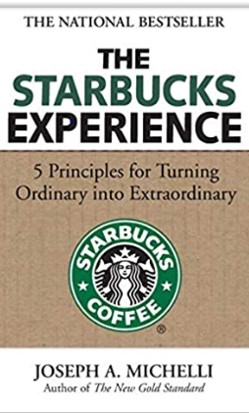
Starbucks Elements
Ideal which not always achieved, but good for thought Starbucks elements – published in 2006

Slide 20
Starbucks – element 1
1 Make it your own
Both your principals and your employees
Be welcoming
Be generous
Pay it forward
Be considerate
Be knowledgeable
Be involved

Slide 21
Element 2 – everything matters
Attention to detail
Create an ‘environment’
Quality wine first
Décor [to whom does it appeal?]
Tables, booths, open ended picnic tables
Dress code for your staff
Ages of your staff
Scratches on the front door
Cleanliness of your bathroom

Slide 22
Starbucks – Element 3 surprise and delight
Manage, then exceed expectations
01
Offer unconventional experiences
02
Practice ‘joy’
03
Offer a predictable product
04
Offer a predictable experience
05
Figure out how to delight
06

Slide 23
Discussion on how to surprise and delight
How might you
Manage, then exceed expectations
Offer unconventional experiences
Practice ‘joy’ -- Marie Kondo's "The Life-Changing Magic of Tidying Up"
Offer a predictable product
Offer a predictable experience
Figure out how to delight

Slide 24
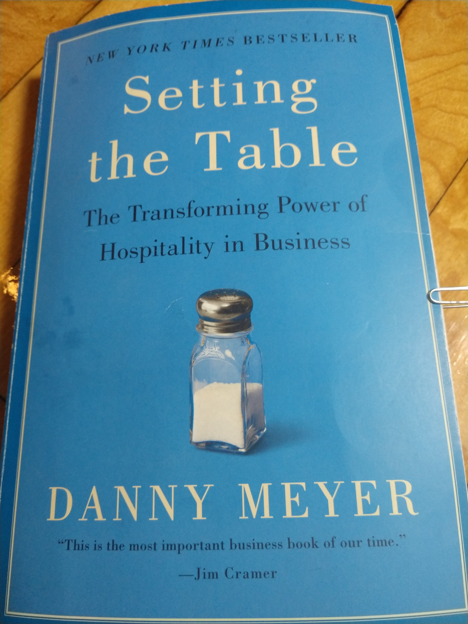
Another great read
Read the book – worth the investment in time
Comments on Johnny the Bagger
Jot down 2 or 3 examples of what you might do FOR you customers

Slide 25
Staff evaluations – internal and external
INTERNAL
Start, if possible, with a non-disclosure and an agreement that “What happens in the office stays in the office.”
Quarterly, with incentives
From you of their performance – and from them on their perspective of the job – be ready to not offend or be offended
I seldom give 10’s early on
Illustrate that you will implement their suggestions where possible
Absolutely confidential
If they leave, be sure to do an exit survey

Slide 26
Secret shopper – if you use one, it can help in staff management too – 50 Questions - Ask
SERVICE – a few of the questions
Were you greeted upon entry? YES or NO
Scale of staff interest in your patronage/friendliness: 1 2 3 4 5
Were you given a clear explanation of services offered? YES or NO
Scale of clarity for various services: 1 2 3 4 5
Did the server introduce him or herself, and ask engaging questions about your wine knowledge to determine customer tasting preferences? YES or NO
Were you presented with a comprehensive tasting menu? YES or NO
Scale of readability/variety/explanation of wines: 1 2 3 4 5
Was the server knowledgeable about the menu and receptive to questions? YES or NO - 1 2 3 4 5 for either Yes or No
Did the server explain tasting techniques? YES or NO 1 2 3 4 5 for either Yes or No
How comfortable would a novice drinker be in this winery? 1 2 3 4 5 NA
Did the server make an effort to help the novice drinker? 1 2 3 4 5 NA
Did the server present the bottle for viewing? YES or NO
Was the bottle pre-opened? Are all bottles kept refrigerated? How long are open bottles kept?
Did they ask for the sale?

