Slide 1
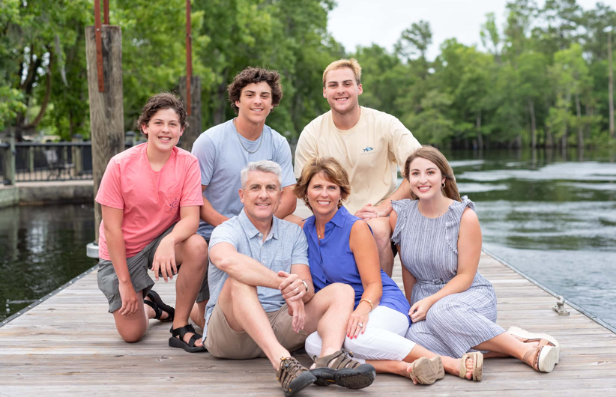
Generational marketing to Boomers, X’s, Millennials and Z’s
Donniella Winchell
dwinchell@ohiowines.org

Slide 2
To plan any marketing strategy, consider 3 items
You MUST have a plan as it will become overwhelming
Focus on that group’s needs and perspectives IGNORING your personal preferences*
Do only what you can do well
*That is…the winemaker who makes wine to suit only his own palate goes bankrupt!!

Slide 3
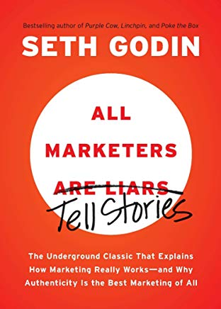
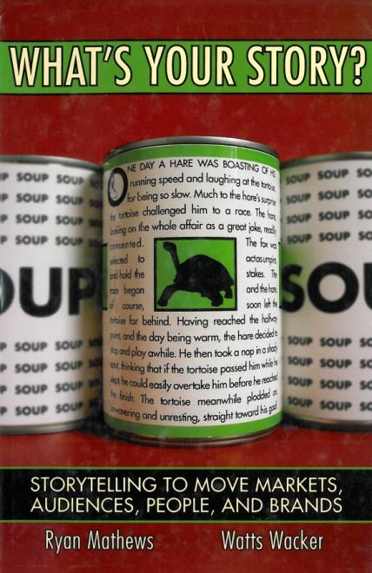
With ANY generation, you must have a vision of where you want to go and that the ‘story’ is truly key
Seth Godin:
Marketers are Liars/Storytellers
Watts Wacker:
What’s is your story?*
*Difficult reading, but powerful

Slide 4
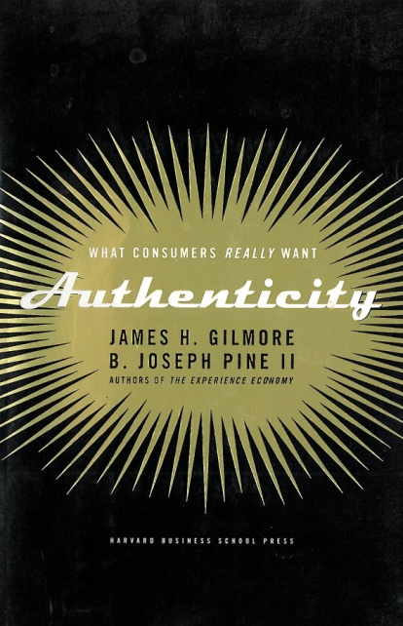
Cash comes from authentic experiences
You can charge for your experience and be ‘real’
The fish on the wall story
Jefferson
Rockefeller, Carnegie
Kroc
Gates, Musk
“REAL”
Ice wine picking
Fall Harvest
Winemaker for a Day
Oregon Boot Camp
Experience Economy
Authenticity
Jim Gilmore and Joe Pine

Slide 5
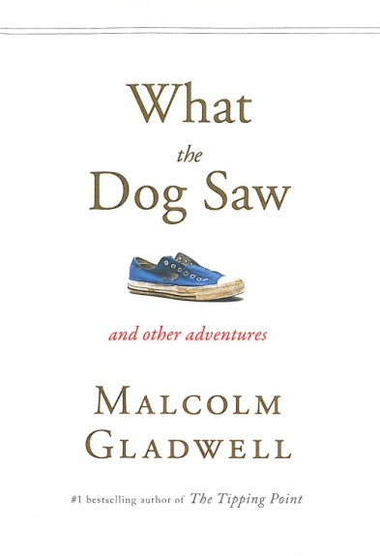
Target micro-groups/opportunities
Micro-Trends
Mark Penn
Tipping Point and
What the Dog Saw
Malcomb Gladwell

Slide 6
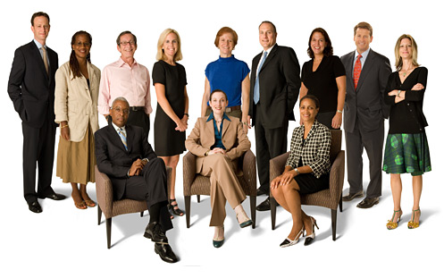
Gender differences regarding Social Networking – very generic
Women
Quietly competitive
More collaborative
With FB friends, conversations more extended
Pinterest
More attention to all Social media
Emotional hooks
Men
Outwardly competitive
Less verbally dexterous
15% more Twitter followers than women
Direct, easy action
From Brand Champs blog -- this and next 3 slides

Slide 7
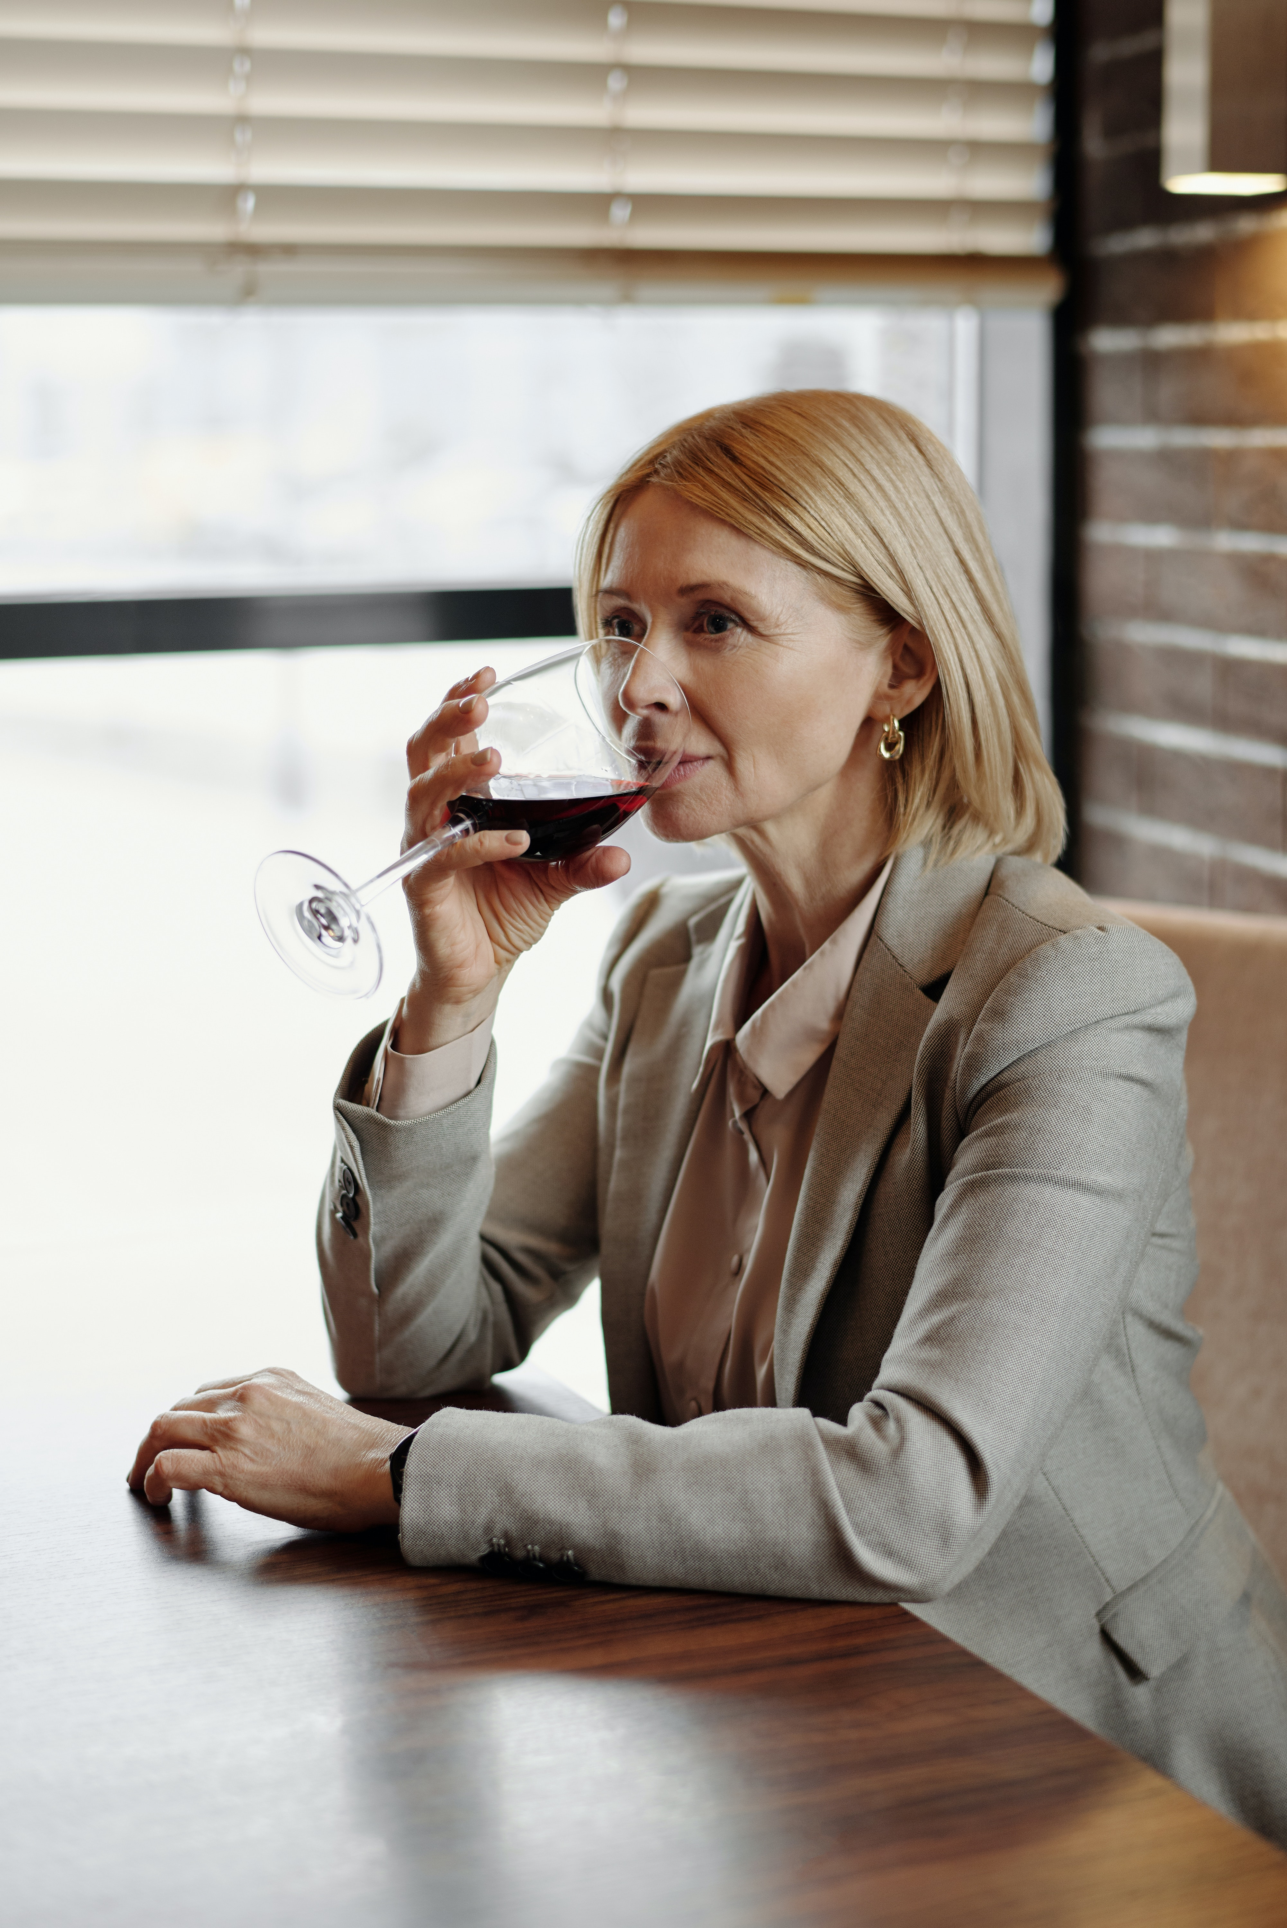
Going after women*
Respect
People first
Individuality
Craft activties to her interests
Stress Relief
Make her laugh
Connection
Girlfriend factor, connect to ‘that happened to me’
Trust
Help others

Slide 8
Going after men*
Wine ‘insecurity’
Eliminate insecurity, education
Make him the guy in the know
Appropriate images
Use Twitter
One click connection
One stop shop

Slide 9
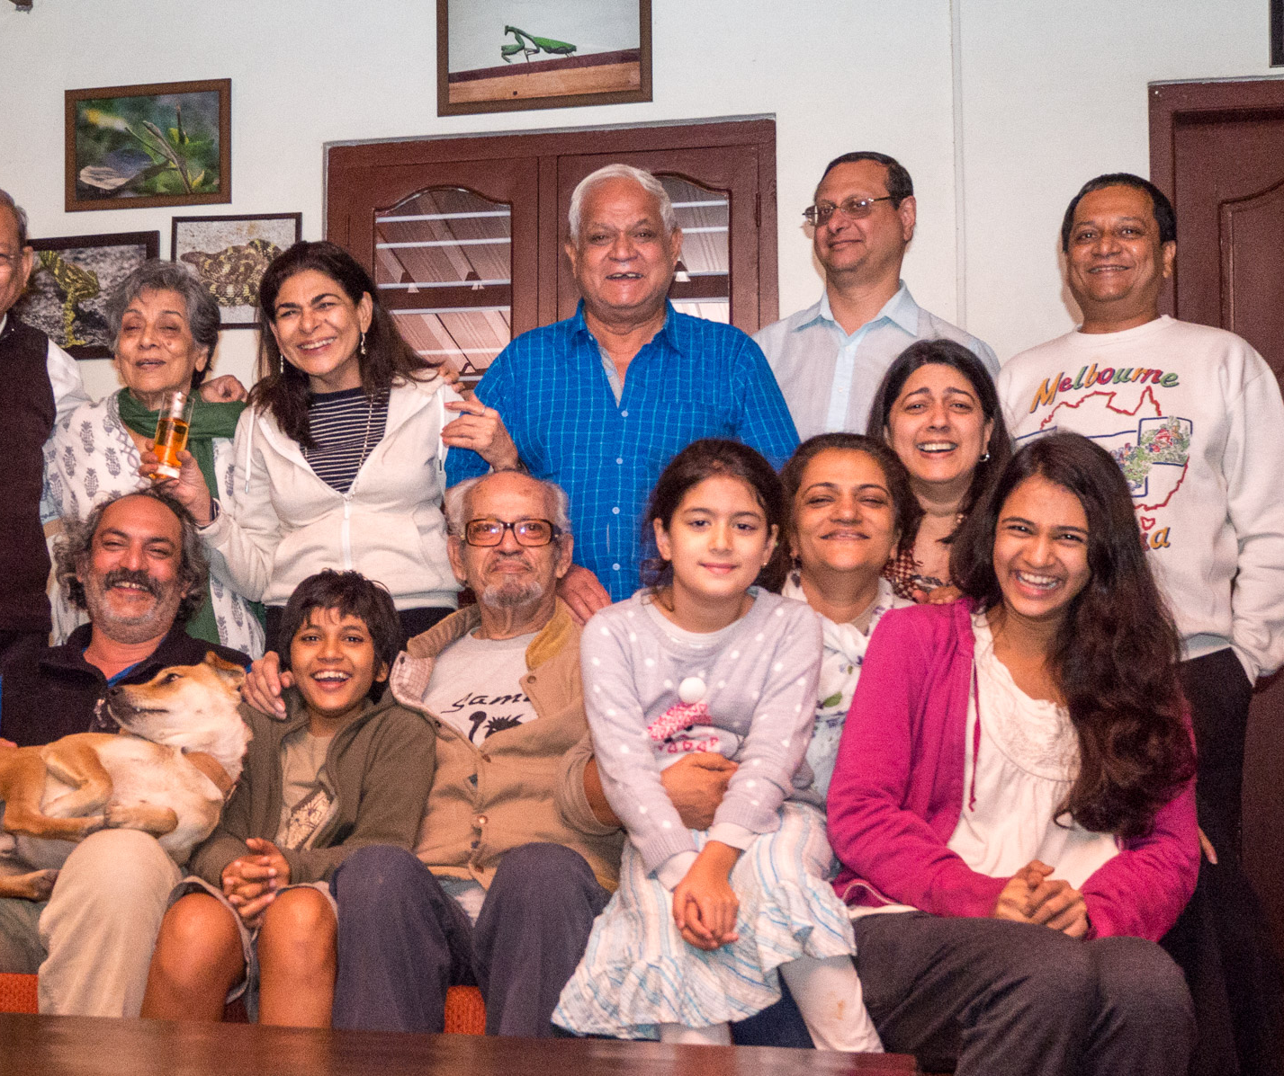
Generational Markers
Shared life experiences
Financial, Social, Political
Depression, vs. roaring 90’s vs. 2008 recession vs. current prosperity, coming recession
Prohibition, women’s lib, aids epidemic, opioids, marijuana legalization, Covid
Kennedy, Reagan, Clinton, Obama, Trump, Biden
Shared ‘links’
Values, Experiences, Music, Events
Definitions of faith, family, ‘citizenship,’ expanding diversity, gender issues
Extended family households, stable marriages, single parents, foster homes
Elvis, Jimmy Buffet, Garth Brooks, Eminem, Lady Gaga, Beyonce, Jay-Z, Taylor Swift
Womens’ Lib, Woodstock, Iraq, 9/11, Katrina, Joplin hurricane, school shootings, 2008 financial crash, Covid

Slide 10
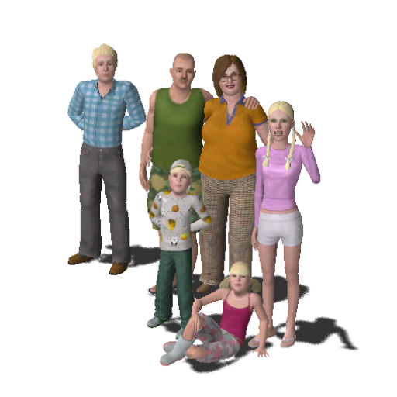
Generational Breakdown
Generation | Years of Birth | Ages
Matures | Before 1945 | Small numbers but younger group: lots of $
Boomers | 1946-64 | Retiring, some inherited wealth
Gen X er s | 1965-78 | Kids or DINKS, height of earning power – retiring/empty nests on the horizon
Millennials | 1979-95 | Raised in boomer households, defined by interests – dominating workforce soon
Gen Z | 1996 | Ready to be convinced – if we do our homework

Slide 11
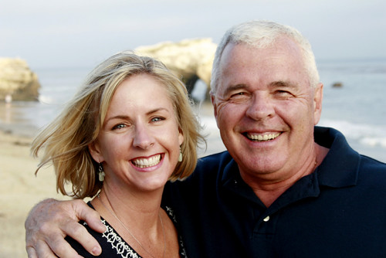
Boomers 1946-64 -- still very important
76 Million – millions retiring each year
Younger segment: double income, no kids, dog parents
Inherited wealth
Low savings – ‘spending children's’ inheritance’
Even though they are aging – many will not admit
Independence
Somewhat socially conscious
Eat out LOTS
Definition of self: what do you do? Answer for those still working: their job
Vietnam, Woodstock = drugs, sex and rock n roll
Raised by Dr. Spock influence thus were permissive parents – are/will be permissive grandparents
DEMAND GOOD SERVICE

Slide 12
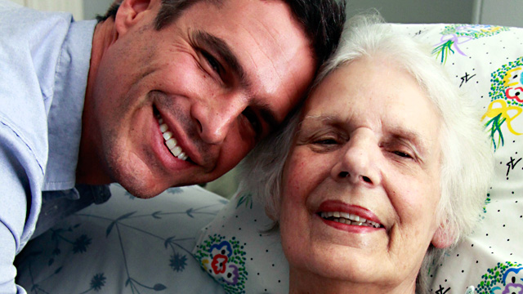
More Boomers 1946-64
Still aspirational
Like experiences
Health conscious
Value driven, coupons?
Personal indulgences
Believe education is key to success
‘Are’ 10 years younger than chronological age
Internet ‘savvy’ – use a work – more SM than some think – more FB than others
Sometimes ‘sandwiched’ with ‘almost adult’ kids and very elderly parents

Slide 13
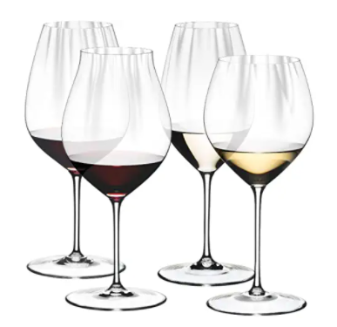
Reaching then marketing to Boomers 1946-64
Newspapers – first wave
Radio but dramatic segmentation – plus Sirius
Magazines: for ‘dreaming’ not hard sell – need a follow-up call to action
SM: women on Facebook
Like status symbols: Gucci vs. Walmart
Luxury: small and large: spa, wine, fine dining – fancy cars
Promote: You deserve it!
Youthful images – perhaps not AARP
Grandparents buy lots
Offer lots of options
Red wine is healthy
Higher priced wines will sell
If it tastes good, it is ok
Part of the ‘fine lifestyle’
Sell with ‘hippy’ labels
Make it female friendly
Match with food
Offer in restaurants
Educate them casually

Slide 14
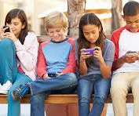
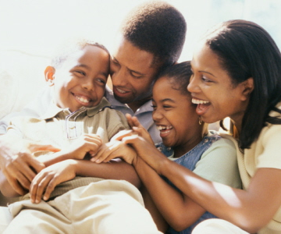
Gen X 1965-78
Very small market
Less than 39 million
‘Lost Generation’
Divorced parents, Latchkey kids
Beneficiaries of women’s Lib movement
More multi-cultural
Increasing number of stay-at-home moms
Independent, self reliant but skeptical
Trendy retail shopping, brands important – Gap, Nike, Apple, Amazon
Childbearing years – worried about safety for their kids
Perpetual ‘good times’
Limited cash flow after affluent childhood
Less loyal to ‘Made in America’

Slide 15
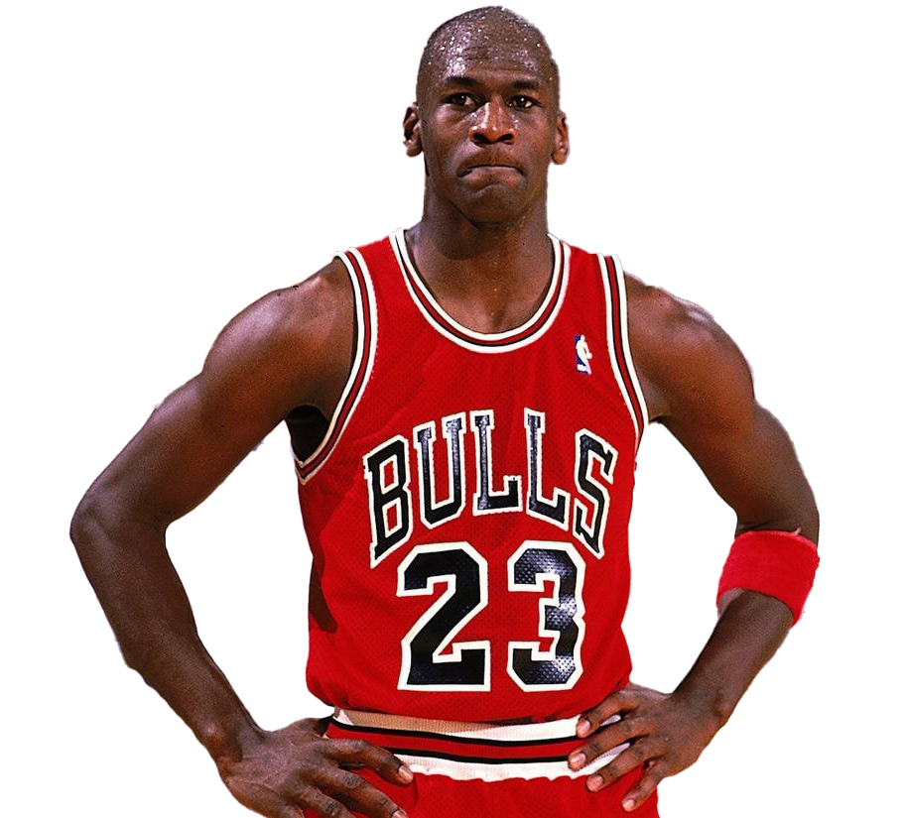
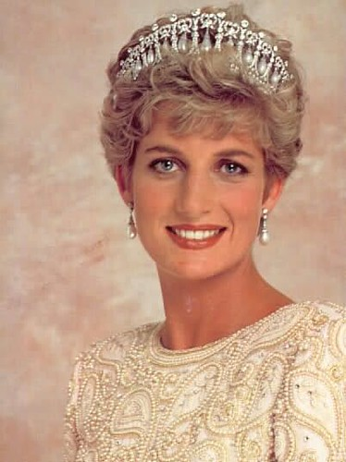
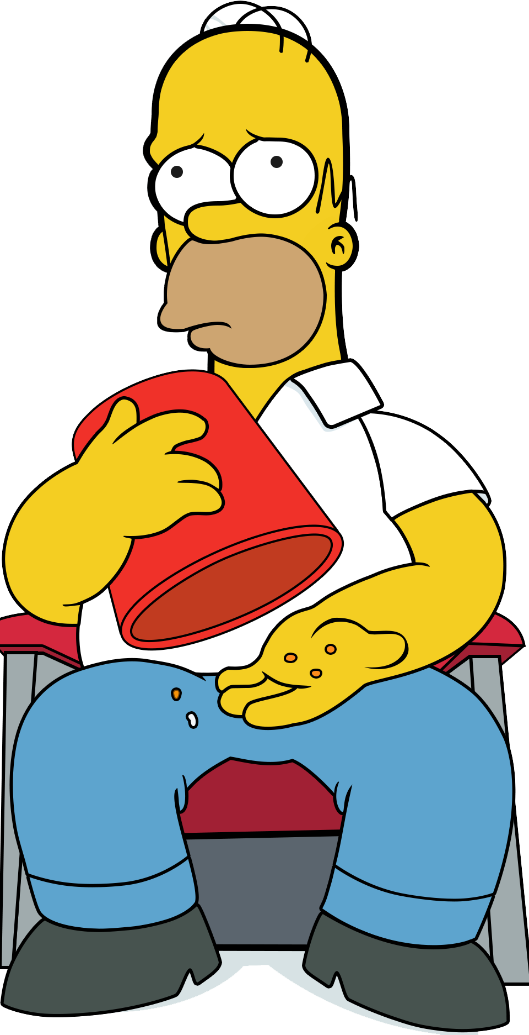
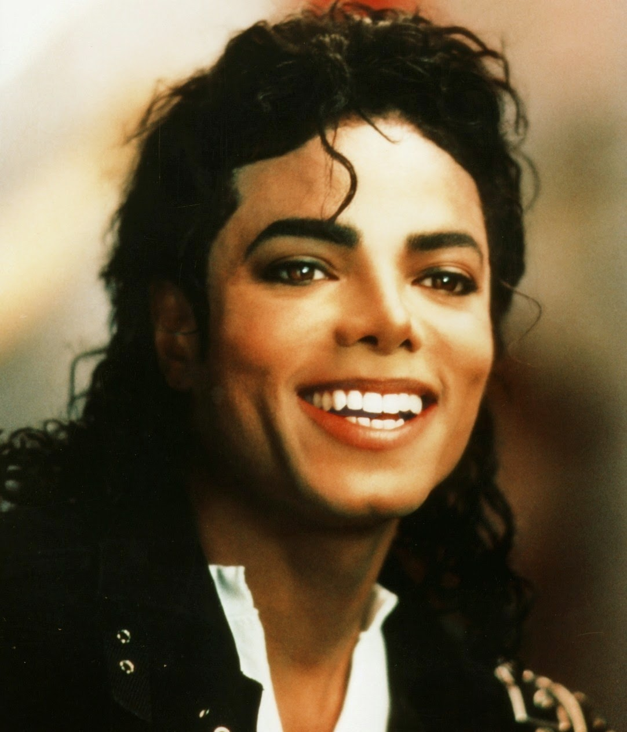
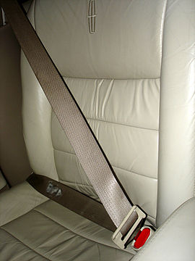
More Gen X 1965-78
Environmentally conscious
Powerless to control layoffs, inflation, divorce, home foreclosures, gas prices
Trust each other:
Group think
Adventure travel
Sesame Street!
Michael Jordan
Use seat belts
Anti drunk driving
Edu – tainment: ironic, edgy humor
Cause or purpose driven marketing
Non-traditional marketing: most marketed to generation in history

Slide 16
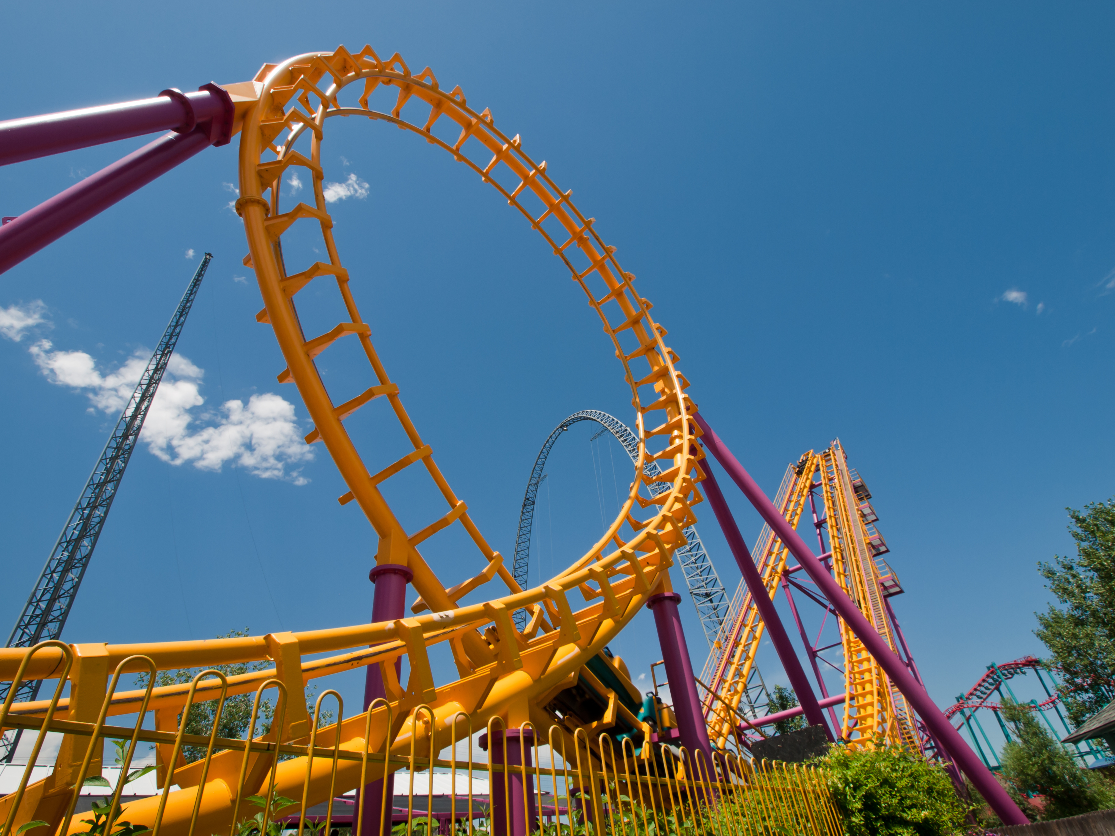
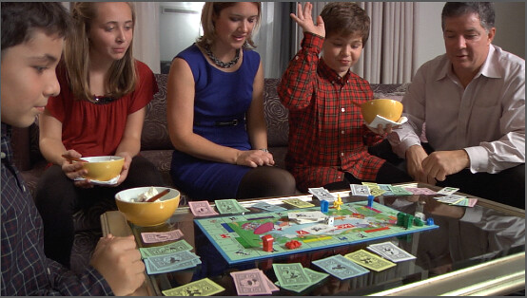
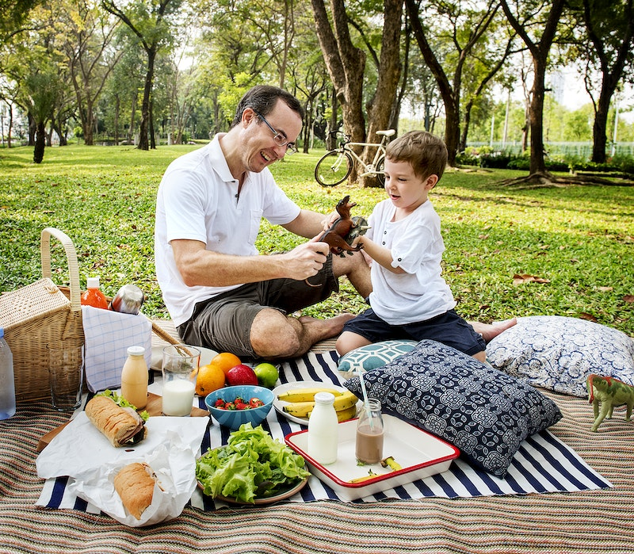
Marketing to Gen X 1965-78
Create group activities
Use computers – they started at age 9 – but NOT as much on the internet as are the millennials
Like things ‘retro’ [not sentimental] and ‘eclectic’ styles
Focus on ‘family’ things, memberships
Get rid of ‘hard sell’ – are skeptical about nearly everything – anti-commercials work
Give them respect
Be Authentic
Canoeing, hiking, mountain biking
Focus on ‘green’
Make it fun and edgy/funny
Like colorful ads
Charity causes important
Like ‘danger’ with a safety net: Survivor, roller coasters

Slide 17
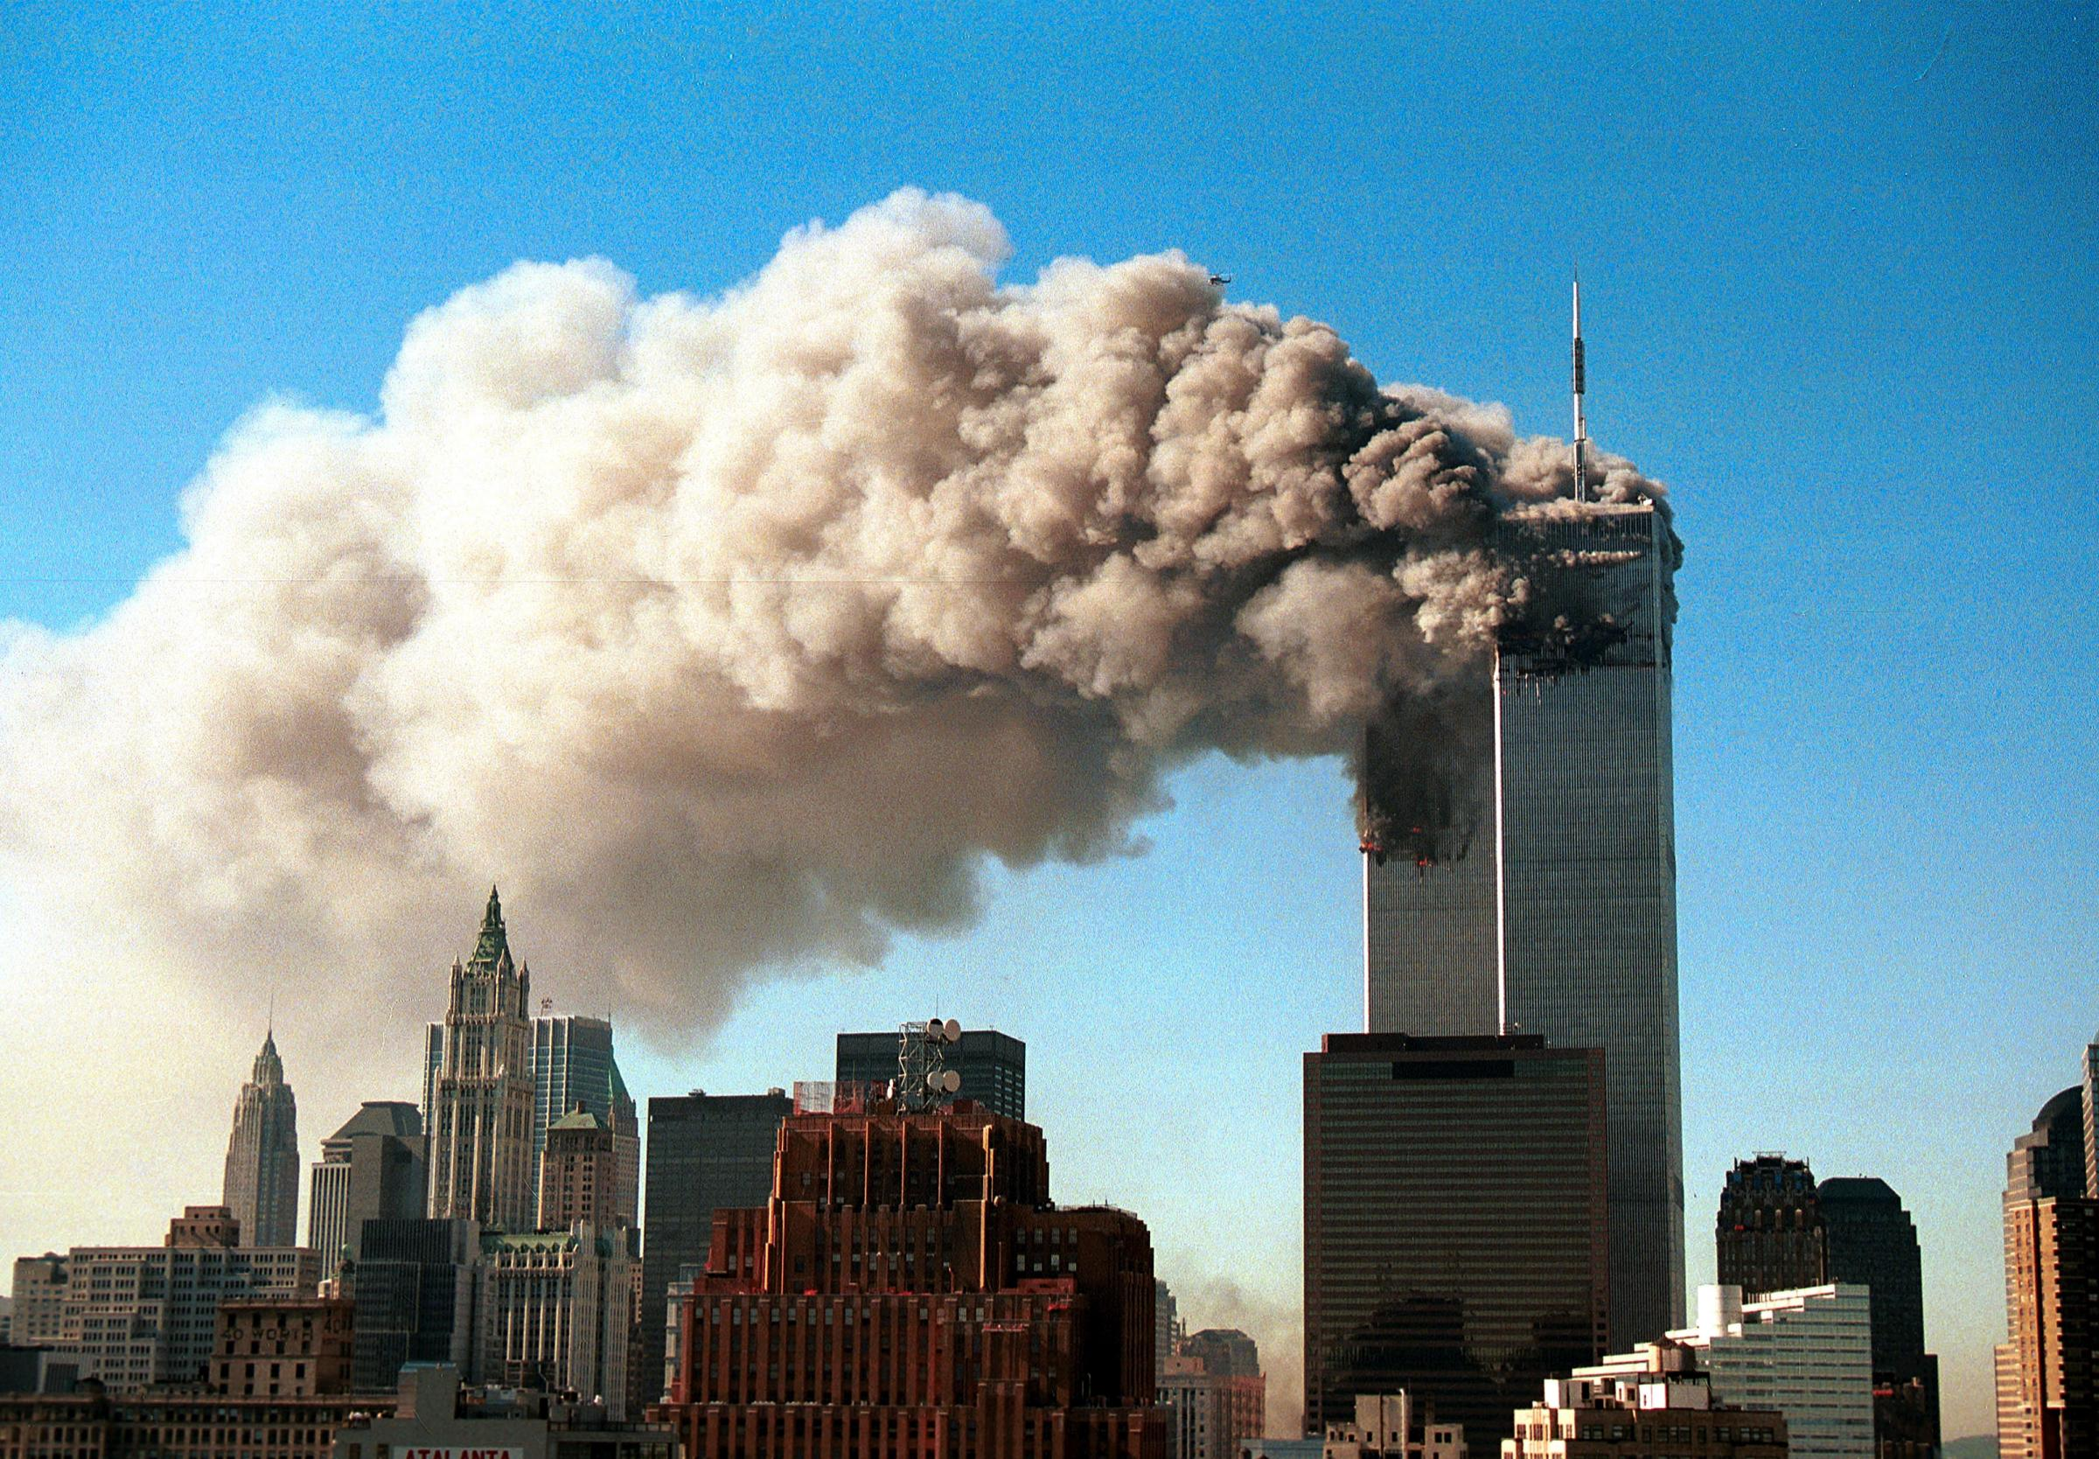
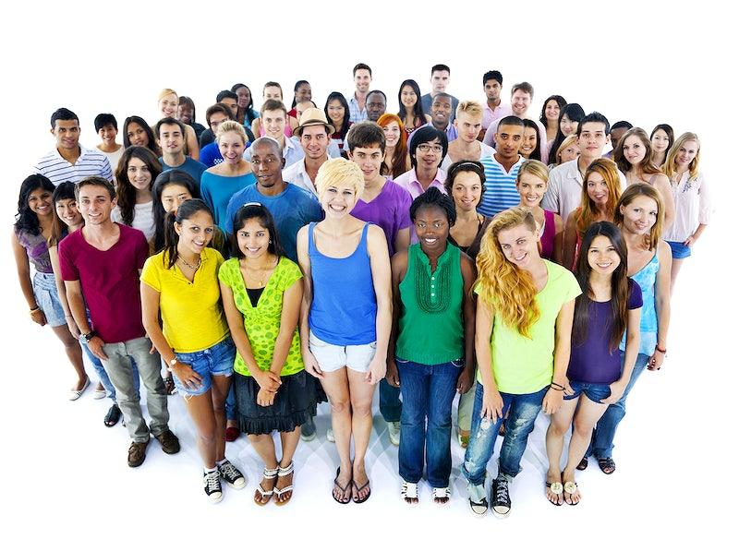
Millennials 1979-95
Huge market – nearly 80 million
2 Tiers: before and after 2008 recession
Young families or singles
Grew up with ‘boomer parents’
All about technology
Connected ----- nearly ALWAYS
Continual motion, multi-tasking
1 in 4 single parent family
1 in 3 not Caucasian
Ethnically diverse, do not notice
Major events really major: 9/11, Katrina, Iraq, Recession
They like their grandparents
Segments more patriotic than X’ers or Boomers

Slide 18
Millennial markers 1979-95
Multi taskers
Social media inter-twined with their lives/not necessarily dominate it
Tech savvy
Very curious
Self assured
Spiritual but not ‘religious’
Want instant gratification and positive feedback
Volunteering important
Collaborative – group projects, outings
Authenticity critical: B-S meter sensitive
Transparency critical
Career advancement important
Diversity important

Slide 19
More Millennials 1979-95
Not just grades – community involvement
Fast paced – edgy
Life is fun - social networking
Self reliant – working moms
Very family focused – ‘will make soccer moms look like child abusers’
Positive view of future – winning video games --- American Idol
‘Pack mentality’ – do not ‘date’
‘WE’ focused
Inured to advertising
Jobs secondary to life – but $ important
Live anywhere, work remotely

Slide 20
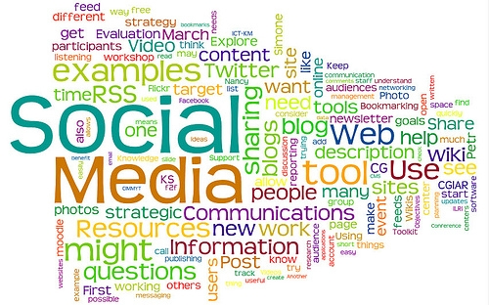
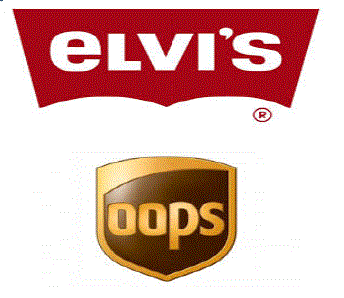
Appealing to Millennials 1979-95
Penetrate with the internet, e-marketing, SM
Save them time, they will pay more
Create unique and identifiable logo
Use technology: podcasting, YouTube, TikTok, Smart phones, text messaging, Facebook, Apps, Responsive web site, QR codes
‘Nice’ people are ‘in’
Faith based marketing
Create multi-generational opportunities
Stress group opportunities
Figure out what is trendy early and climb on board
Engage THEM – FB, YouTube, TikTok, Crowd Sourcing

Slide 21
To cater to Millennials 1979-95
WiFi your tasting room
Offer ‘dry’ wines, varietals
Be authentically ‘green’
Make sure tasting room staff is both nice and their age
Make sure your logo/labels are ‘cool’
Bigger table options in your tasting room
Make some accommodation for family activities [including grandparents]
Great web site: clean, 2 clicks, soft education
Frequent web posting – first page search

Slide 22
Z’s: 1996………You do not drink your father’s drink…… WE CANNOT LOSE THEM: Abstention [26%], White Claw, Spirits
2008 financial crisis in family
Climate change concerns
Obama then Trump elections
Opioid, Fentanyl, and Covid impacts
Marijuana legalization
Suicides
School shootings
Racial riots
Me too movement
Gender identity discussions
Adventure seeking
Dobbs decision
Pragmatic, practical
ALWAYS connected
Will not read much copy
24% of population
2020: 3 trillion in purchasing power
25% of workforce by 2030

Slide 23
More Z’s 1996
Hours per week: 28+ phone/SM, 13 on TV, 10 on laptop [Millennials: 14 phone, 16 laptop, 14 TV]
Especially like ‘cool’ products, even over cool experience
Trends in clothing brands change often
Neon colors to neutral palates in makeup
Very entrepreneurial [72% in HS wants own business] – future business owners? Hobbies to part time jobs to careers
‘Edgy’ = good
Short ‘cool’ videos – Tic Tok
Want to be taken seriously
Smart phones ONLY from birth
This Photo by Unknown Author is licensed under CC BY-SA-NC

Slide 24
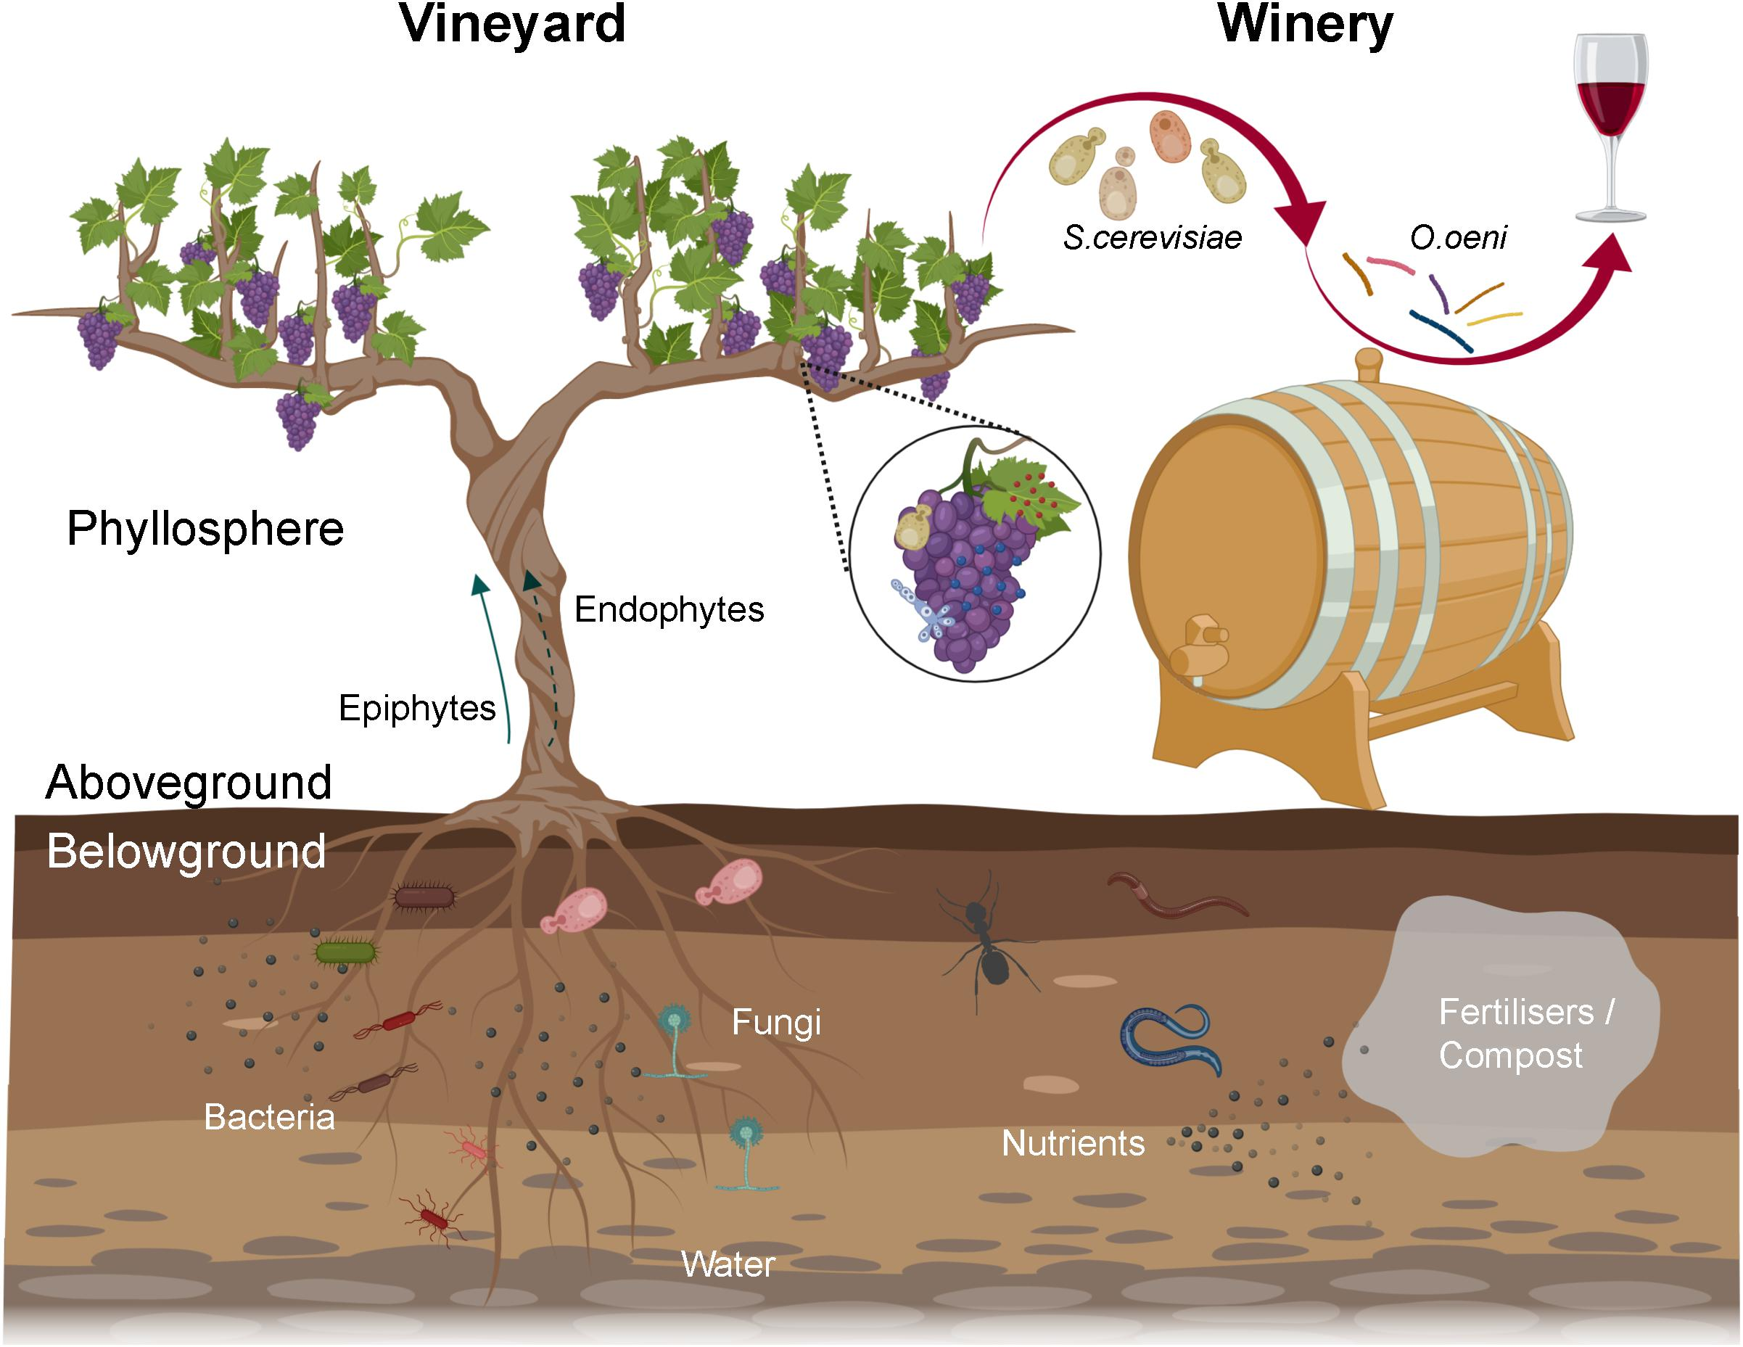
More Z’s 1996
Apps easy /texting critical/do not use phone calls for communication
8 second attention span
Techno sometimes/often better than face to face
Story telling, ‘Explaining’ videos, info-graphs
Independent, VERY self confident
Working earlier age than parents
Healthy lifestyle
Multi tasking
Make a difference
Percentage of foster care
‘Spiritual’ not necessarily formal religious groups
97% on-line daily
Very influential with their parents
Living at ‘home’
Trades vs. college
Check phones 50-100+ times per day – job restrictions?

Slide 25
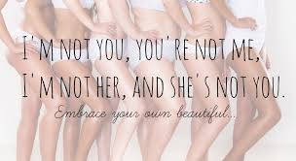
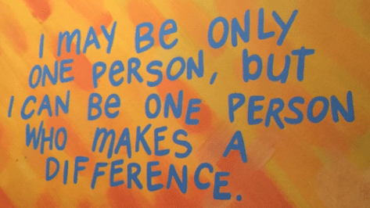
Z’s Marketing hints 1996
Not FB – hashtags, Snapchat, Instagram, Tik Tok – what is next?
51% on Snap 11 or more times per day
Influencers/bloggers, not traditional media
Story telling
Short videos
Charity causes
Authentic – BS meter
Cancel culture
Create ‘share worthy’ content
‘Real’ people, not just models
Research on-line, shop in person [social experience for them?]
Customize their experience [private wine label?]
Accept phone payments

Slide 26
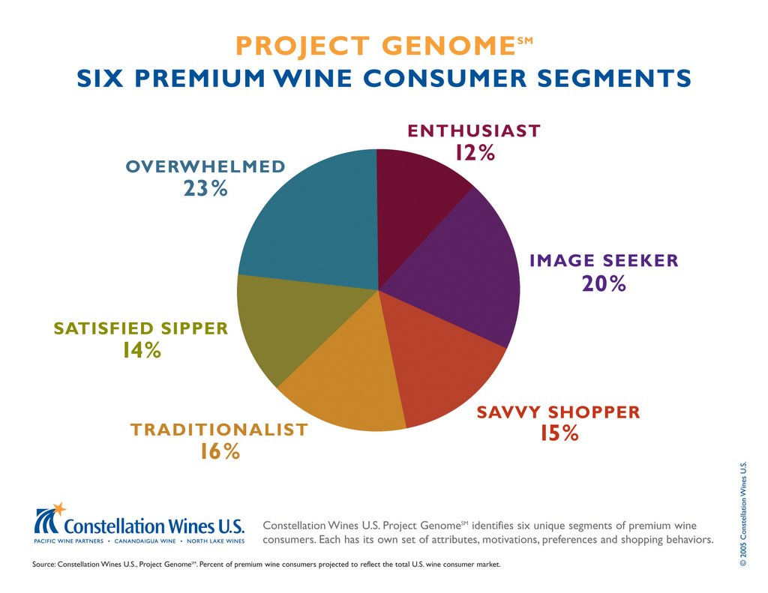
Once ALL of the generational differences are considered – look at the Constellation Genome Project
2008, 2014, 2022
Six segments – Covid and internet purchases may change somewhat – but for most of us this information is invaluable
This Photo by Unknown Author is licensed under CC BY-NC-ND

Slide 27
How they
Price driven
“I believe you can purchase a good wine without spending a lot”
“Price is the primary driver”
21% of buyers
26% of profits
24% of all their alcohol consumption
$12 average bottle price * [2014]
Everyday loyals
“Wine drinking is a part of my regular routine”
“When I find a wine I like, I stick with it”
20% of buyers
22% of profit
44% of all their alcohol consumption
$10 average bottle price * [2014]
Overwhelmed
“I drink wine but it is not an important part of my life”
“I do not enjoy shopping for wine. I find it complex and overwhelming.”
19% of consumers
9 % of profits
34% of all their alcohol consumption
$9 average bottle price* [2014]

Slide 28
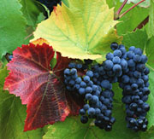
More Genome
Enthusiasts
10% of consumers
“I love everything about wine”
“I love researching purchases, reading reviews, shipping, discussions, drinking and sharing”
15% of profits
40% of alcohol purchases are wine
$13 per bottle average
Image seekers
18% consumers
“how others perceive me is important”
“I want to be sure the wine I choose says the right thing about me”
26% of profits
24% of alcohol purchases
$12 average bottle price
Engaged Newcomers
12% of consumers
“I am young and new to a category”
“Wine is a big part of my socializing”
14% of profits
24% of alcohol is wine
$13 average bottle price

Slide 29
Two more books

Slide 30
For every generation and Genome group
Prioritize your targets among the various groups
Only do what you can do well
Do not impose your standards on your target audience
Craft different message for these groups – have a handful of approaches ready
Whatever you do: Michael Mondavi quote: Manage the Mystery, Maintain the Magic
Then hire ‘them’
This Photo by Unknown Author is licensed under CC BY-NC-ND

Slide 31
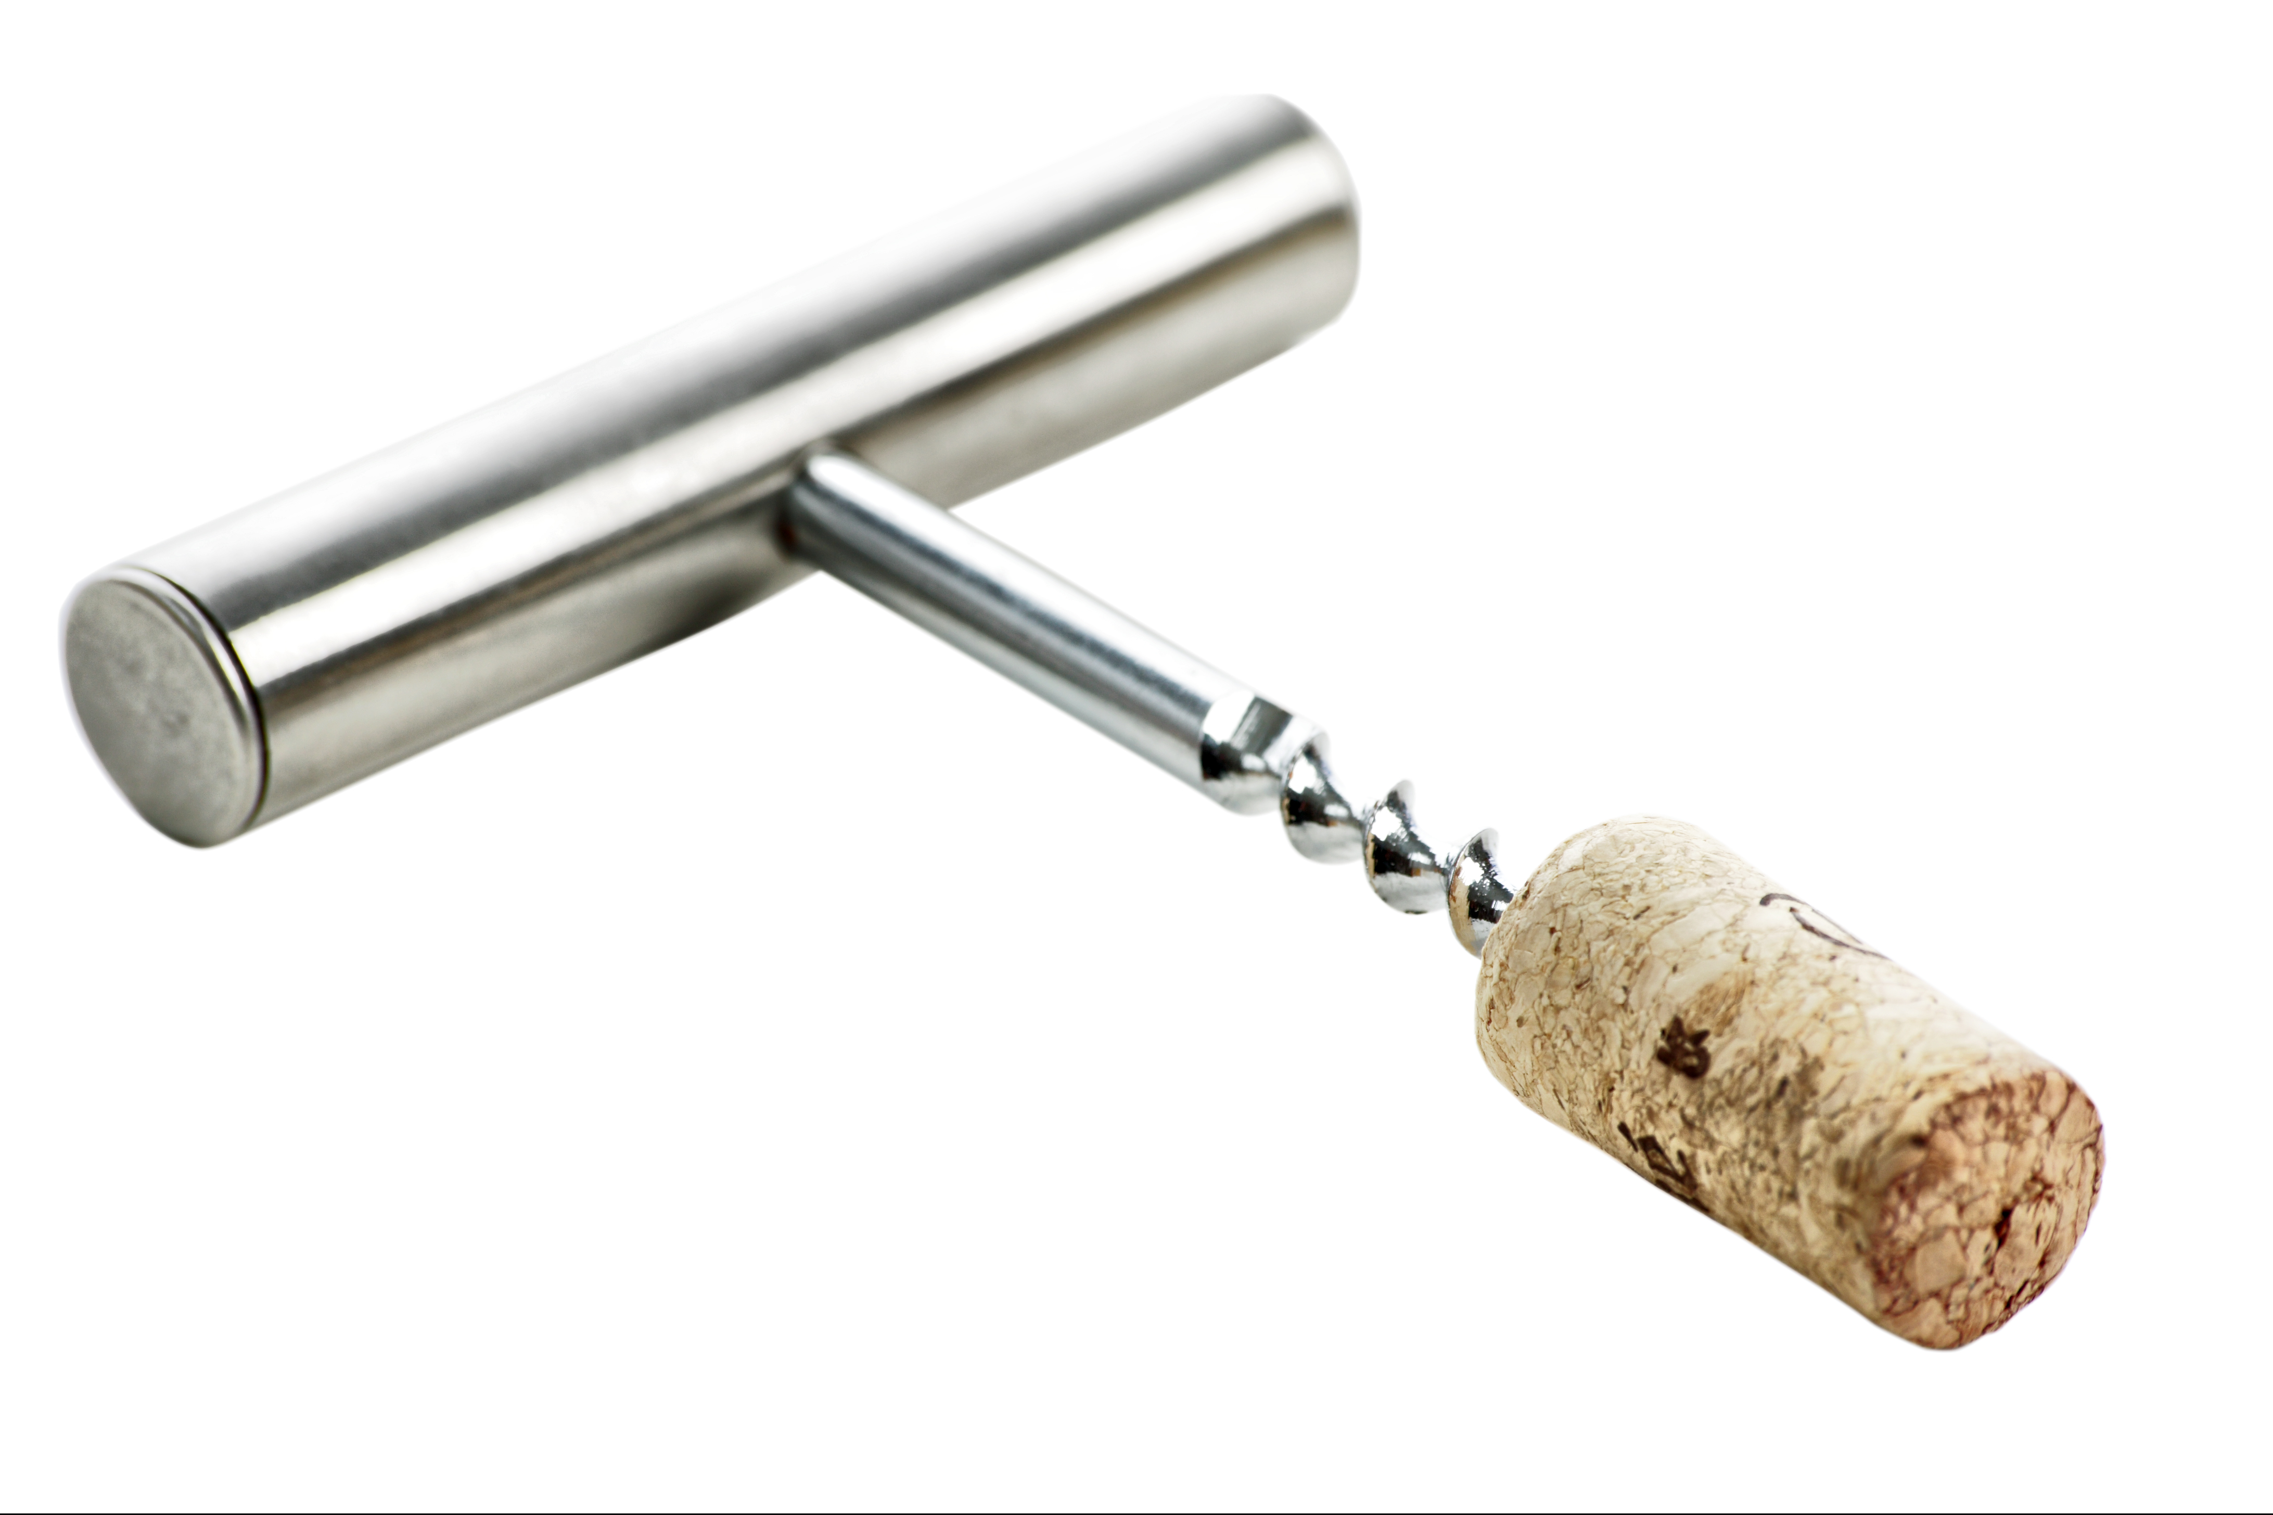
Sources
’Wine Market Council report/Balzac Communications/ Nielson Wine Marketing Study
Kent Geist, Zeitgeist Marketing, License to Steal
Numerous blogs and RSS feeds including Joe Puluzzi [Junta 42 and LTS], Social Media @ Smart brief, Hubspot
Books cited 2004-2022
License to Steal attendees over the years
Several Time Magazine articles
Some images from Microsoft on-line
My employees, Kids, Grandkids and their friends
WineBusiness 2014 article on the Genome
NPR radio series on Millennials
Lalia Rach, NYU School of Journalism and Sports Marketing, address to the national Retail Merchants Asso.
Judy Randall, Travel Trends, OTA presentation
Brand Champs blog
Peter Yaswich, National Travel Monitor, IAAPA presentation
Chuck Underwood, Generational Imperative, Cleveland Plain Dealer Workshop
Phil Goodman, Boomer Marketing Cleveland Plain Dealer Workshop
Gordon Food Service ‘Wowing Consumers’

Slide 32
One bite at a time

Slide 33
Thank you

