Slide 1
Wine Price and Value Perceptions and Realities
Stephen Menke, Assoc. Prof. of Enology
Horticulture and Landscape Architecture
Colorado State University Enology Program

Slide 2
Unique Wine Value Chain
Wine is both a seasonal product (vintage) and a stored product (up to decades)
but both judged for perceived value similarly at tasting or point of purchase
Grape quality & wine quality dovetail
strong sensory memory of grapes in wine
Vineyard images and wine romantic history perceptually entwined
Therefore, how do we define wine value?

Slide 3
Actual and Perceived Wine Value
Actual Wine Value = Price Sold
Costs for Production and Sales/Marketing
Markup beyond costs
Costs can vary by desire to justify markup
Ex., oak, aging, free tastings, promotion, competitions, advertising, philanthropy

Slide 4
Actual and Perceived Wine Value
Perceived Wine Value
Price set for wine
= costs + winery/seller perceived added value
Price wine sold
= buyers’ reconciliation of their perceived wine value with winery perceived value

Slide 5
Components of Perceived Value by Winery
Quality of fruit, labor,yeast, additives
All production and sales costs
Market reputation of wine product niche
quality, variety, style, market trends, sales venue
Competitor niche price and reputation
Desired timeline for clearing inventory

Slide 6
Components of Perceived Value by Consumer
Quality
Attractive package and wine looks/tastes good
Distinctive from other wines in niche, but of style
Meets or exceeds quality expectations
Reputation
Previous experience, grass roots, or sales person
Awards and media buzz
Availability
Scarce product can enhance quality and reputation
Scarce at purchase point can → choose competitor

Slide 7
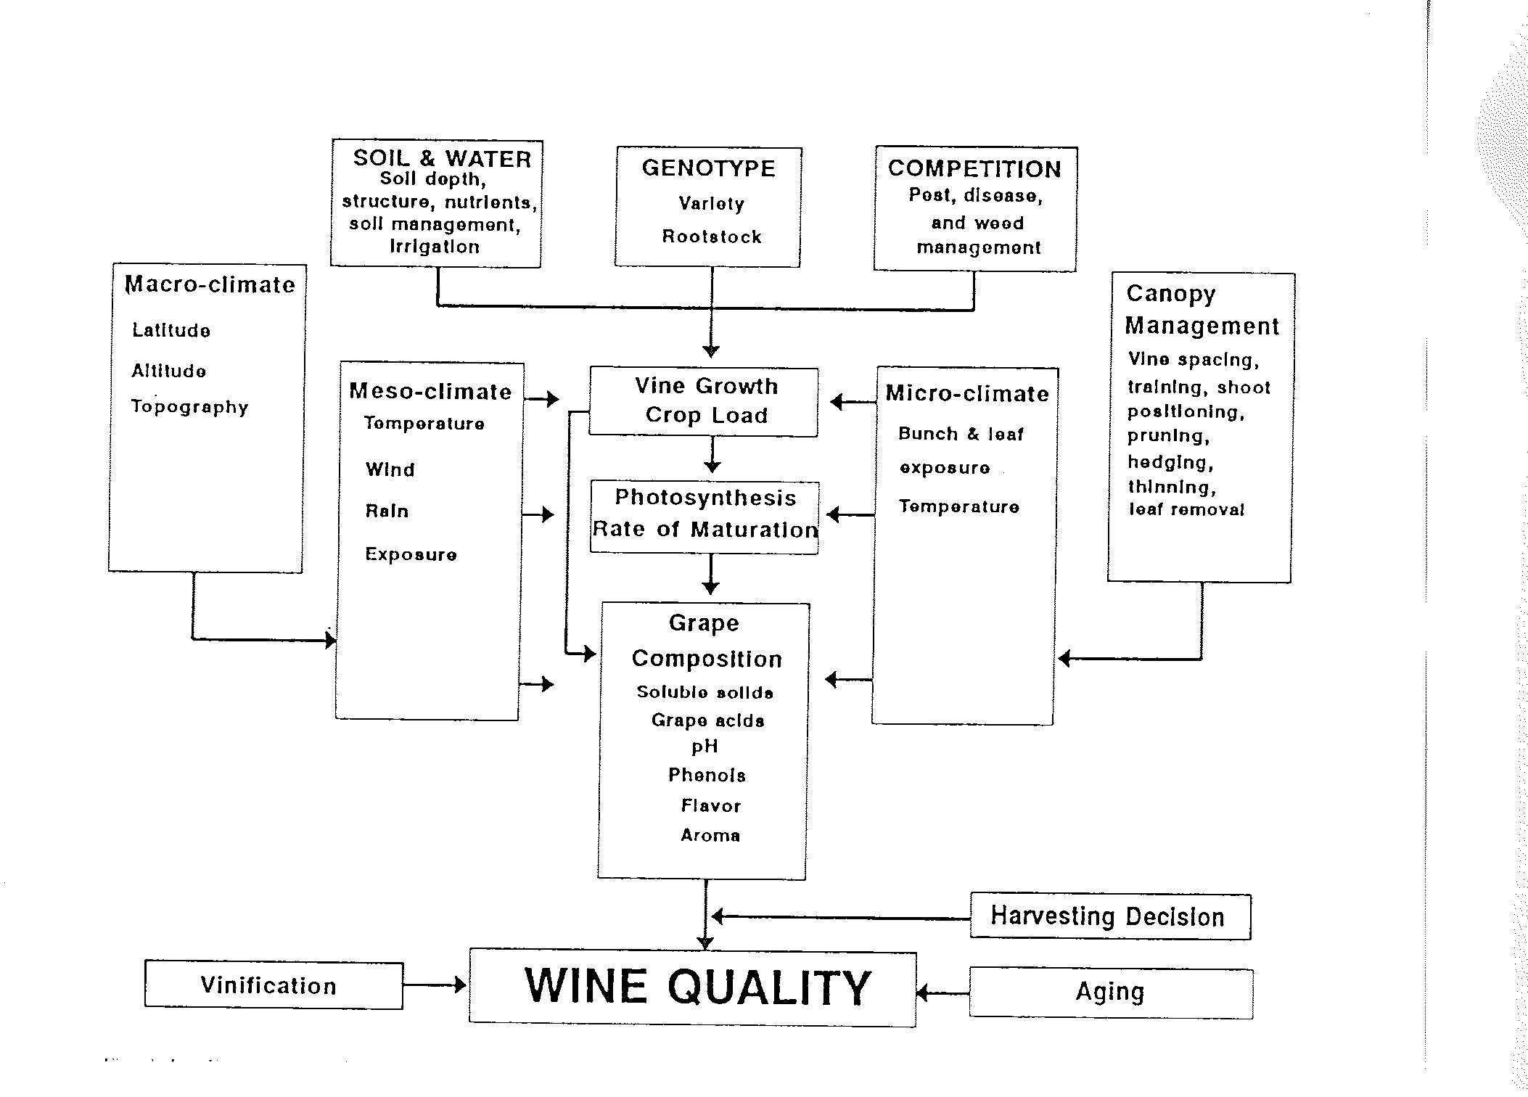
Grape Factors of Wine Quality/Reputation for Winemakers

Slide 8
Factors Driving Consumer Interest in Your Wines
Location of Purchase Point
Crucial to perceived value
Reaching purchase point inhibited by distance
TODS signs effective to alleviate location displacement
Shopping online inhibits impulse, but reputation promotes
Shipping/loyalty costs can inhibit impulse to buy

Slide 9
Factors Driving Consumer Interest in Your Wines
Tasting during winery/retailer experience
Winery →strong driver of impulse buy and long-term perceived value, availability hurts repeats
Retailer → good driver of short-term impulse buy, and availability can lead to repeat sales

Slide 10
Factors Driving Consumer Interest in Your Wines
Personal recommendations
Friends and family
Retail staff
Media coverage by writers and critics
Magazines or national newspapers
Best for regional promotion or known brands
Local publisher, social media, specialty writer, blogger
Small wineries, specialty, and local wines

Slide 11
Factors Driving Consumer Interest in Your Wines
Competitions and Awards (with promotion)
Good for tasting room and websites
Can be oversold (silver is a failure?)
Local restaurants
Very effective for local perceived value
Presentation and price point critical
Commercial advertising
Published media
Expensive, works best for known national brands
Circulars and retail websites
Best for promotional retail sales or winery visits

Slide 12
Targeting Point of Sale Perceptions Winery, Wine, and Consumer
Winery must know perceived value at each point in the value chain and price accordingly
Wine Quality and Reputation drive each other
Quality is key
Consistency needed for reputation
Reputation building is necessary
Lets consumer know why quality is in wine
Customer must seek value (buyer task) and understand why they perceive value (winery task)

Slide 13
Test of Tasting as Driver at Different Price Points
Blind tasting
Three wines of same labeled variety
Taste wines
Write down perceived price
Prices revealed
Discussion

