Slide 1
From Doom to Boom The New York Wine Story
Jim Trezise
President, Wine America

Slide 2
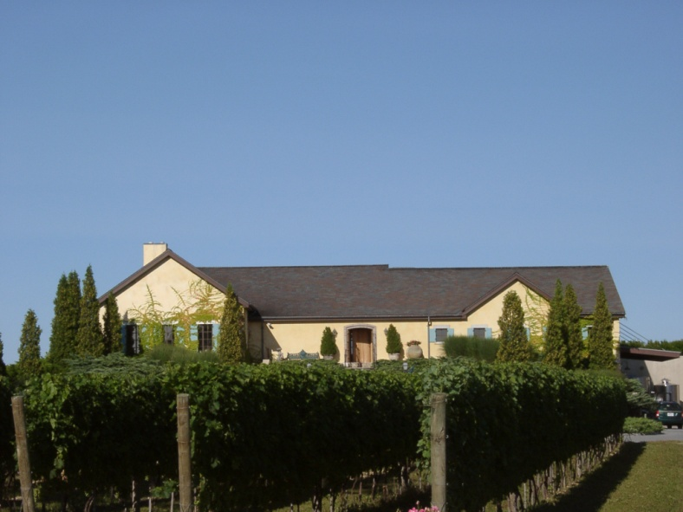
“The fastest way to make a small fortune is to begin with a large fortune and open a winery.”
--California Wisdom
Quality • Productivity • Social Responsibility

Slide 3
DOOM
1986 Wine Spectator Cover
“Crisis in New York Vineyards”
Photo of bulldozer ripping out vineyards

Slide 4
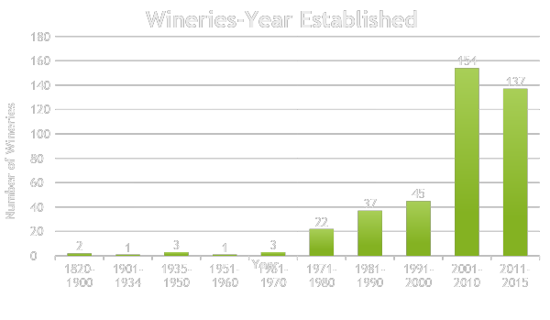
New York Wine Industry Growth

Slide 5
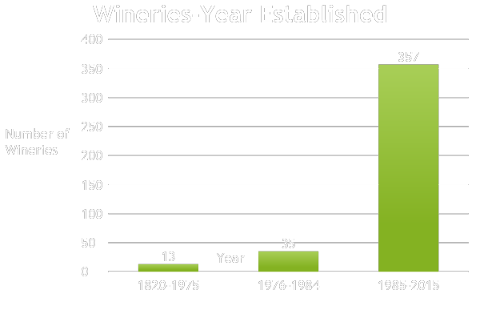
New York Wine Industry Growth

Slide 6
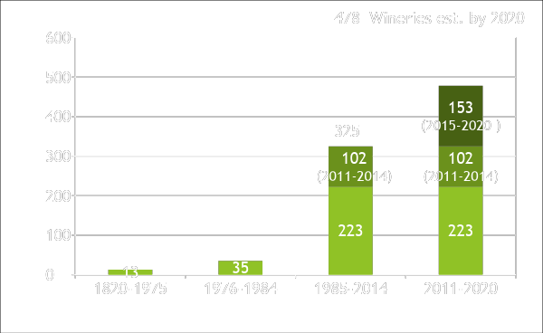
Wineries-Year Established
478

Slide 12
As of August 2014

Slide 13
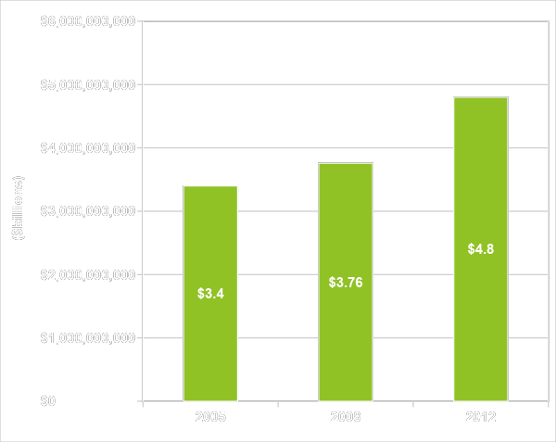
Grape, Grape Juice & Wine Industry Annual Economic Impact, 2012:

Slide 14
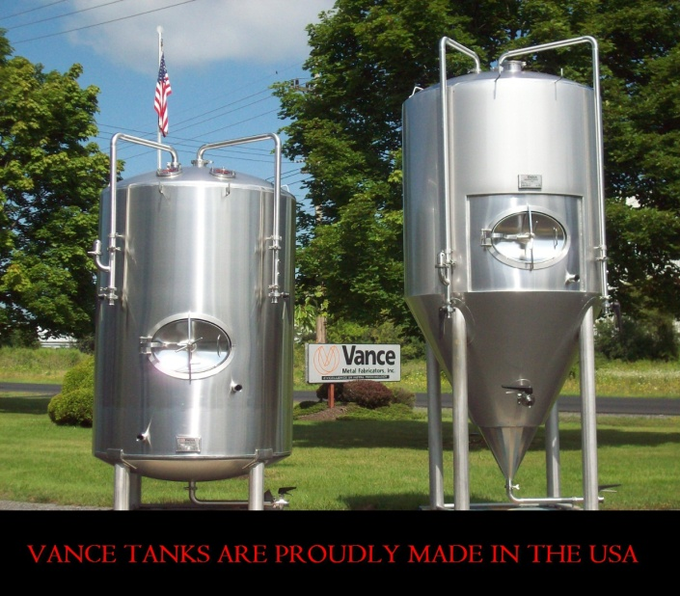
Vance Metal Fabricators
1995: Began making wine tanks
Over 1,100 sold in 15+ states
10% of total business, with 15% goal
Expanding to “beverage” tanks (wine, beer, cider, spirits)

Slide 15
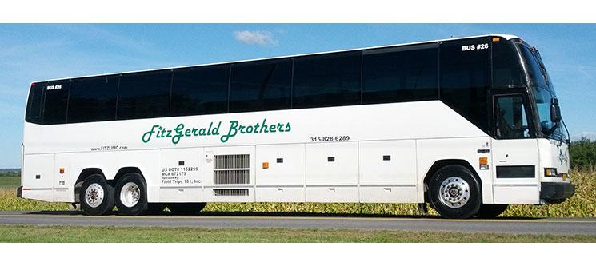
Fitzgerald Brothers Transportation
2001: Start of company (Finger Lakes Wine Tours) with 1 bus
Today: 38 vehicles (50-passenger buses, vans, limos, cars)
Growth: 15,000 passengers annually
Jobs: 70 drivers, 10 full-time employees, many vendors
Expansion: New bus garage

Slide 16
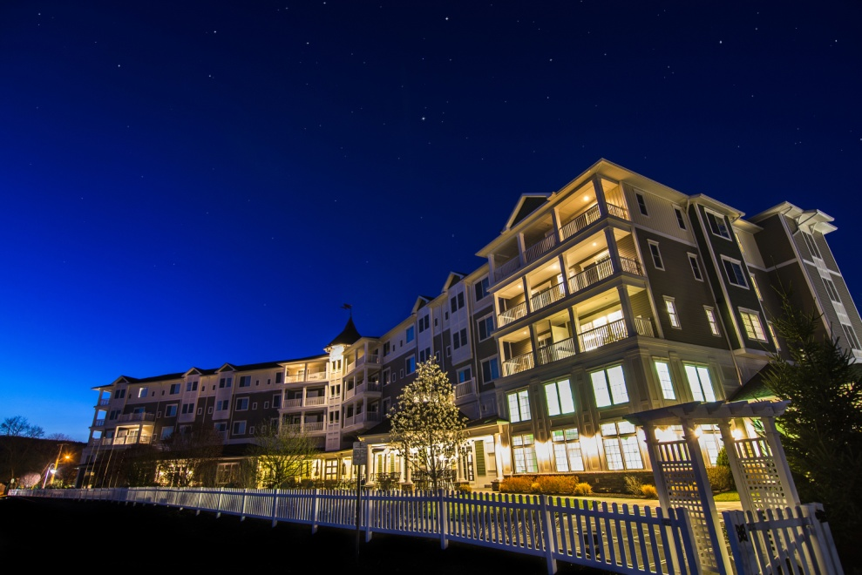
Watkins Glen Harbor Hotel
Year Opened: 2008
Employees: 100 in 2008, 140 now
Guests: 30,000 in 2008, 40,000+ now (not including conference attendees)

Slide 17
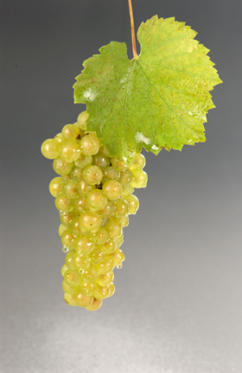
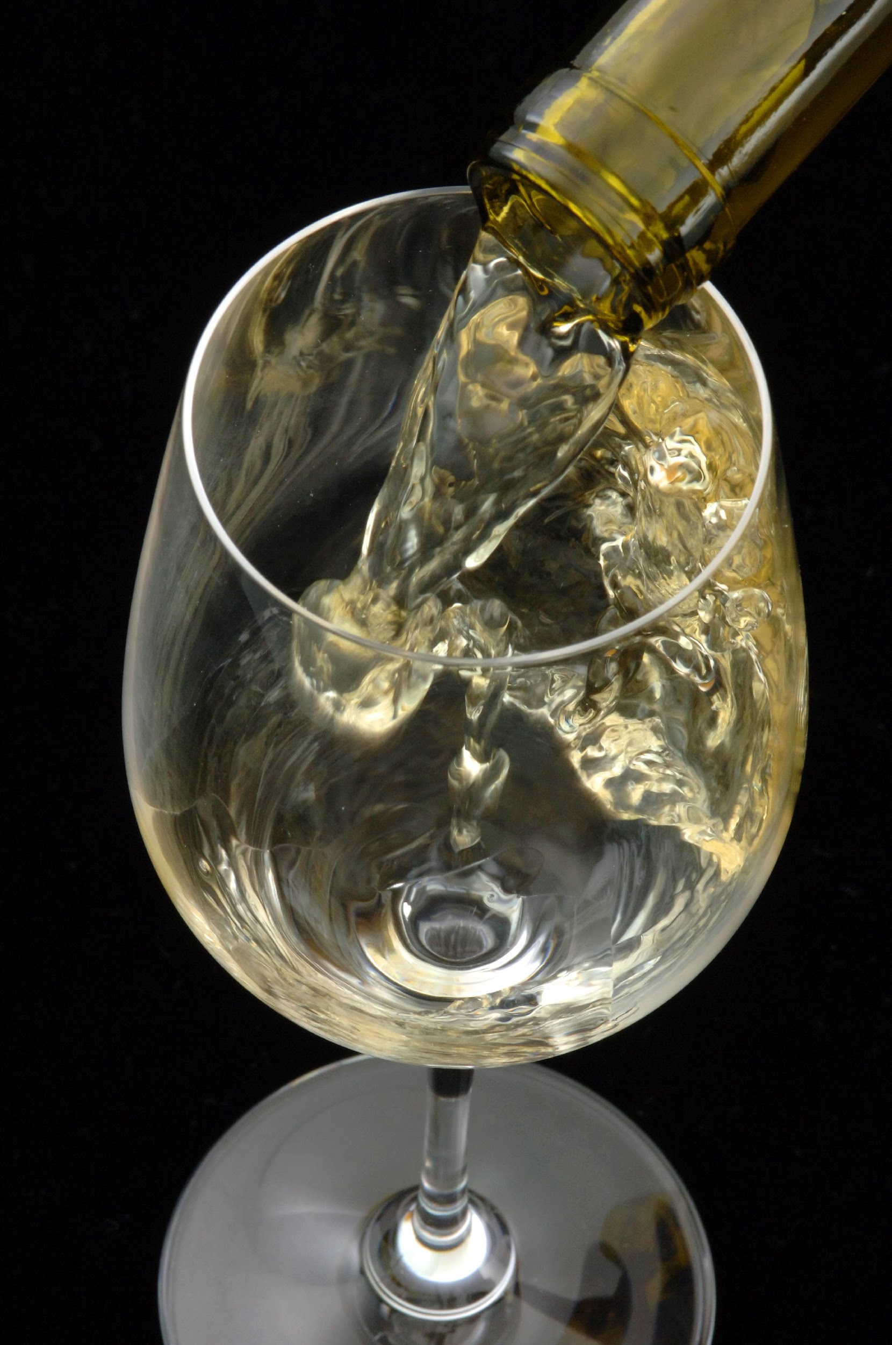
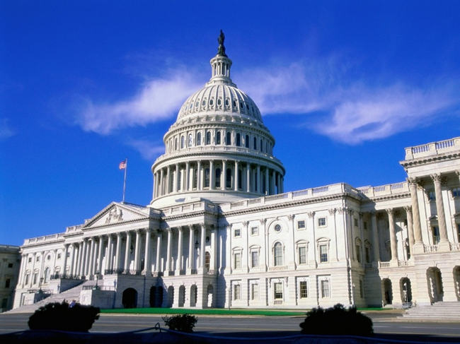
The Magic Blend
Unity
Business Climate Change
Grapes
Research
Promotion
Quality
Unity

Slide 18
Diversity is our Strength Unity is our Power

Slide 19
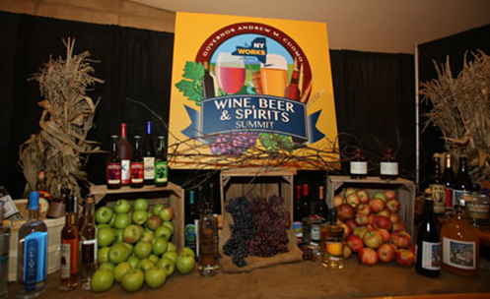
Business Climate Change
The Forgotten Climate: Business Climate
Farm Winery Act of 1976
1984: Wine Coolers in Grocery Stores (and Liquor Stores), Winery Deregulation, Wine Tastings in Liquor Stores
1985: Creation of New York Wine & Grape Foundation
2011: New Administration in New York (Andrew M. Cuomo, Governor)
Three “Wine, Beer, Spirits & Cider Summits”
Major Legal and Regulatory Changes, Promotional Support

Slide 20
Business Climate Change
“Entrepreneurial Government”
New Government Attitude: Partners
Support of All Farm-Based Craft Beverages
Legislative and Regulatory Change
Promotional Support

Slide 21
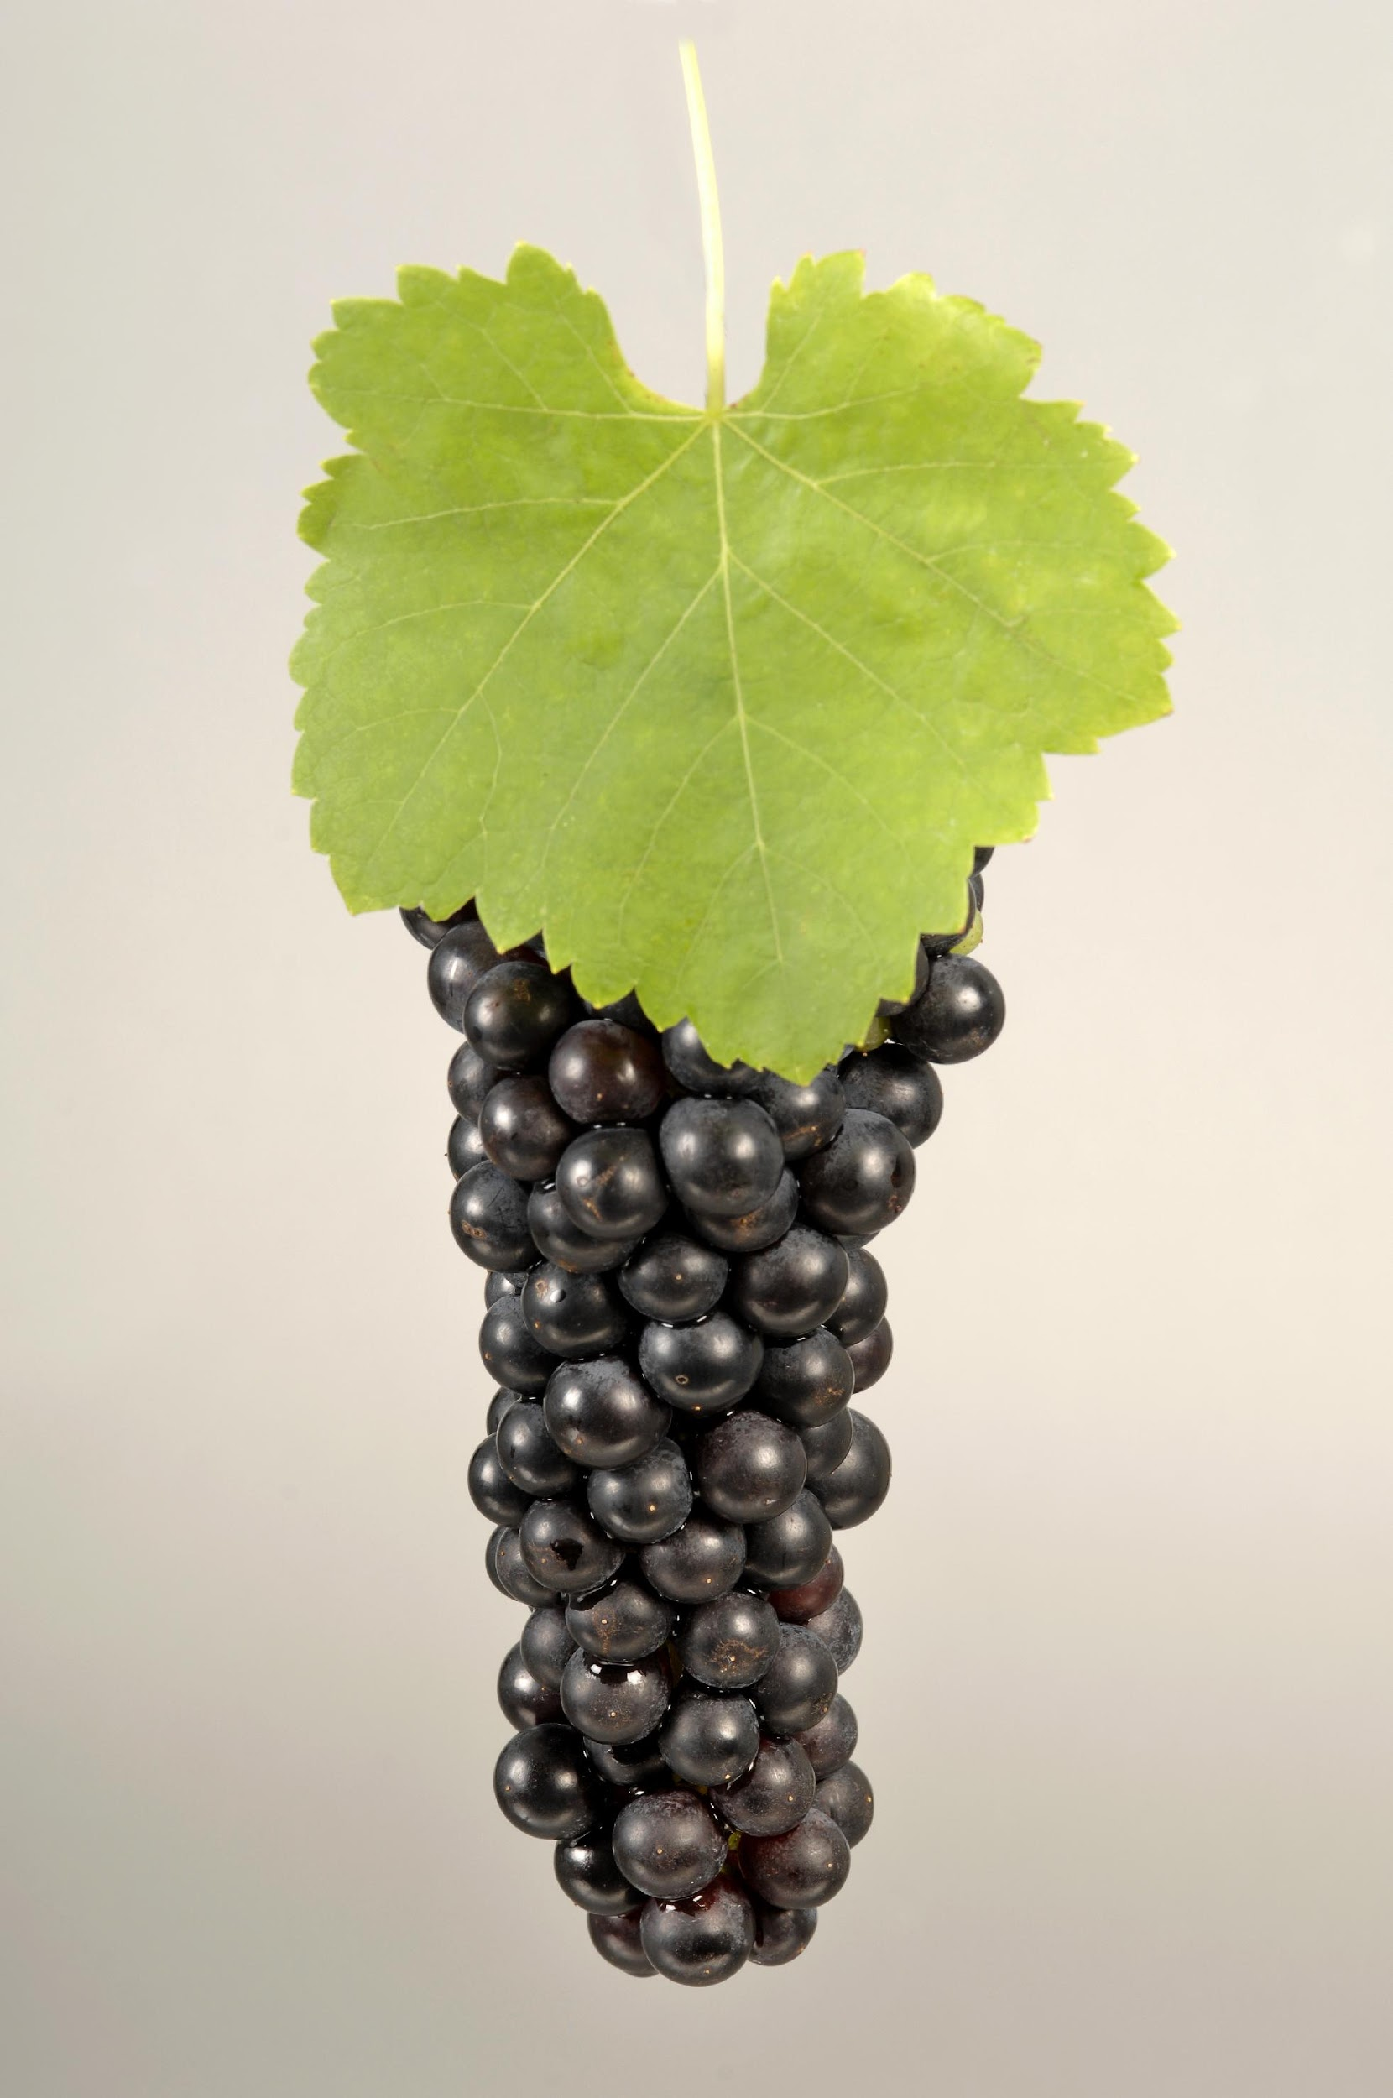
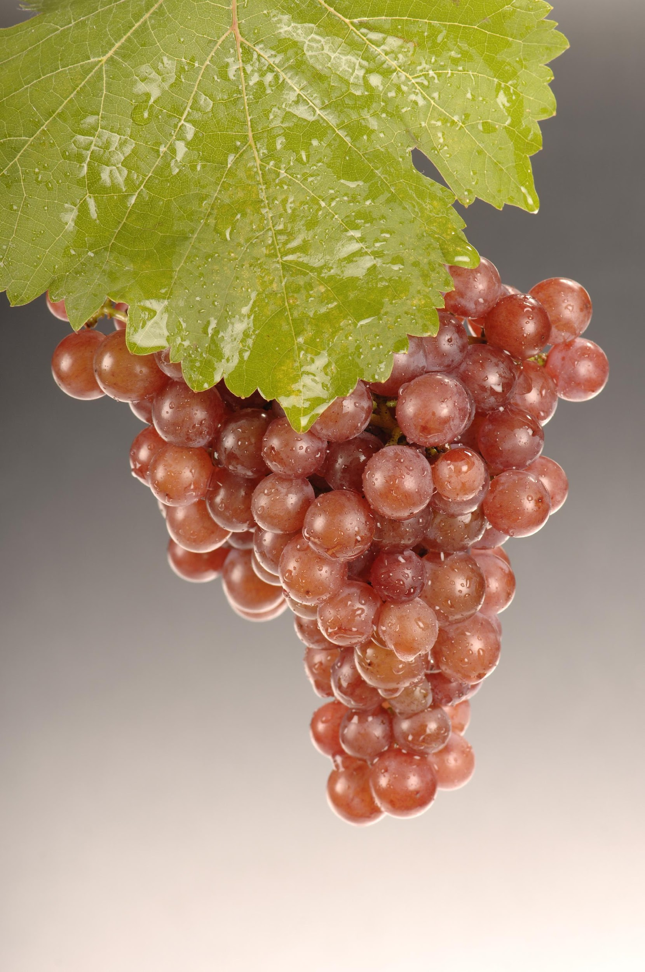
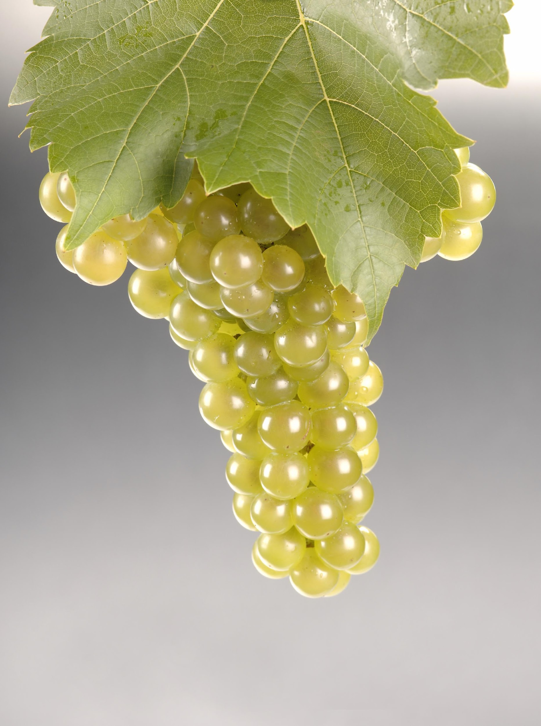
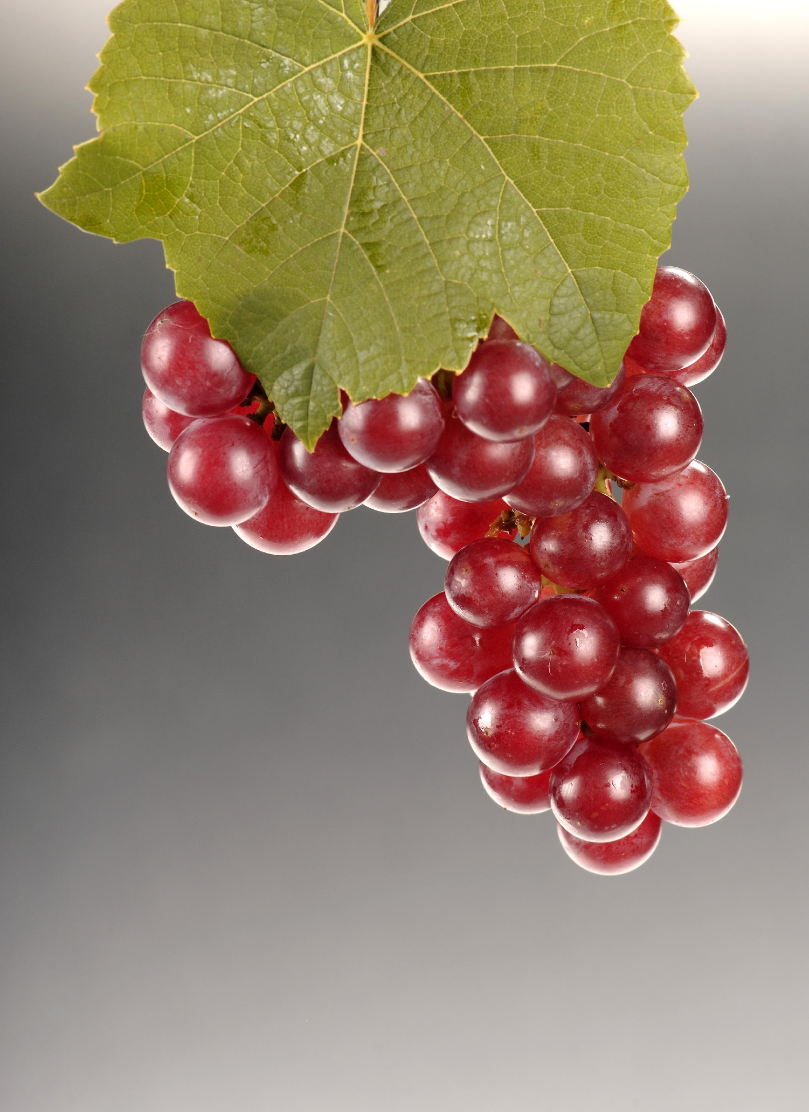
Grapes
Vitis Labrusca (“Native American”): Concord, Catawba, Niagara
French-American Varietals: Baco Noir, Vida, Vignoles
Vitis Vinifera (“European”): Pinot Noir, Chardonnay, Riesling
Cornell Creations: Noiret, Cayuga, Traminette
“Minnesota” Varietals: Marquette, Brianna, LaCrescent
Something for Everyone (and Everywhere)

Slide 22
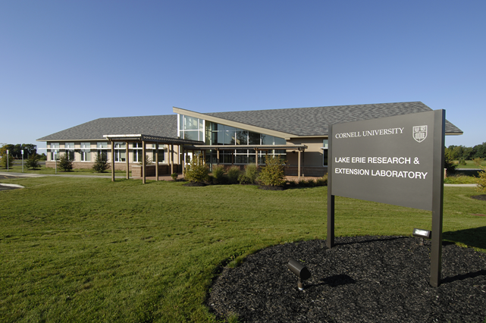
Research
Cornell University/Cornell Cooperative Extension
Focus on Quality, Productivity and Sustainability
Collaboration Among Industry Members

Slide 23
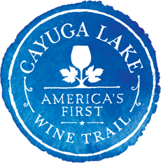
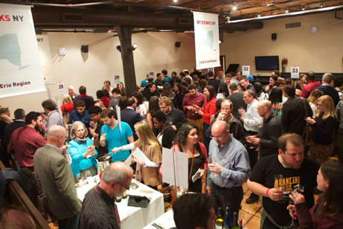
Promotion
Bring the People to the Wine, Take the Wine to the People
Wine Trails: From 1 to 20
NY Drinks NY: Unlocking the City
Export: Europe, Canada, Asia

Slide 24
Promotion Strategy “Bring the people to the wine, take the wine to the people”
Tourism
Wine trail support
Web site
New York Wine Country “bookazine”
Discover New York Wineries “interactive infographic”
Familiarization tours

Slide 25
Promotion Strategy “Bring the people to the wine, take the wine to the people”
Market Promotions
“NY Drinks NY”
Wine Competitions Program
The Wine Press
Conferences
Trade Shows
Other organizations

Slide 26
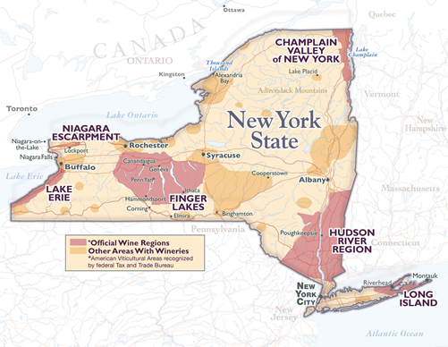
Wine Trails: Key Elements
Unity—Competitors collaborating
Geographical logic (logical geography)
Bylaws, financial structure, regular meetings
Highway signage
Brochure
Website
Special Events
Advertising
Unity

Slide 27
Wine Trail Evolution
1983: Cayuga Wine Trail created -- #1 in America
1985: New York Wine & Grape Foundation created
2016: 17 New York wine trails spanning the state (Long Island, Dutchess, Shawangunk, Cayuga, Seneca, Keuka, Canandaigua, Thousand Islands, Lake Ontario, Niagara, Lake Erie, Chautauqua, Adirondack Coast, Cooperstown, Hudson-Berkshire, St. Lawrence, Upper Hudson Valley)
Provided model for other states
Provided model for other commodities (beer, cheese, maple, etc.)
Competitors Collaborating

Slide 29
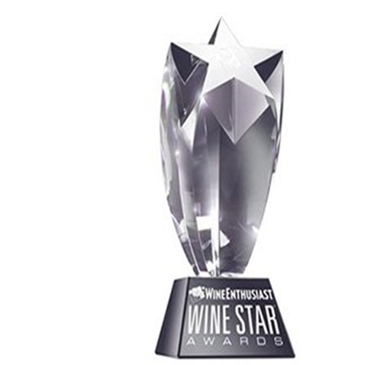
Quality
Riesling!
Other Wines: Dry Rose, Cabernet Franc, Merlot, Ice Wines
Routine 90+ Scores in Major Wine Media
1,000 Gold Medals in Major Competitions
“Wine Region of the Year”
No Longer the Rodney Dangerfield of the Wine World

Slide 30
Communication
New York Industry
State, National, International Colleagues
Other Organizations (Wine America, FIVS, Wine Market Council, National Grape and Wine Initiative
New York State Government
Federal Government
Media

Slide 31
Strategic Goal
“To have the New York grape and wine industry recognized as a world leader in quality, productivity and social responsibility.”

Slide 32
Recognition
“Wine Region of the Year” 2015
30-year overnight success

Slide 33
The Future: Up, Up, and Away!
More Wineries
More Wines
Better Wines
More Accolades
Broader Distribution

Slide 34
Diversity is our Strength Unity is our Power

