Slide 1

The New Look of Colorado Wine, or “Why does the Wind Suck?”
Doug Caskey, exec. dir.
CO Wine Industry Development Board

Slide 2
The Past, the Present and the Future…
walk into a bar.
It was tense.

Slide 3
Who or What is the Colorado Wine Industry Development Board?
Is it different than CAVE?
Government Marketing Agency vs. Private Trade Association

Slide 4
The Future
Cultivator Advertising & Design:
Matt Neren, Tim Abare
and Katie Maguire

Slide 5
The Near Future
The Phillips-Rhodes Memorial Grant for Continuing Education and Research
in the Colorado Wine Industry
$20,000 annually to encourage “training, educational opportunities or research projects that would advance the Colorado wine and grape industries.”

Slide 6
The Phillips-Rhodes Memorial Grant for Continuing Education and Research
in the Colorado Wine Industry
Available to:
Those who have been employed in the CO wine or grape-growing industry for at least two years (incl. owners and volunteers)
Those currently enrolled in a certified degree or certificate program at an accredited institution of higher education
A business or institution that supports or is closely involved with the Colorado wine industry

Slide 7
The Phillips-Rhodes Memorial Grant for Continuing Education and Research
in the Colorado Wine Industry
Not available to CWIDB or CWIDB committee members, or employees of the State of Colorado
Funds can only be applied to educational opportunities or research projects that will provide benefit to the Colorado wine industry
25% match required in cash or in-kind
Preference given to proposals using CO produce

Slide 8
The Phillips-Rhodes Memorial Grant for Continuing Education and Research
in the Colorado Wine Industry
Look for application to be posted on www.coloradowine.com toward the end of January or early February
Applications due May 29, 2015
Awards announced July 10, 2015
Completed by June 30, 2016 unless proposed and approved as a multi-year project.

Slide 9
The Present
VOCA Public Relations:
Alana Watkins, Courtney Lis

Slide 10
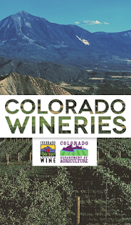
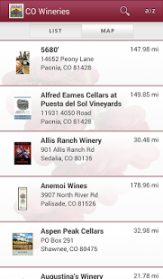


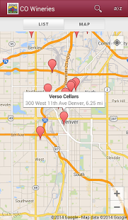
More presents:
CO Wine Mobile Apps
Apple iTunes Store Android Google Play Store

Slide 11
Marketing and Branding Consultation:
John Recca, Brandwerks cell: 720.300.9955
“We thank you for your support.”
One hour for $50 to John.

Slide 12
The Plu-imperfect Past
“Why does the wind suck?”
and other questions addressed to Courtney Perez,
US Dept. of Treasury Alcohol and Tobacco
Tax and Trade Bureau
What’s TTB?
When will visit be made to Delta Co. vineyards as part of the “extension” duties of CSU faculty?
Cold weather vineyard practices; new grape planting
Why is CSU focusing on obscure hybrids, rather than those that are have[sic] a successful history in cold climate regions.[sic]
Why does CSU not investigate many of the vinifera that actually do produce in cold climates?

Slide 13
The Plu-imperfect Past
CSU, the Wine Board, the Wine Development Fund and the industry
The CWIDB and the CO Wine Development Fund were created by the CO State Legislature in 1990 in part to establish a funding source to continue the salary of the State Viticulturist, then Rick Hammon, after money from the Four Corners Project ran out.
At least one-third was mandated to go to research and development and at least one-third to marketing and promotion
The research portion has been going to CSU every since to fund the work done at the Orchard Mesa Research Station and elsewhere.

Slide 14
The Plu-imperfect Past
CSU, the Wine Board, the Wine Development Fund and the industry
In 2008, new AD Dean created and partially funded the State Enologist position at the request of the wine industry
  in part to solidify and replace the somewhat spotty services of the outside consultants the CWIDB has been hiring up to that point
About 5 years ago, the CWIDB initiated discussions with CSU to explore ways to improve the identification, execution and communication of the research.
In the Fall of 2013 a new Associate Dean and Director of Ag Experiment Stations promoted the idea of bringing in outside industry experts to review the Viticulture and Enology program.

Slide 15
The Plu-imperfect Past
CSU, the Wine Board and the Industry
The Program Review Committee consisted of:
  Dr. Stan Howell, Professor Emeritus of Viticulture, Michigan State University
  Dr. Sara Spayd, Extension Viticulturist and Professor, North Carolina State University
  Mr. Mario Mazza, General Manager and Enoligst for Robert Mazza, Inc., PA and NY
The report consists of the observations and recommendations of the three experts above
And may lead to many changes in how CSU and the CWIDB approach research

Slide 16
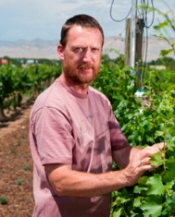
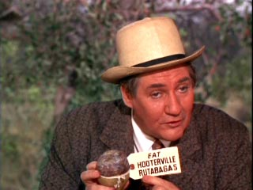
Some answers to questions addressed to Courtney Perez
What’s TTB? The government agency that regulates
the alcohol industry on the federal level especially winery licensing and operation plus labeling
When will visit be made to Delta Co. vineyards as part of the “extension” duties of CSU faculty?
extension
Faculty researcher

Slide 17
Some questions to questions addressed to Courtney Perez
Why is CSU focusing on obscure hybrids, rather than those that are have[sic] a successful history in cold climate regions.[sic]
  What other wine growing region has been getting to -10 or
  -20 in December or even November consistently?
  What well-known, cold-hardy cultivars are you thinking of?
Why does CSU not investigate many of the vinifera that actually do produce in cold climates?
  Which cultivars are you thinking of?
  Have you followed CSU’s trials and blends of Rkatsiteli or Dornfelder?
  Shall we experiment with the Siberian varieties or hybrids that taste more like wines consumers are familiar with?

Slide 18
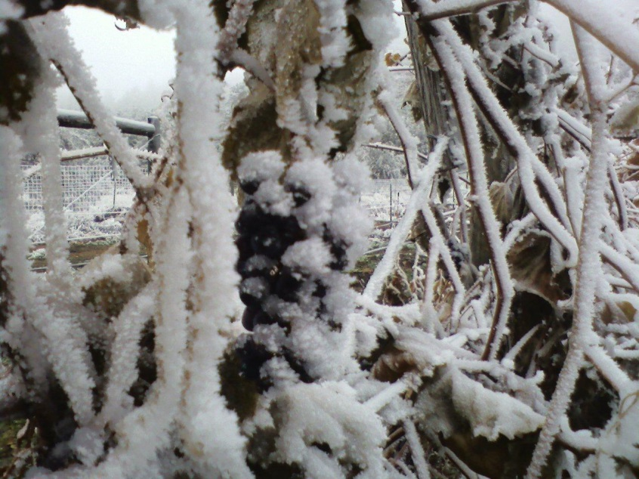
A possible answer to questions addressed to Courtney Perez
What is the predicted effect of shifting Vitis vinifera acreage to hybrid acreage on the Colorado wine industry?
  How many of you had absolutely no crop loss due to cold injury in the 2014 harvest?
  Fort Collins test vineyard plots went below -10° F in mid-Nov
  80% primary and virtually all secondary buds of Aromella survived and very similar results for Frontenac
  4 ton/acre statewide average for Frontenac and La Crescent is a reasonable expectation
  Colorado is already at 10% hybrid acreage:
  3 acres of hybrids going in for every 1 acre of vinifera planted

Slide 19
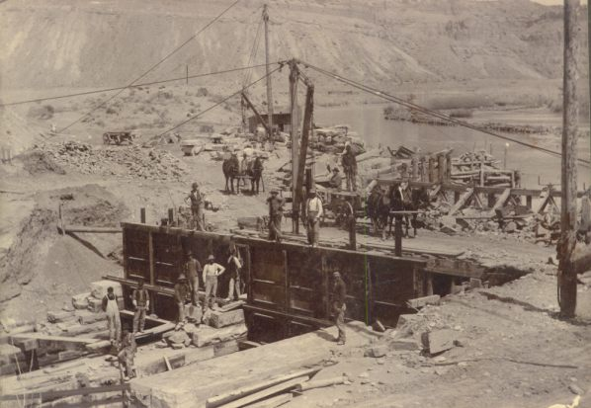

“Long Past?”
1882: gravity irrigation diverts Grand River water
at mouth of DeBeque Canyon

Slide 20
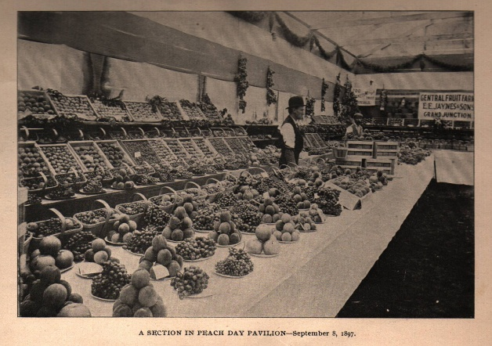
A bit of Grand Valley history
1883: grapes first planted
1890: Gov. Crawford plants 60 acres of grapes
“The finest varieties of European grapes, such as the Black Hamburg, Flame Tokay, Zinfandel, Sultana, Muscat and Malaga grow to perfection in the open, and this is the only valley in the State where it is possible to grow them at all.”
—The Resources of Mesa County, Colorado and the Advantages and Opportunities it has to Offer, c. 1897

Slide 21
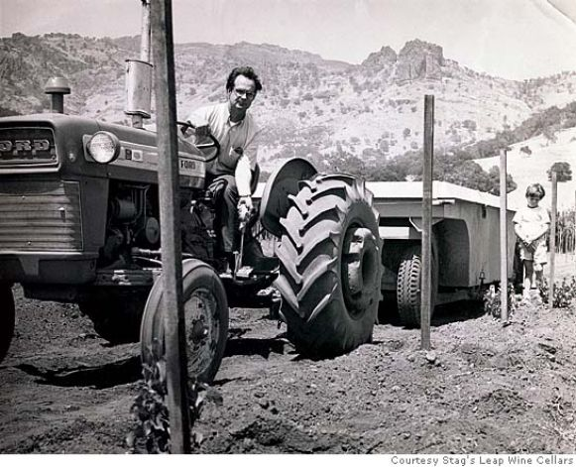
More Colorado wine history
Warren
Winiarski,
the UC Davis grad
who served as the winemaker for Denver’s Ivancie Winery in the 1960s, shown in 1970 planting Stag's Leap Vineyard in Napa Valley
Photo courtesy Stag's Leap Wine Cellars
Joseph Phelps planted grapes in Greeley and made wine in his basement
Ray Duncan’s family (Silver Oak) had a wine blending sales room in the Larimer Square area

Slide 22
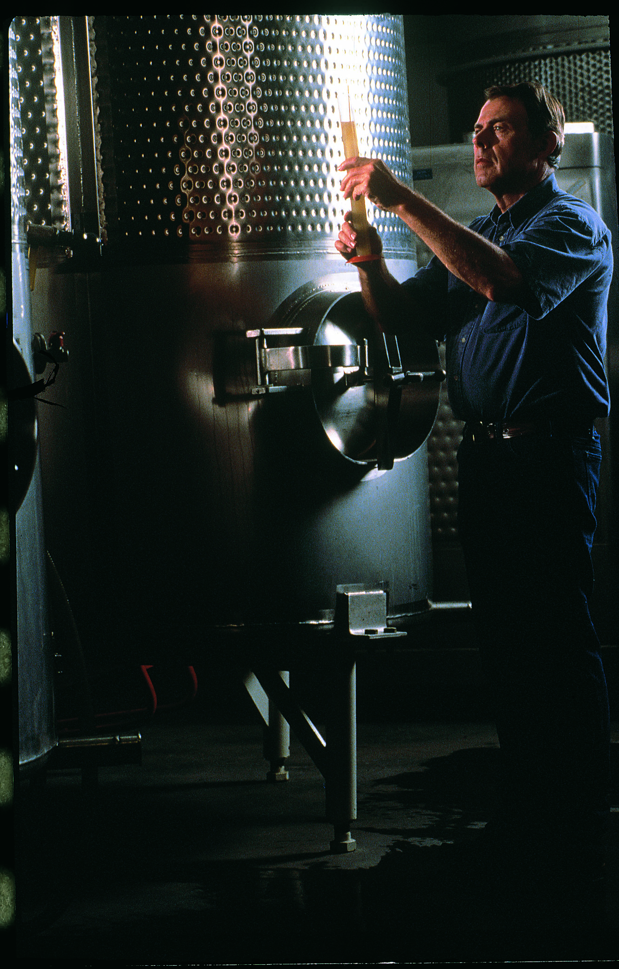
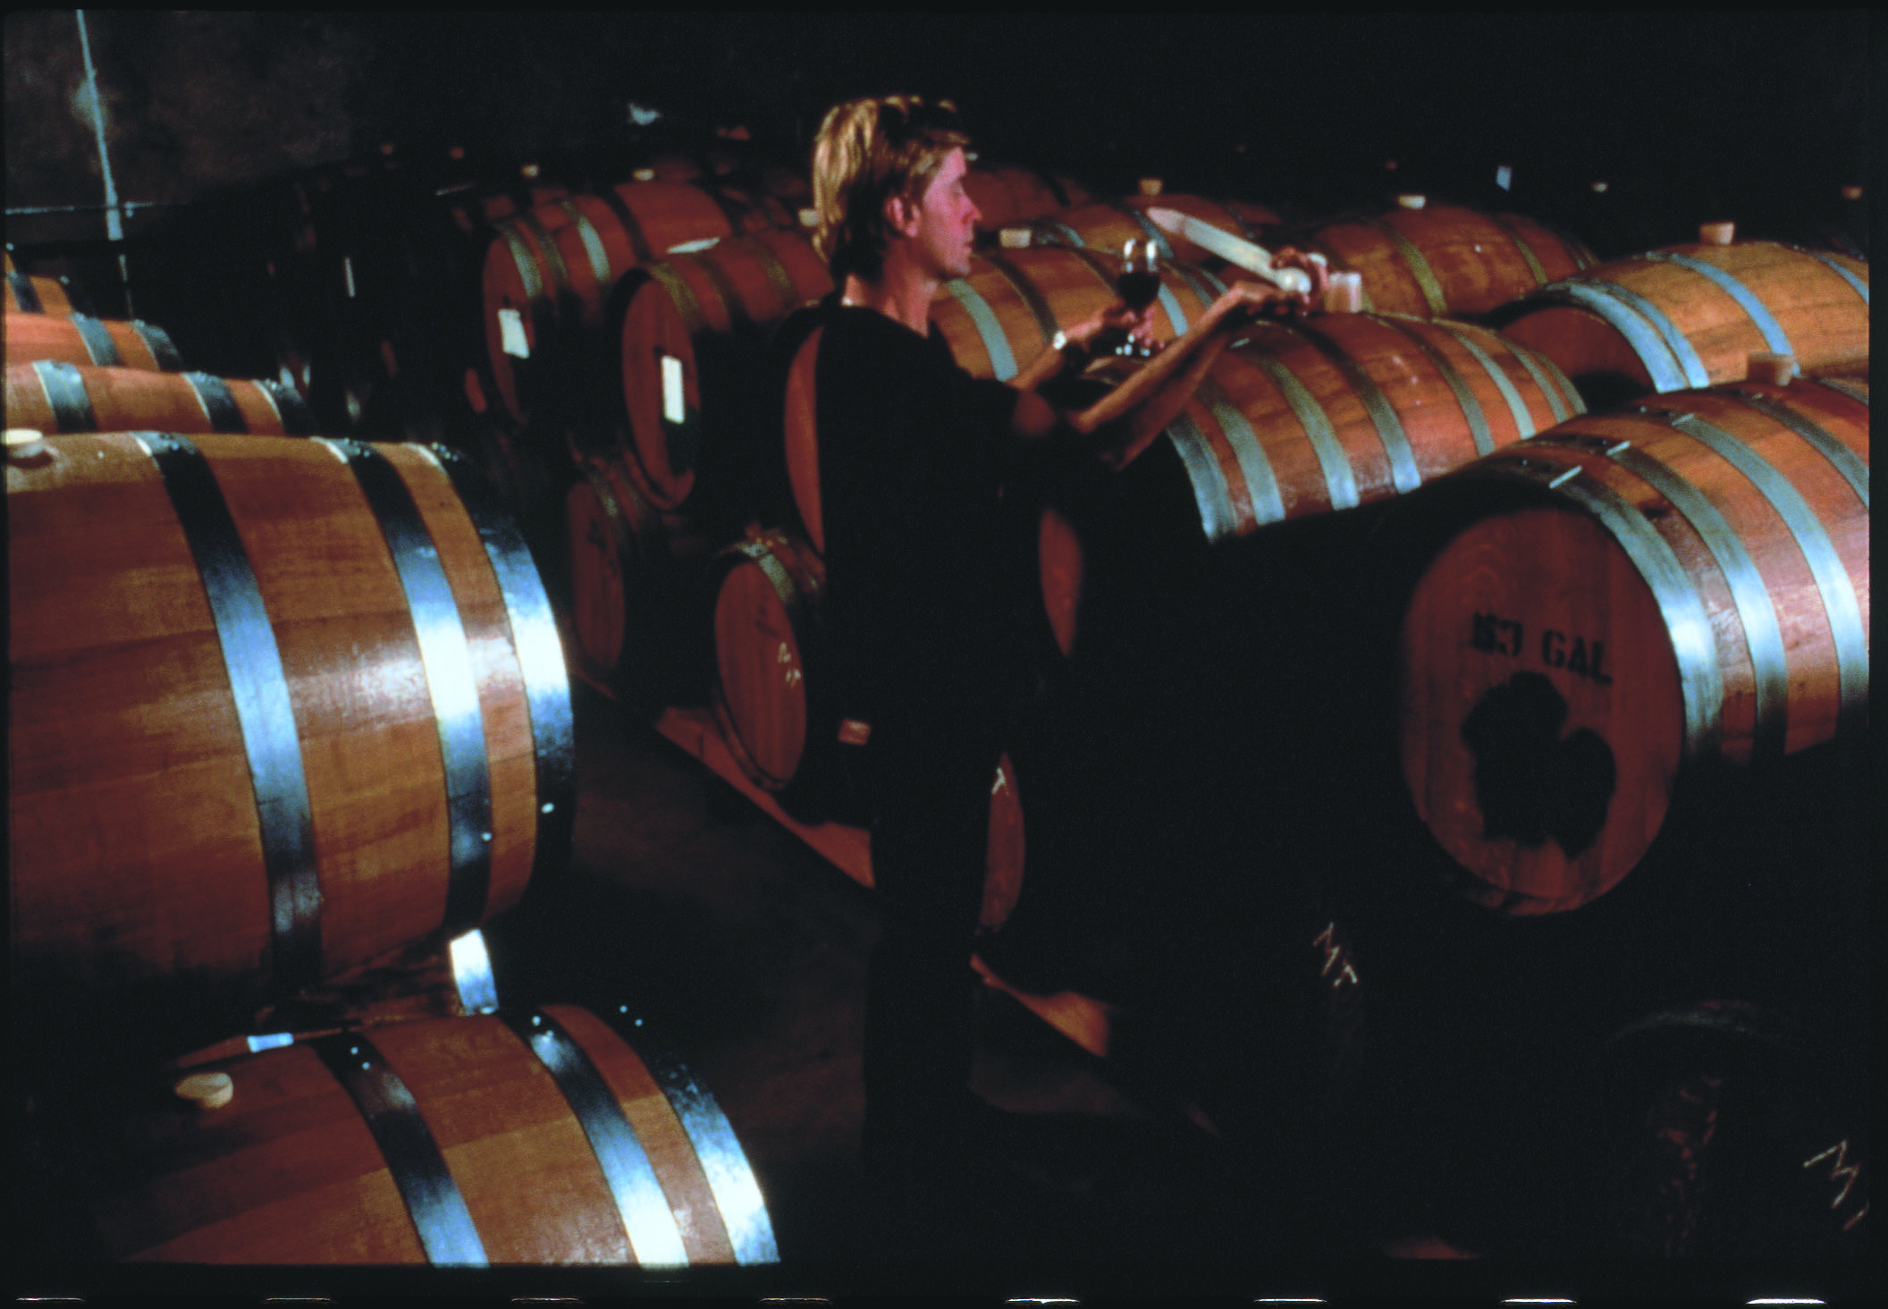
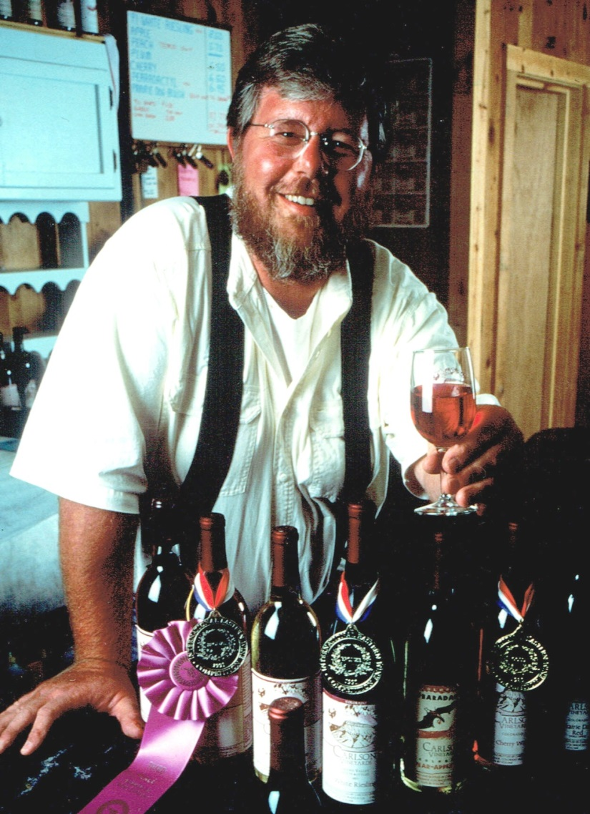
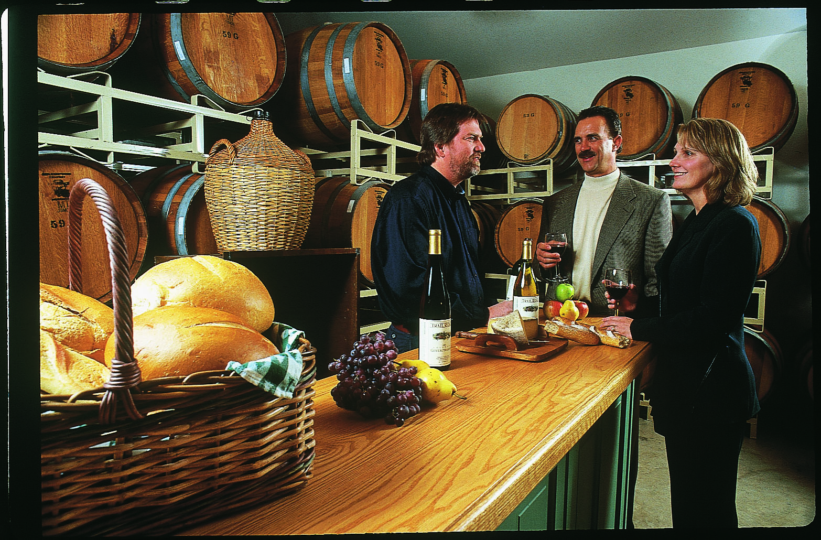
Are these guys old enough to make wine?

Slide 23
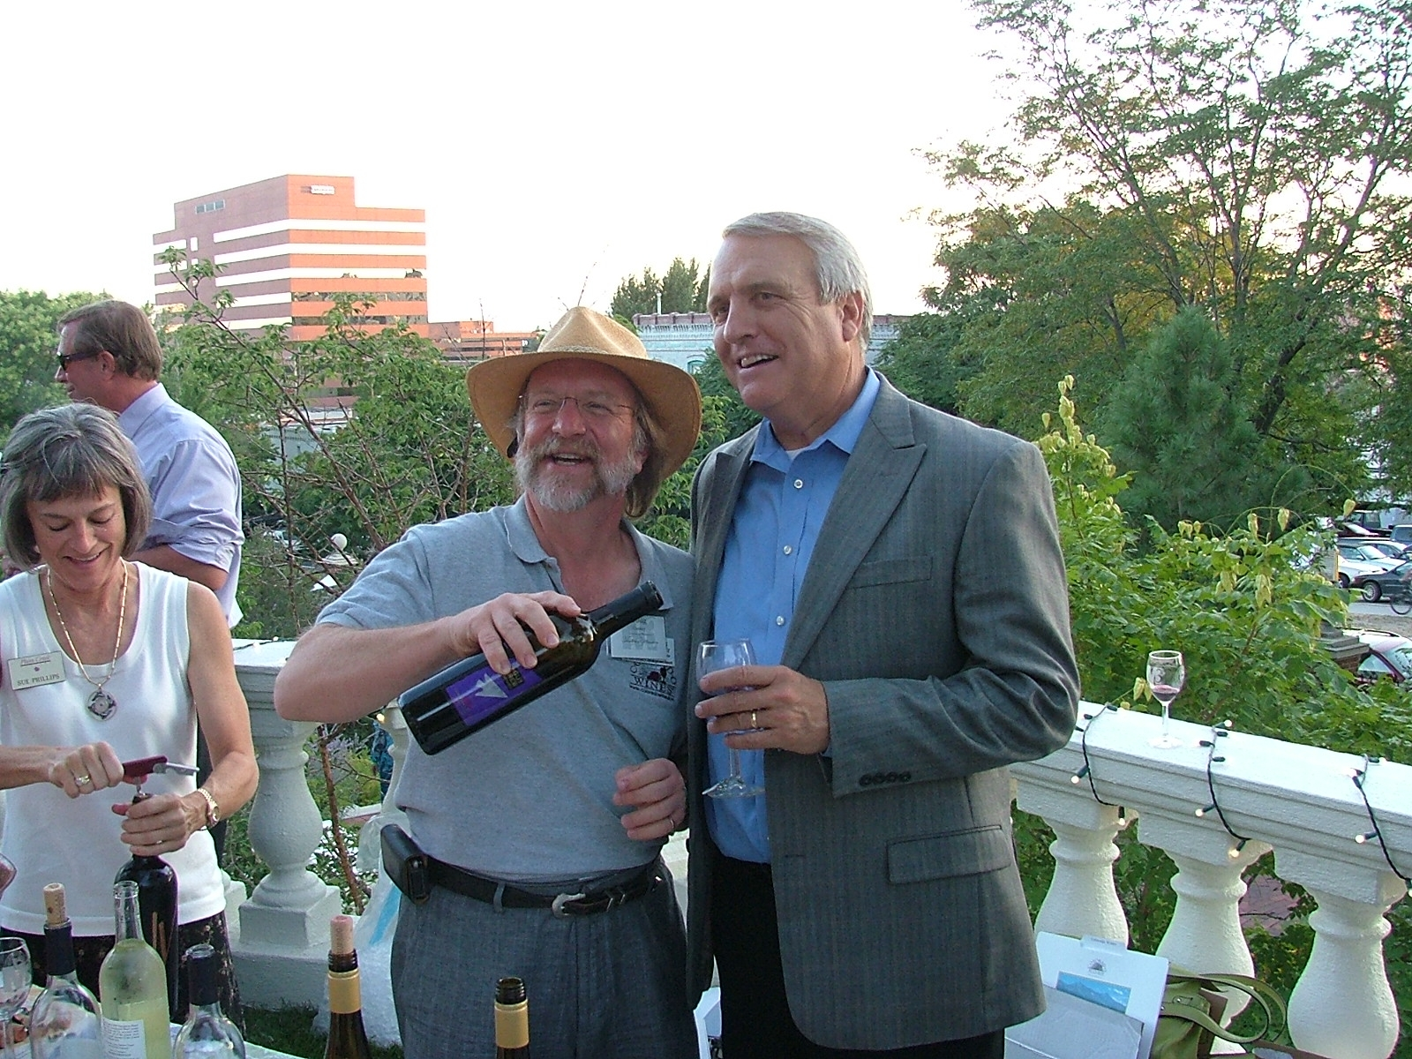
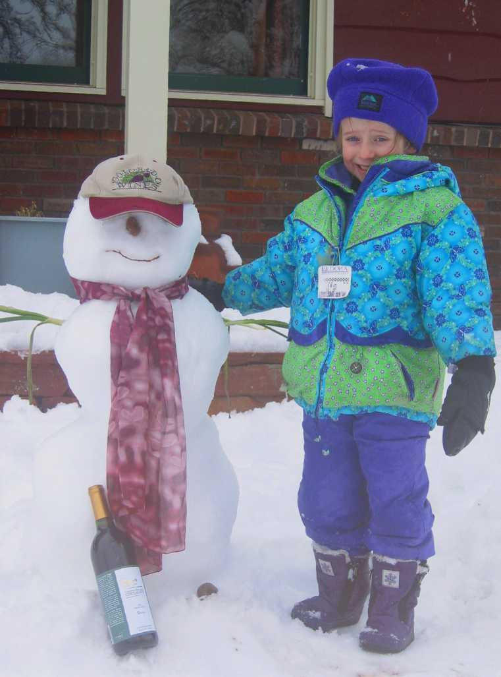
“No. Your Past.”
The former Governor’s Cup August 2010

Slide 24
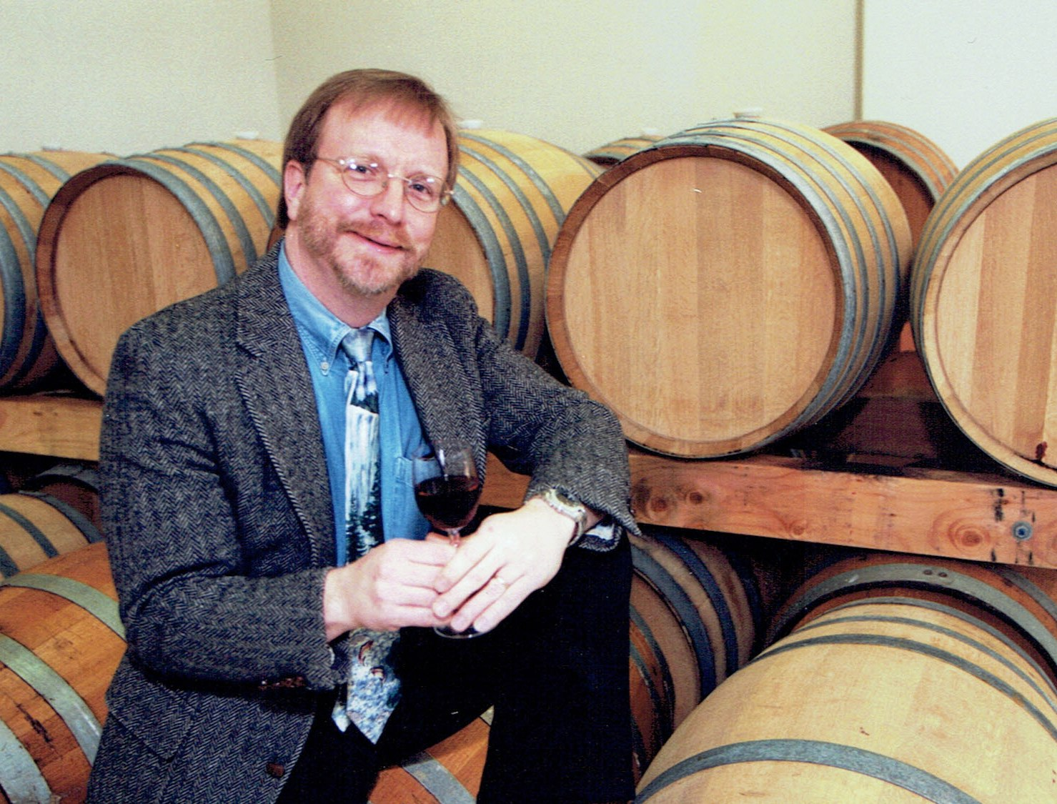
Fifteen years ago…

Slide 25
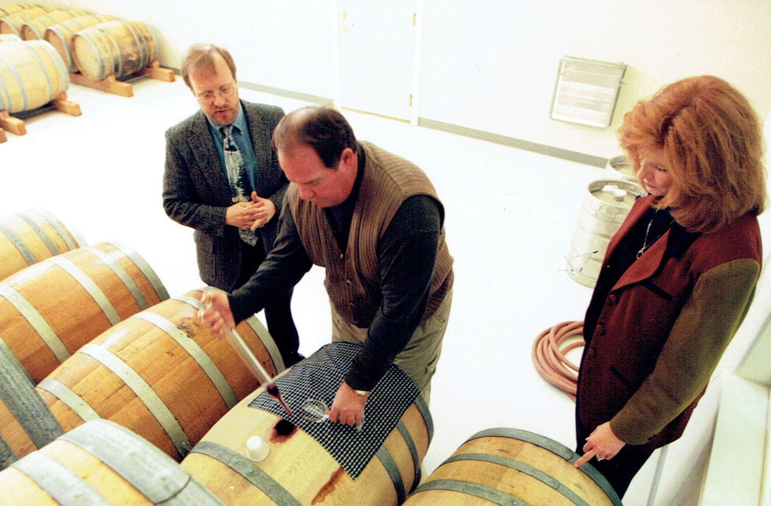
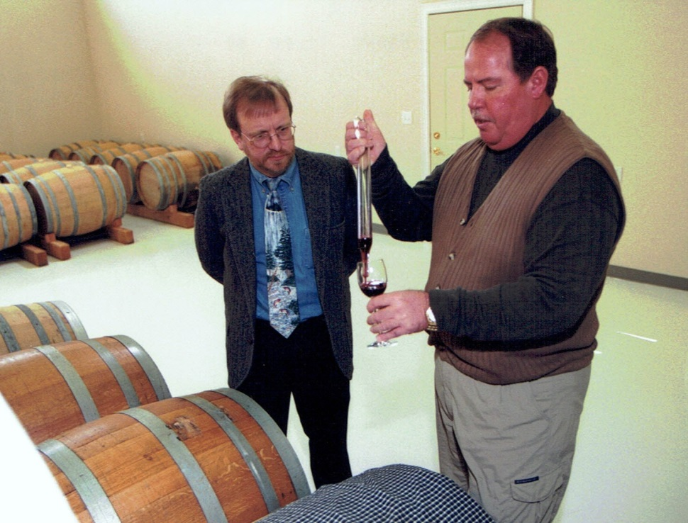
Fifteen years ago…

Slide 26
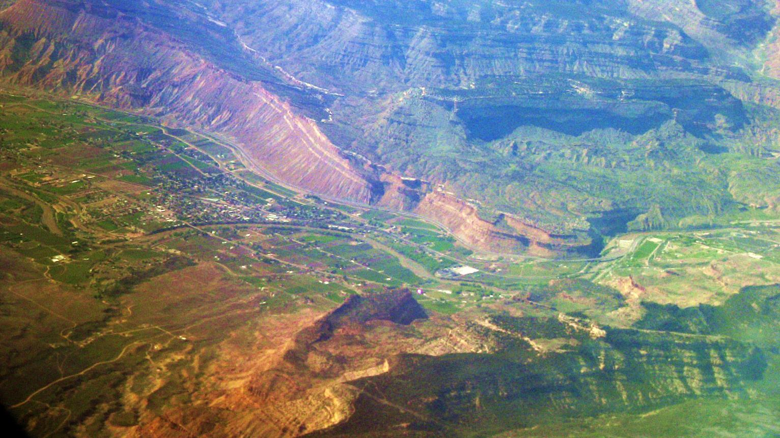
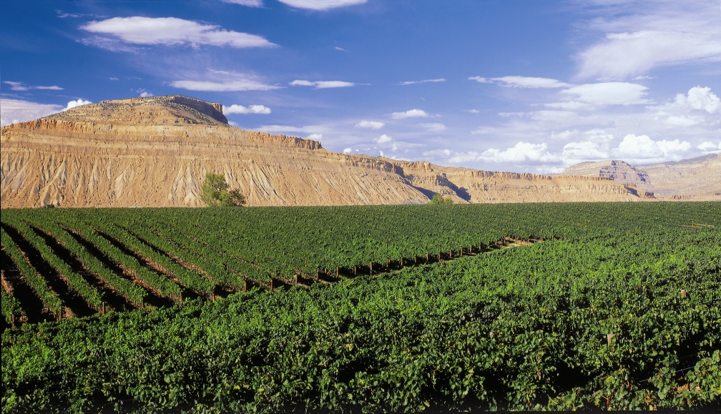
Why does the wind suck?
Mt. Garfield
Bookcliffs facing due south for max solar radiation
Mouth of
DeBeque Canyon
East Orchard Mesa
Colorado River
Airflow down river
Mouth of
DeBeque Canyon
Terroir from 20,000 ft:
Grand Valley’s Canyon Wind
Mt. Garfield

Slide 27
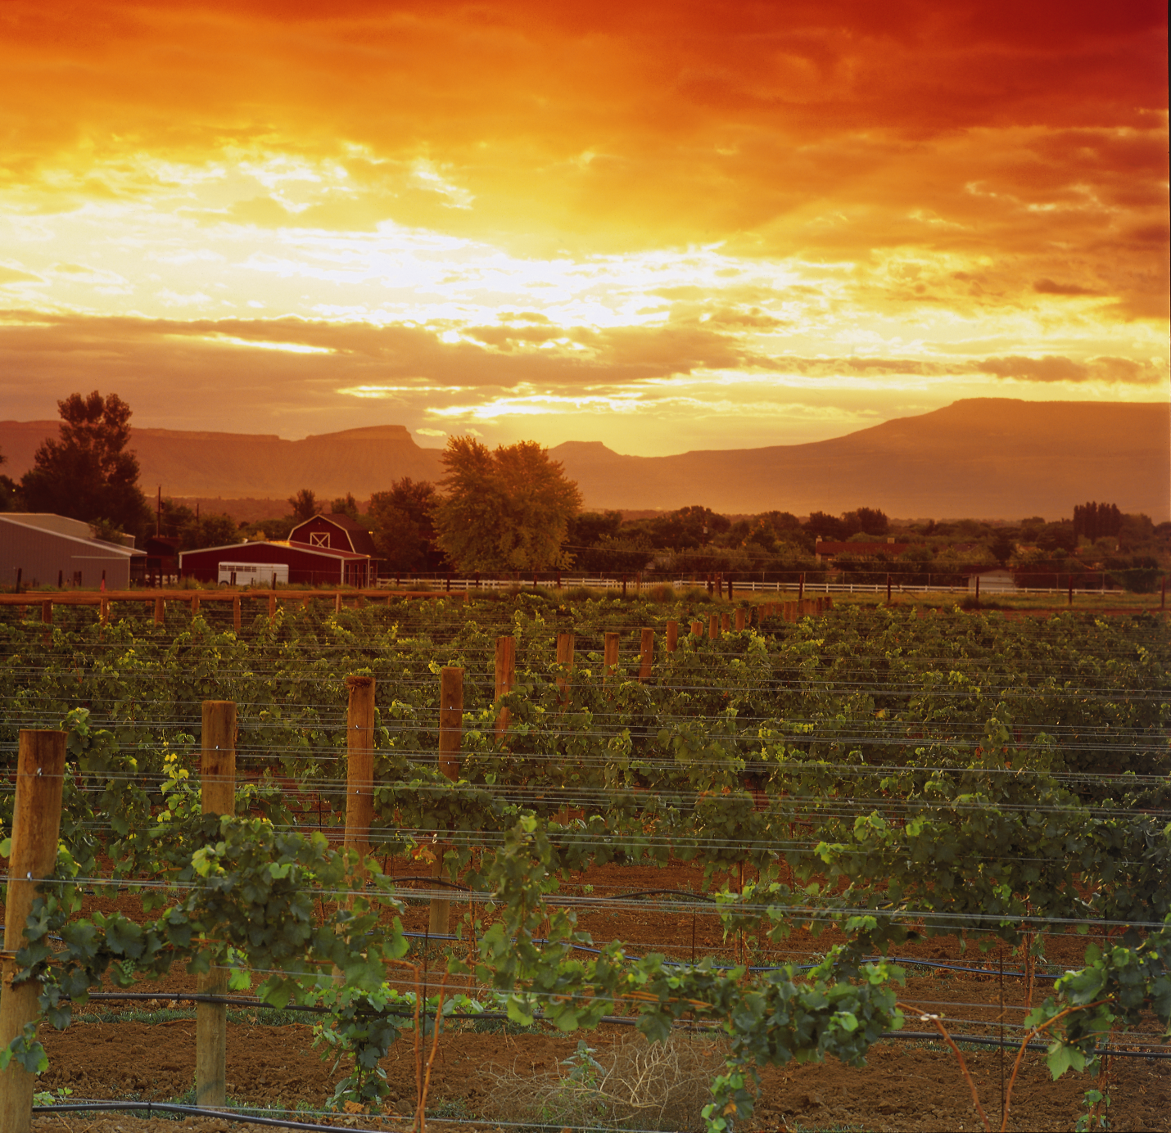
Thank you
Doug Caskey, Colorado Dept. of Agriculture
dcaskey@coloradowine.com
          303.869.9177

