Slide 1
Marketing Your Vineyard
VinCo Conference and Tradeshow
Annual Meeting, January 13 & 14, 2014

Slide 2
Colorado Grapes & Wine
What are the challenges for grape growers and wineries in managing your businesses?
Do you have good grape market data?
Acreage – 2014 – estimate 400-600 acres
Pricing – 2009 – $1340/T
Demand – for CO grapes and wines
What information do you need to plan and execute your business?

Slide 3
California Winegrapes
546,000 Acres
Annual CA Grape Crush Report
Includes tonnage by variety and region
Includes grape prices by variety and region
Includes price paid for each lot of grapes sold, i.e. the range in prices for a variety in a region

Slide 4
Sonoma County Winegrapes
64,000 acres
Average Price 2013 - $2236/Ton
~ 1500 vineyard owners
65% of tonnage – grower produced
35% of tonnage – winery owned

Slide 5
Marketing Your Vineyard
Input from Sonoma County
Brian Clements, Turrentine Brokerage
Randy Luginbill, Silverado Investment Management Company
Dave Magnasco, Constellation Wines
Steve Sangiacomo, Sangiacomo Vineyards

Slide 6
Marketing Your Vineyard Begin with a Marketing Plan
Which wineries meet your business objectives?
What are the market demand and grape prices?
What differentiates your vineyard?

Slide 7
Business Objectives
Tons/A, $/Ton or $/A?
Seeking short-term or long-term relationships?
A transaction or a partnership?
What are your income needs?
What do you want to be known for?
Grape quality, Dependability, Get as much as you can?

Slide 8
Approaching a Winery
Provide varieties, clones and rootstocks
Trellis system
Production history
Vineyard map
Other wineries who purchase your grapes
Quantities available
Length of contract sought
Price expectations

Slide 9
Which Wineries?
Who buys your varieties?
Does the bottle price match your price target?
What is the winery’s reputation as a buyer/partner?
Who makes grape purchase decisions?

Slide 10
Additional Tools
Sonoma County Winegrowers Grape Marketplace
Web based posting of grapes for sale
www.Sonomawinegrape.org/marketplace
Everyvine.com
Web based mapping and grape marketing website
Possibly available to Colorado growers
www.everyvine.com

Slide 11
You Have a Contract
Communicate with the winery throughout the season
Ask to taste wine from your grapes
Build a relationship with the winery
Consistently meet winery needs
Quantity and quality

Slide 12
Sangiacomo Vineyards
Pear growers
60’s began conversion to winegrapes
Initially treated grapes as a commodity
Began branding their vineyards
Made sure their grapes are not a commodity
Also expanded their vineyard holdings

Slide 13
Sangiacomo Brand
Personal brand
Trust, honesty, good for their word
30 contracts today are still a handshake
Give and take with customers
Quality commitment
Do own trials of rootstock and clone for a site

Slide 14
Going the Extra Mile
September 1989 advertised in Wine Spectator!
Invited wine writers to their vineyards
Share an Italian meal & wines from Sangiacomo grapes
In 1989 hosted winemakers/buyers for tasting event
Samples of wines from specific Sangiacomo vineyards
Winemakers discuss their winemaking
Educational tasting by vineyard and block

Slide 15
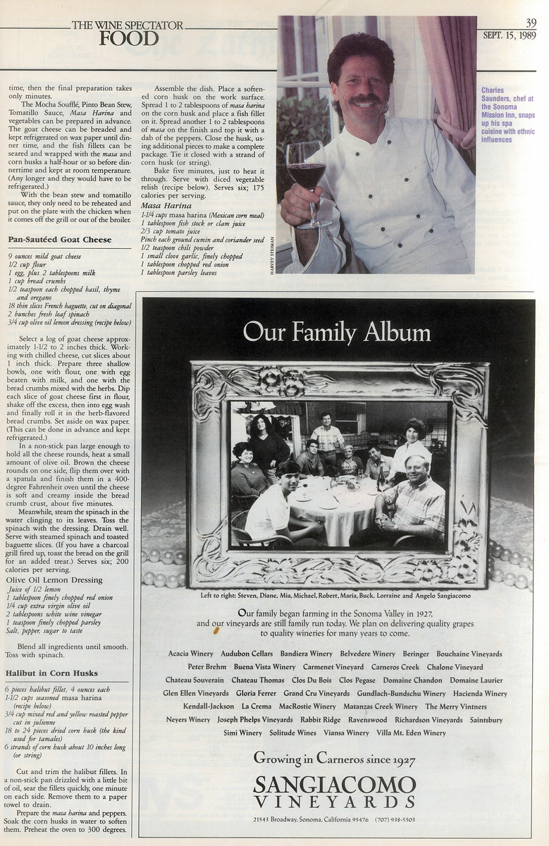

Slide 16
Sangiacomo Suggestions
Need a story
Sustainability part of today’s story
Need a website – www.sangiacomovineyards.com
Intimacy + diversity = Nuance
35 Wineries with vineyard designates
News and Press
Show ratings of wines from Sangiacomo grapes

Slide 17
Vineyard Designate Wines
Build recognition for the vineyard brand
Retain control of the brand
Licensing agreement to protect name
Insure quality is achieved before bottling
Promote their winery customers
Interviews
On website

Slide 18
Developing Your Brand
What are your business objectives?
Gain relationship with aligned wineries
Their business objectives and yours
Build your reputation
Deliver on your promise every time

Slide 19
Vineyard Designate Examples
2013 La Follette Sangiacomo Vineyards Chardonnay, Sonoma Coast
2012 Balletto Vineyards, Sexton Hill Pinot Noir, Russian River Valley

Slide 20
Thank You
Nick Frey
nickfrey@outlook.com

